Slide 1


Slide 2
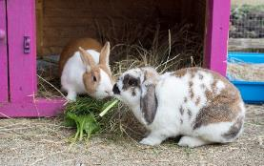
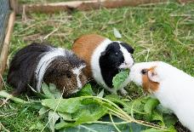
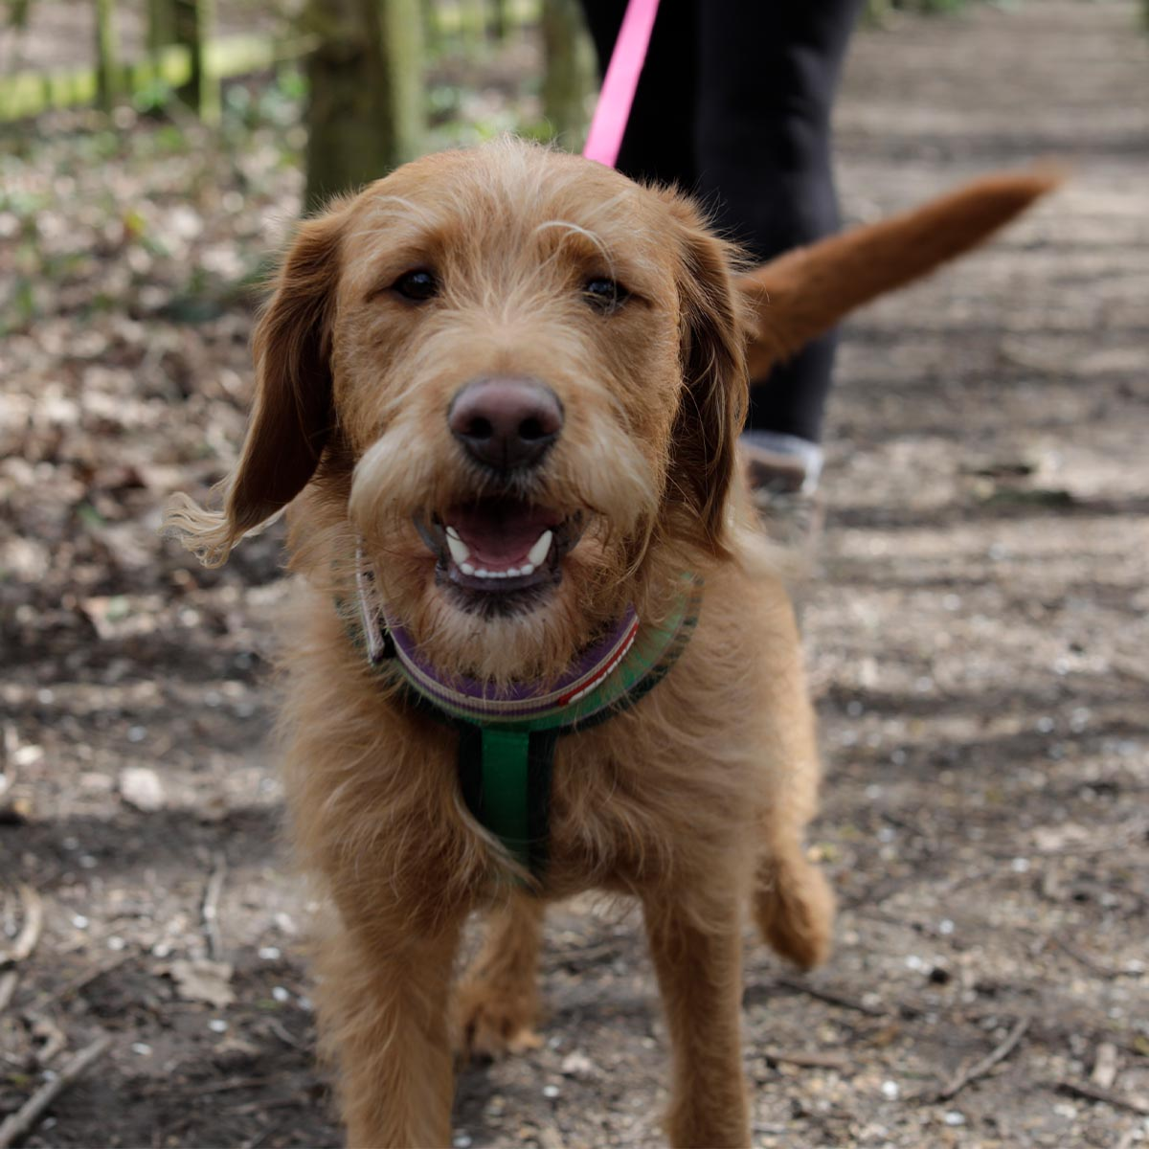
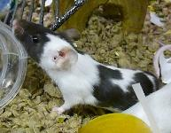
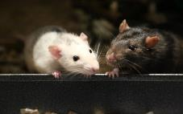
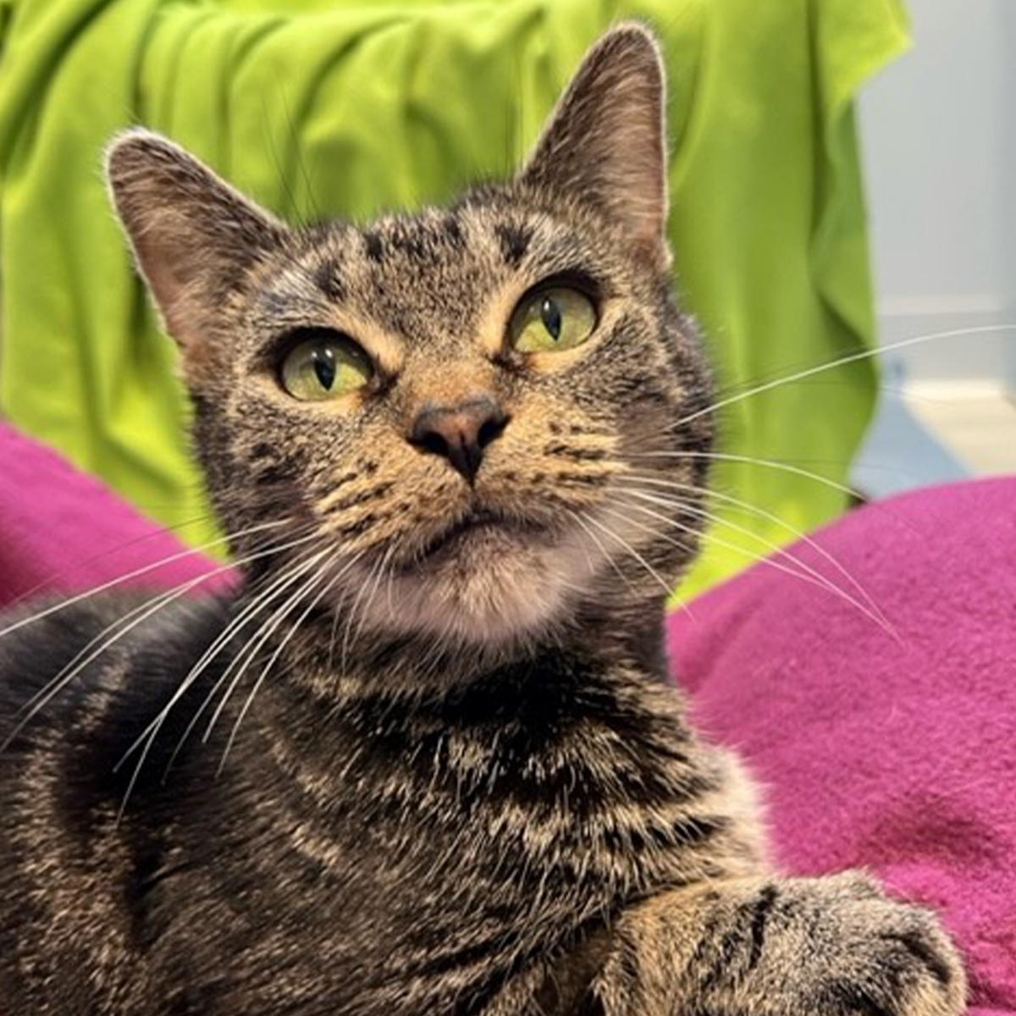
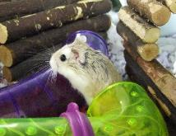
Staying safe around dogs

Slide 3
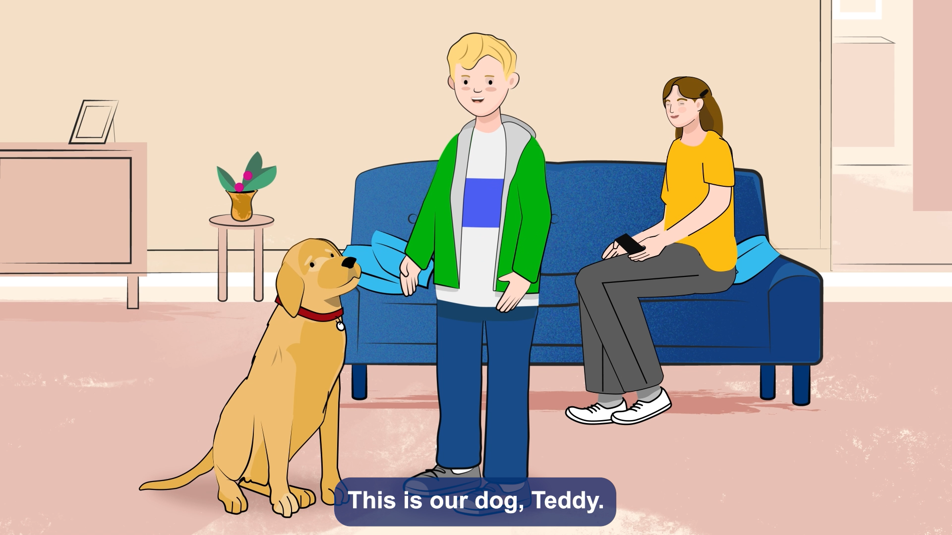
Staying safe around dogs

Slide 4
Dog Safety KS1
Dogs like walks
True!
Sit down = FALSE
Stand up = TRUE

Slide 5
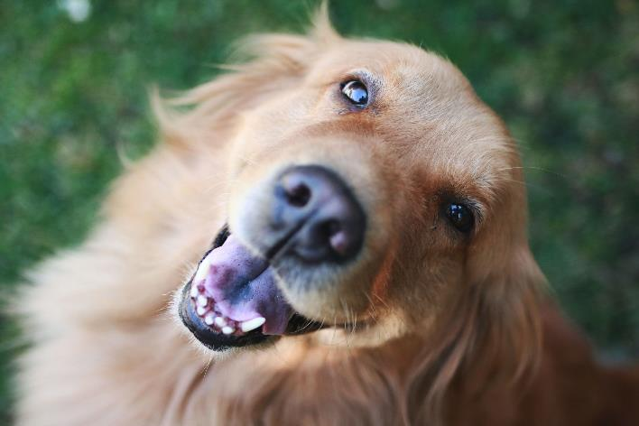
Woody’s dog safety
Dogs like big kisses
False

Slide 6
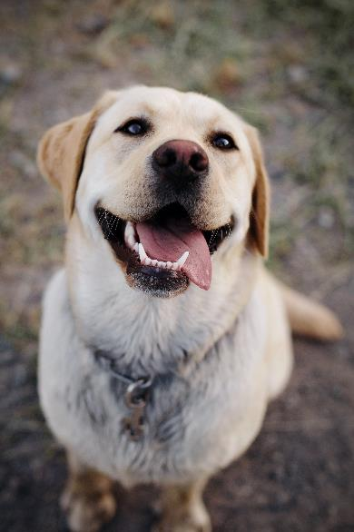

Woody’s dog safety
Dogs like big
hugs
False

Slide 7
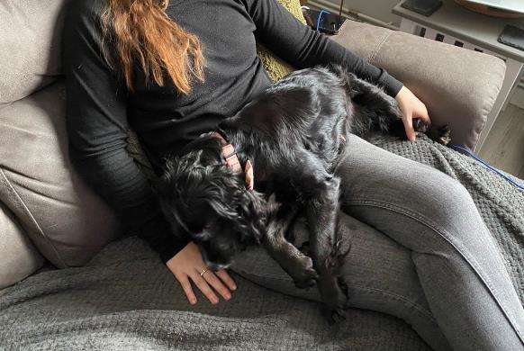
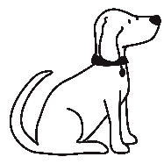
Woody’s dog safety
Dogs like having snuggles
True

Slide 8
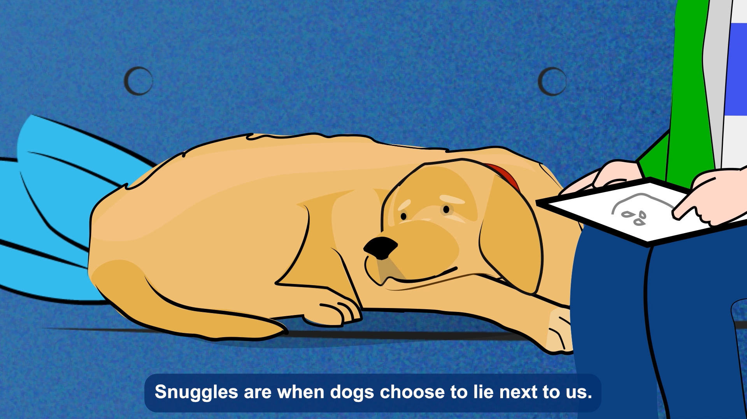
Staying safe around dogs

Slide 9
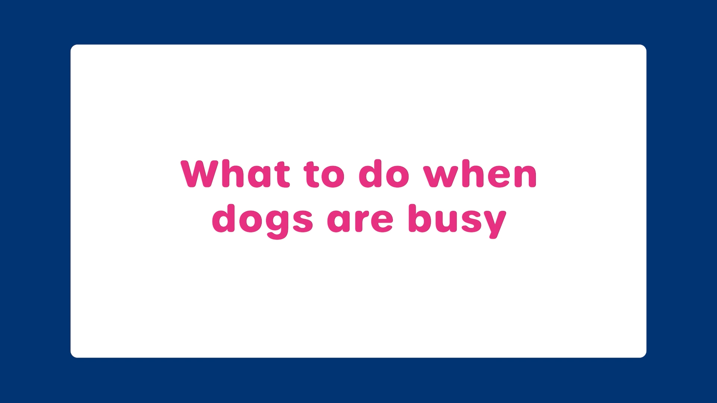
Woody’s dog safety

Slide 10
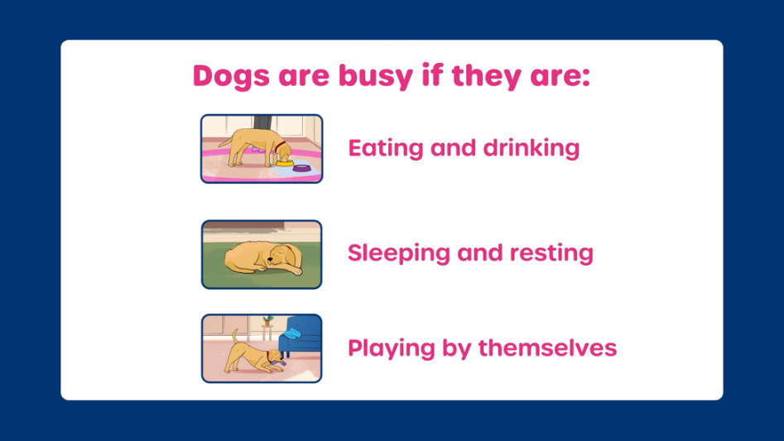
Dog Safety KS1

Slide 11
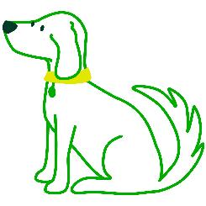
Dog Safety KS1
Having fun with a dog

Slide 12
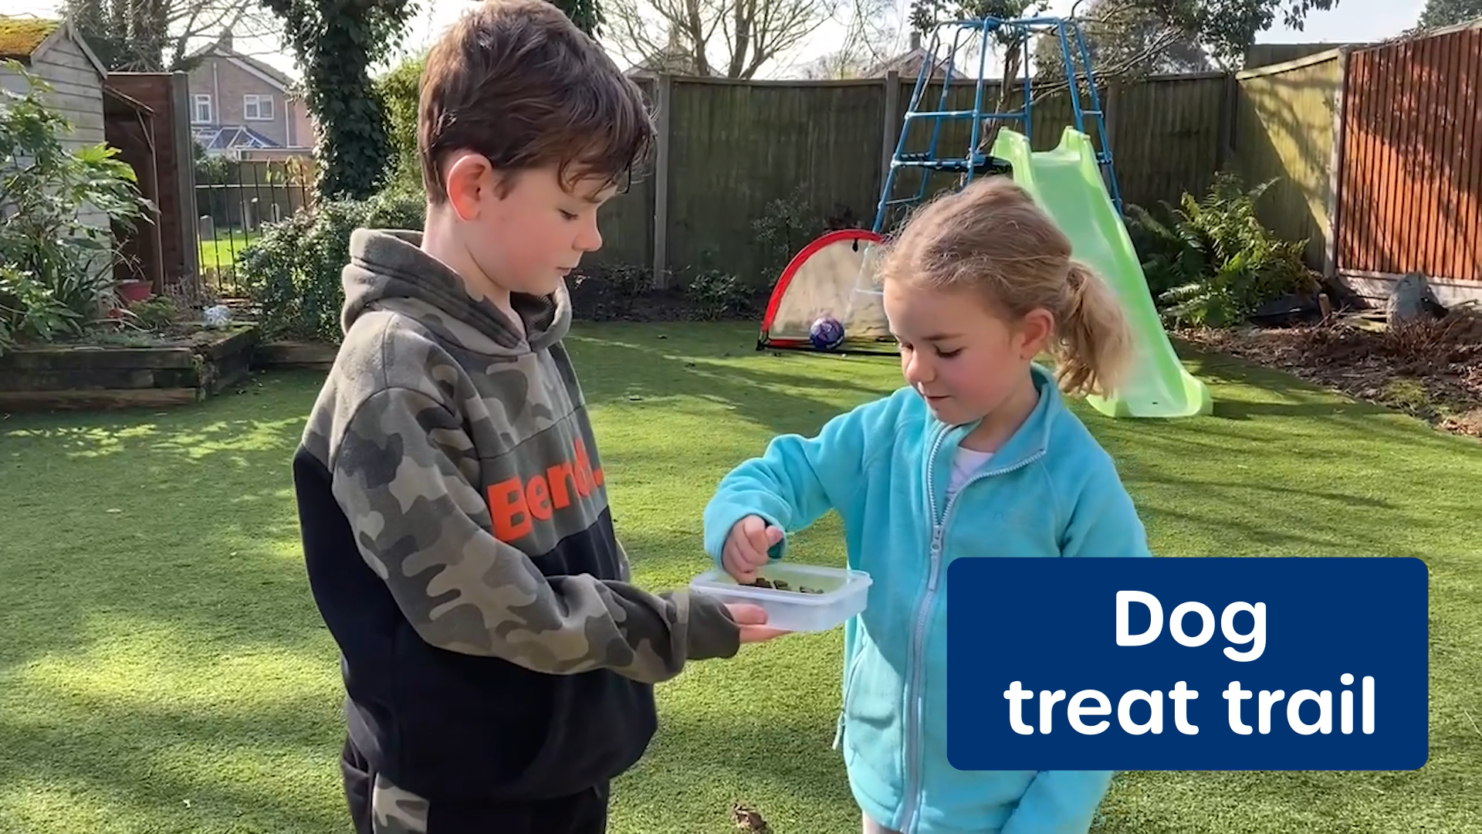
Staying safe around dogs

Slide 13

Staying safe around dogs
Leave me alone please!

Slide 14
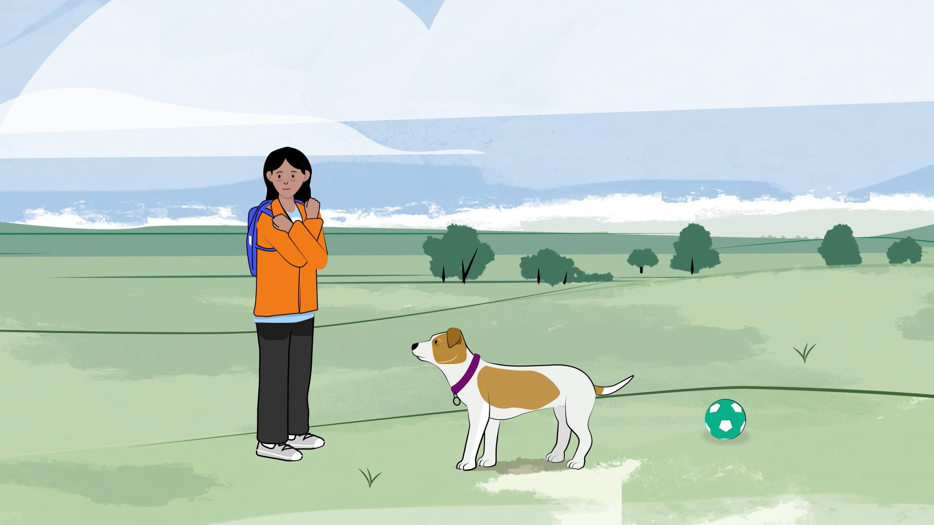
Staying safe around dogs

Slide 15
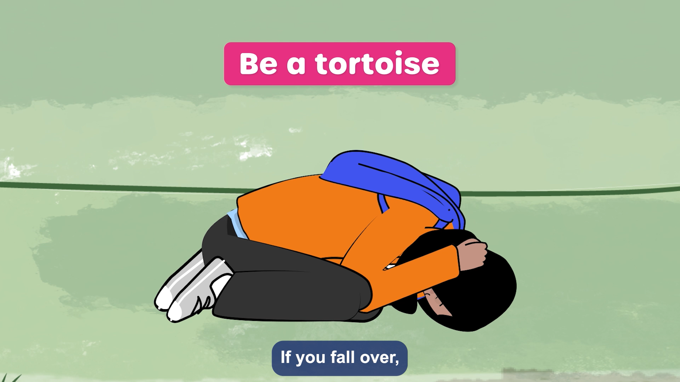
Staying safe around dogs

Slide 16
Dog Safety KS1

Slide 17

Staying safe around dogs

