Slide 1


Slide 2
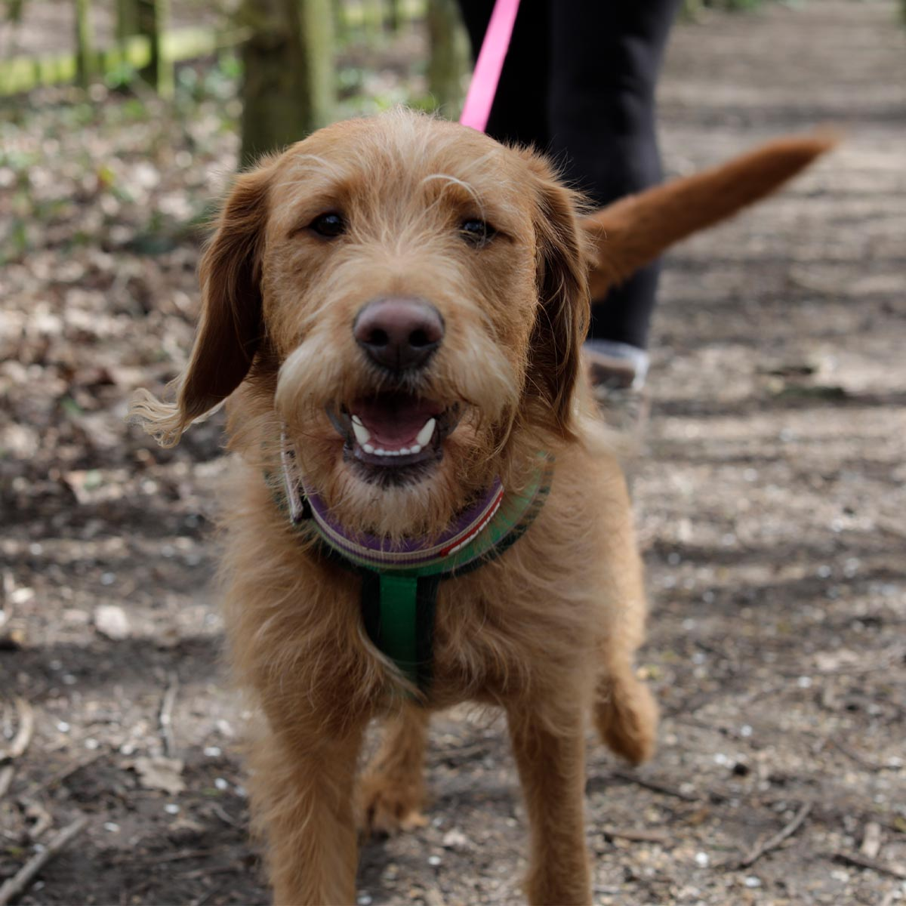
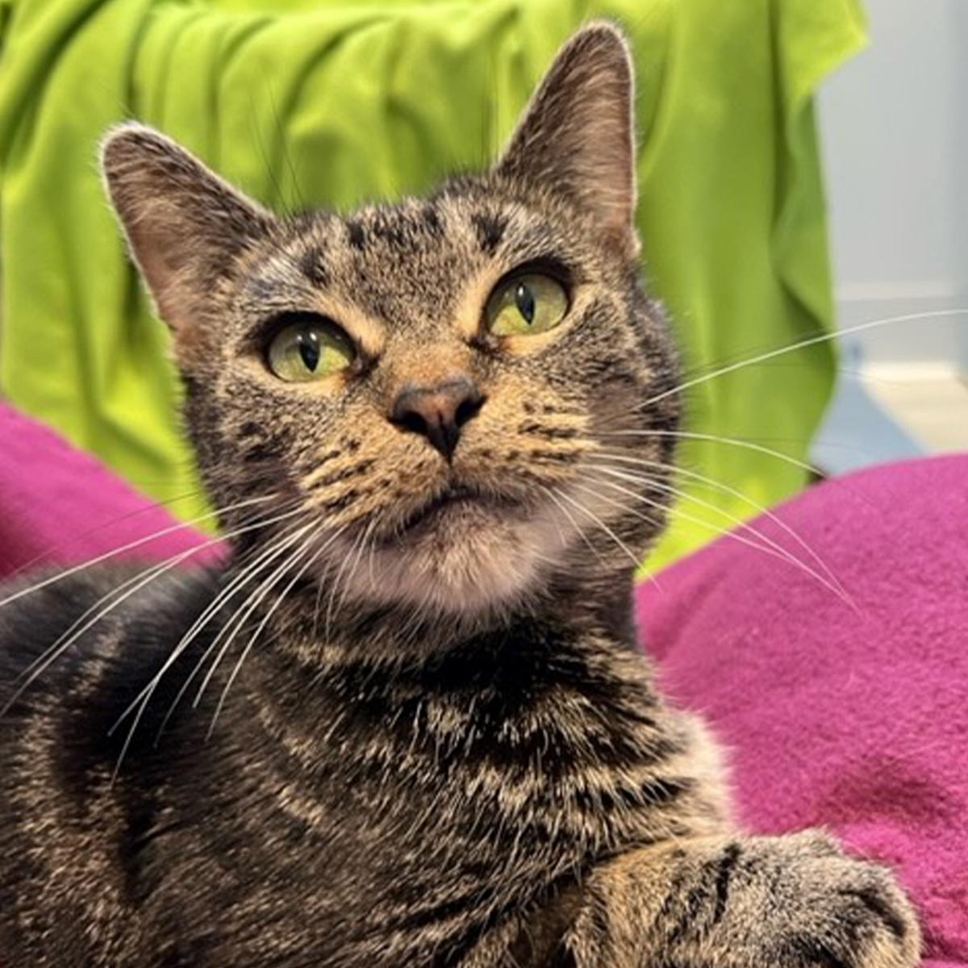
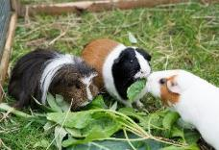
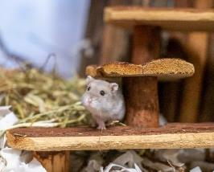
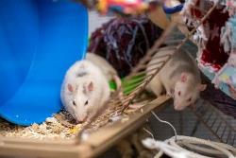
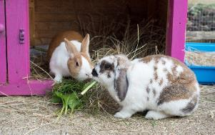
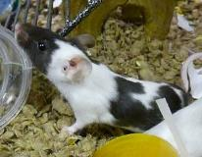
Staying safe around dogs

Slide 3
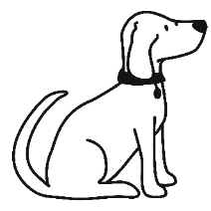
Staying safe around dogs
Warm up game!

Slide 4
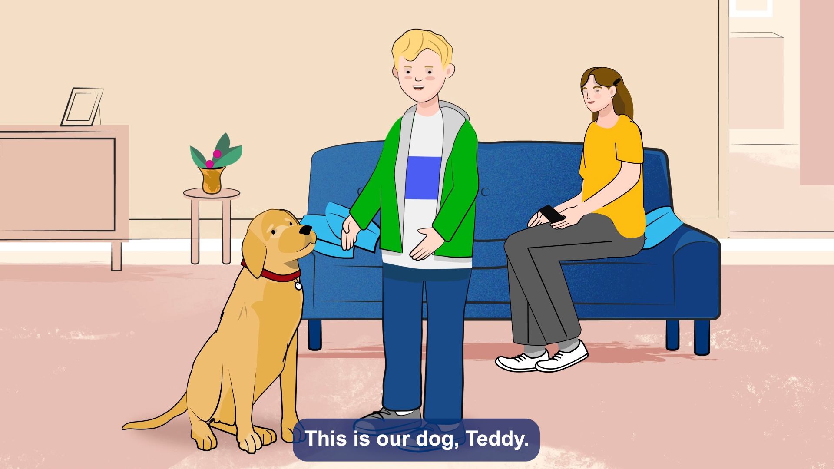
Meet Teddy
Staying safe around dogs

Slide 5
Staying safe around dogs
Dogs like walks
True!
Thumbs down = FALSE
Thumbs up = TRUE

Slide 6
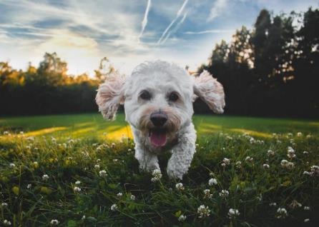
Staying safe around dogs
Dogs have feelings just like we do
True!
Thumbs down = FALSE
Thumbs up = TRUE

Slide 7
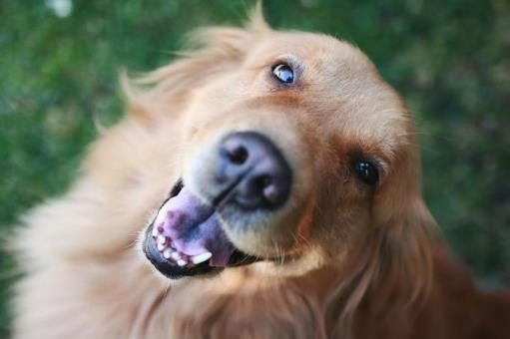
Staying safe around dogs
Dogs like big kisses
False!
Thumbs down = FALSE
Thumbs up = TRUE

Slide 8
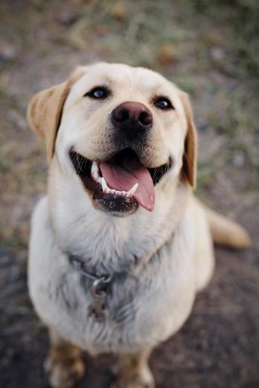
Staying safe around dogs
Dogs like big hugs
False!
Thumbs down = FALSE
Thumbs up = TRUE

Slide 9
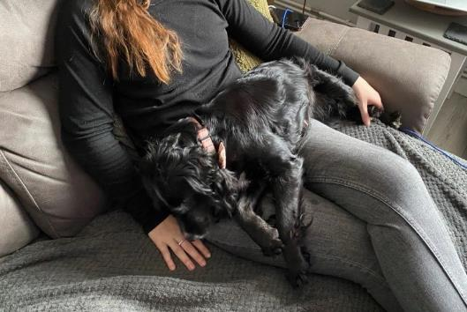
Staying safe around dogs
Dogs like having snuggles
True!
Thumbs down = FALSE
Thumbs up = TRUE

Slide 10
Staying safe around dogs
Times when dogs are busy

Slide 11
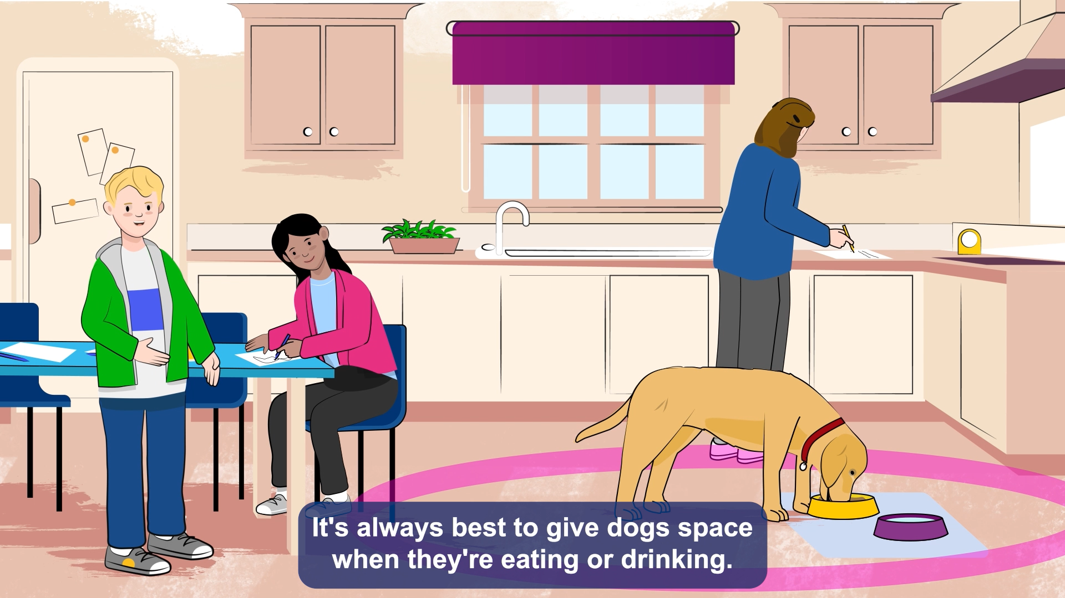
Staying safe around dogs

Slide 12
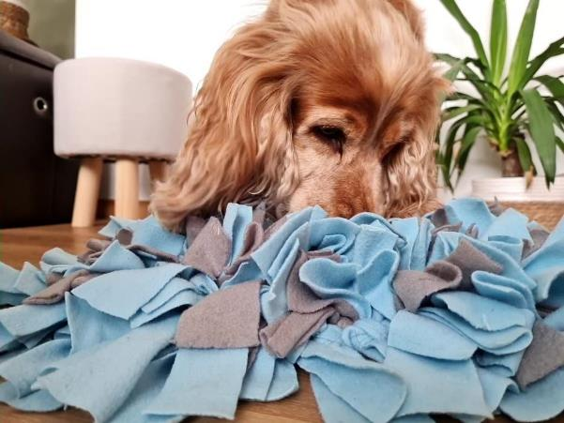
Busy eating
Staying safe around dogs

Slide 13
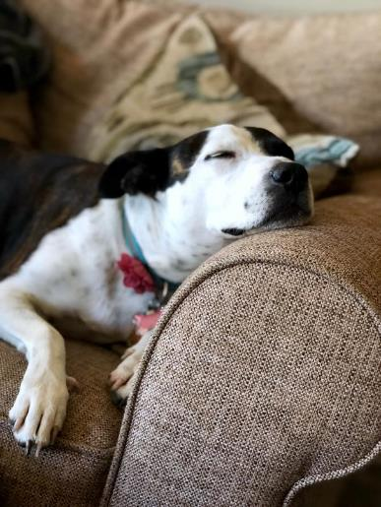
Staying safe around dogs
Busy sleeping

Slide 14
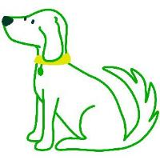
Staying safe around dogs
Having fun with a dog

Slide 15
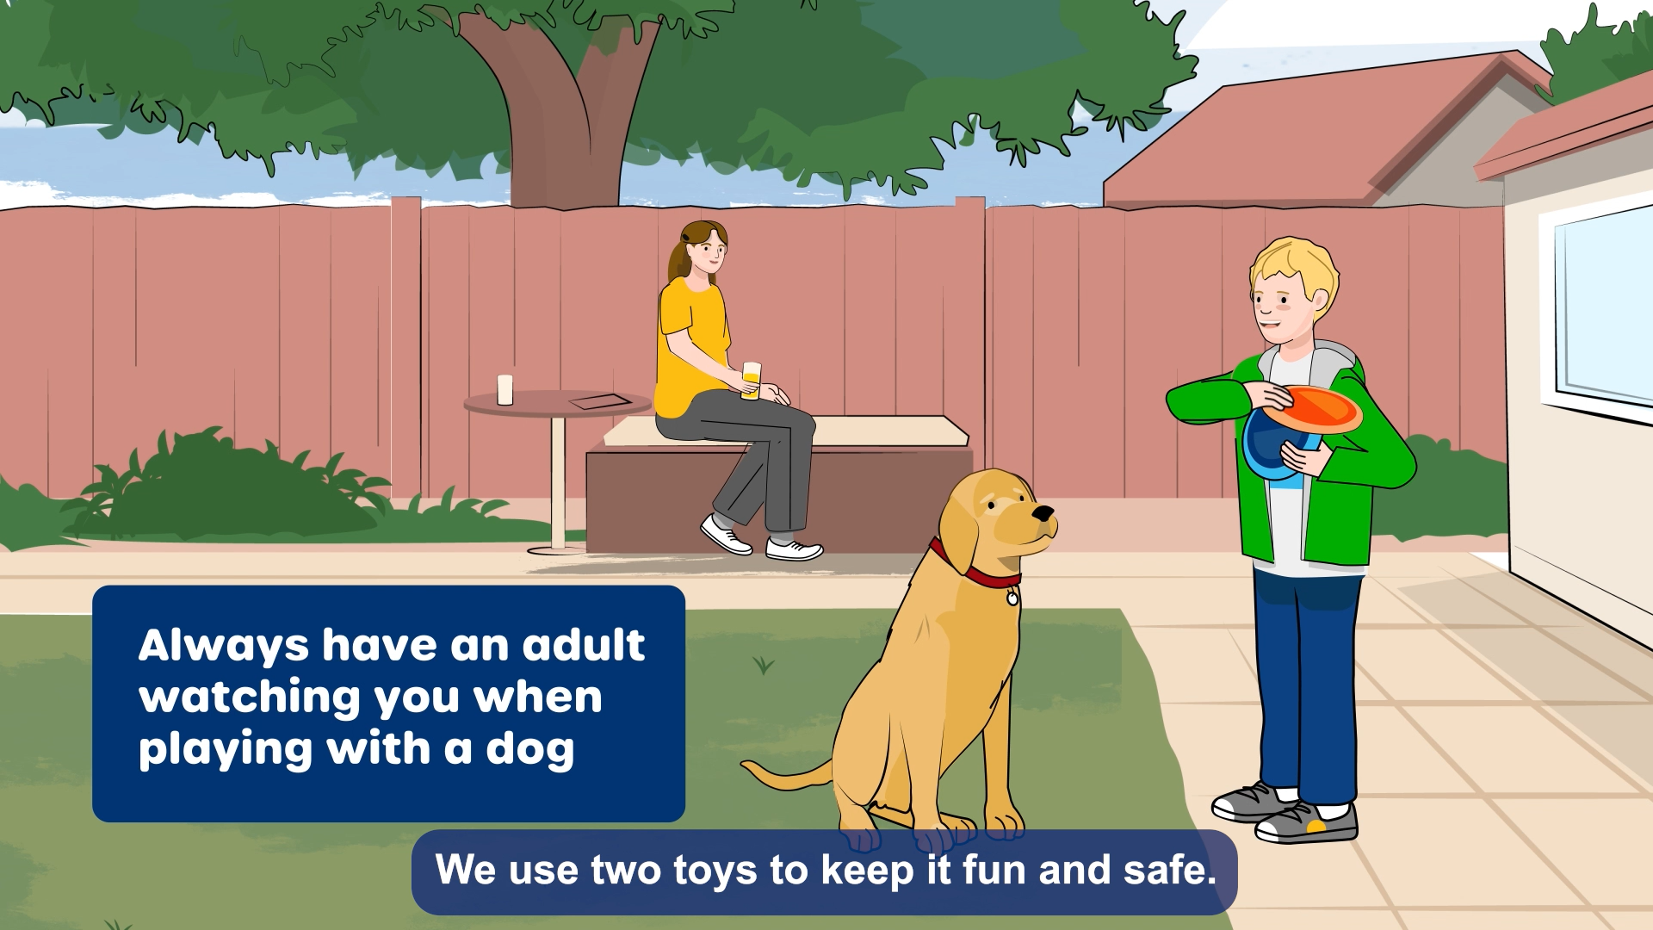
Staying safe around dogs

Slide 16
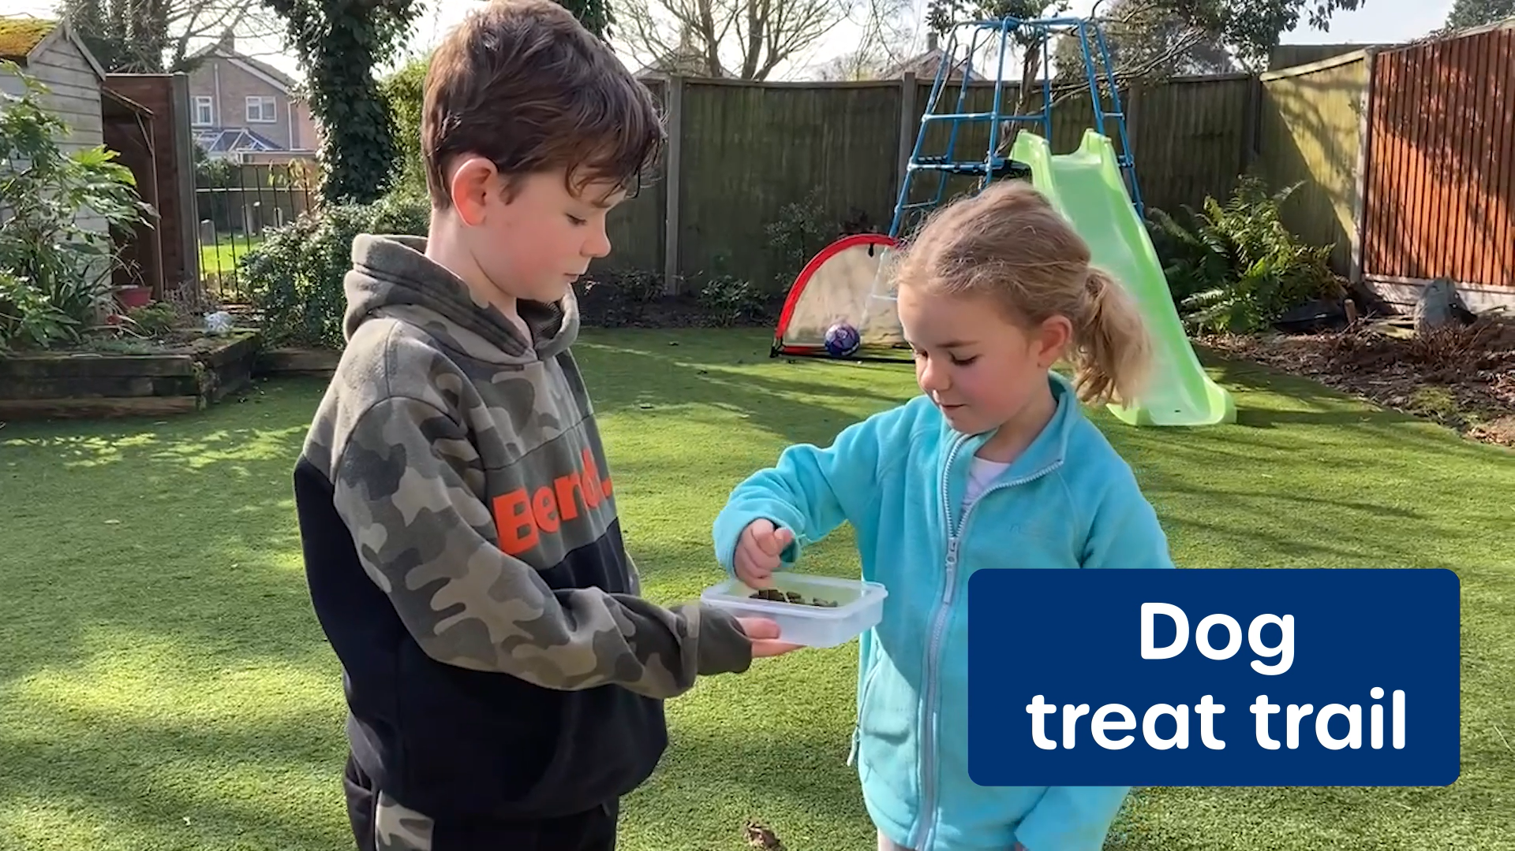
Staying safe around dogs

Slide 17
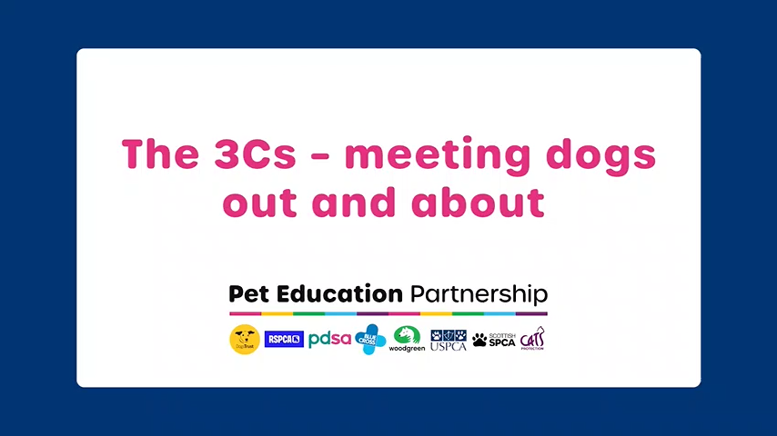
Staying safe around dogs

Slide 18
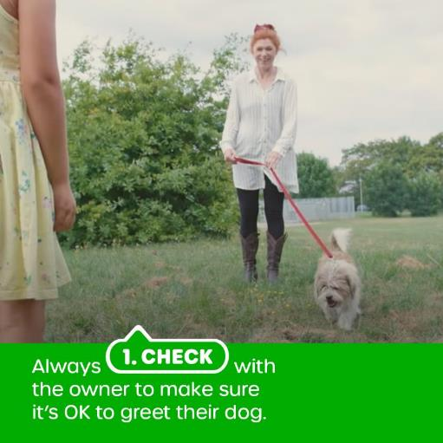
Staying safe around dogs
Check

Slide 19
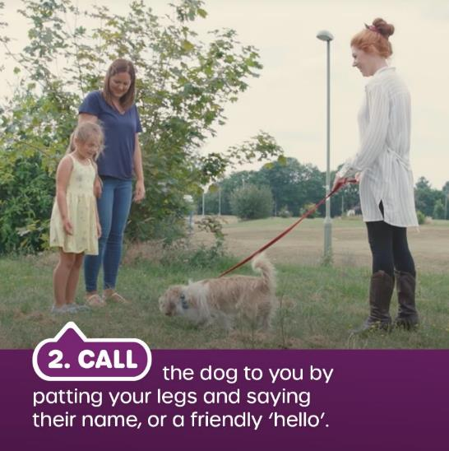
Staying safe around dogs
Call

Slide 20
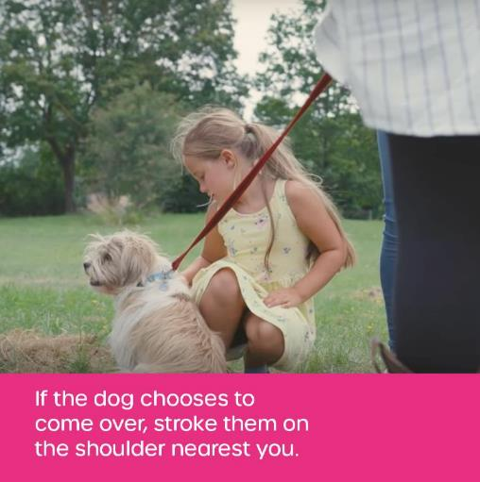
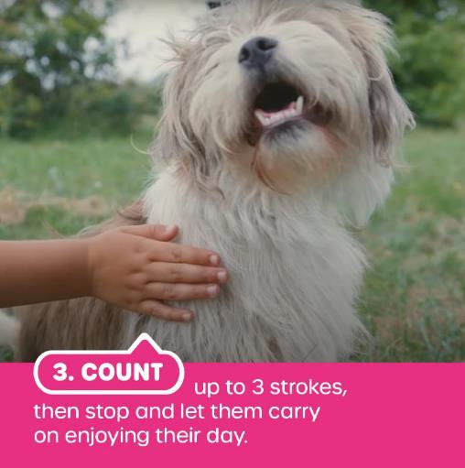
Staying safe around dogs
Count

Slide 21
Staying safe around dogs
Leave me alone please!

Slide 22
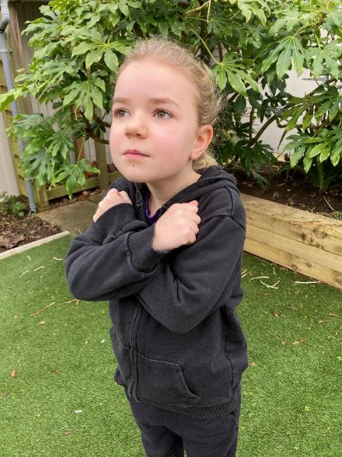
Staying safe around dogs
Stand still like a statue

Slide 23
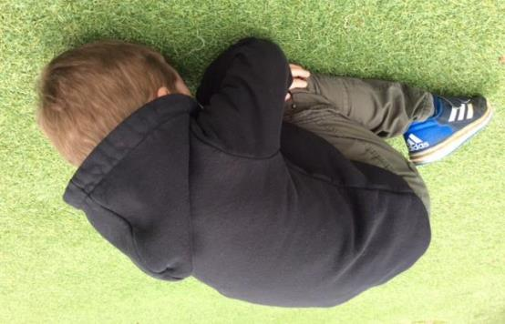
Staying safe around dogs
Be a tortoise

Slide 24
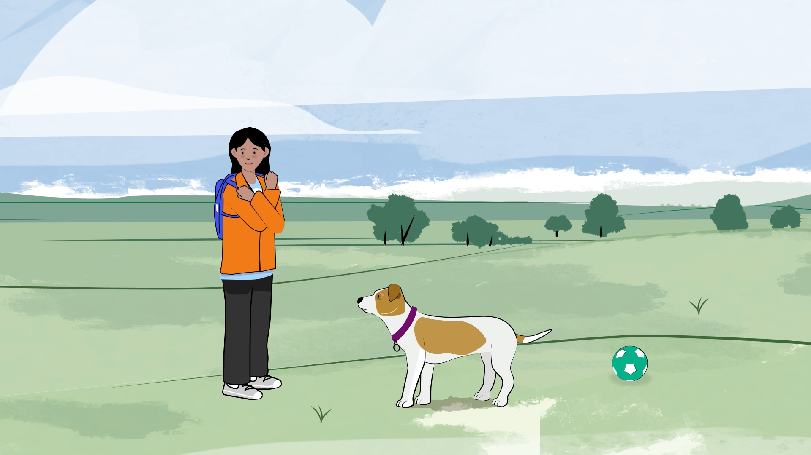
Staying safe around dogs

