Slide 1


Slide 2



Keeping Pets Safe around Fireworks
Notes:
We all know that fireworks can be dangerous for humans, but did you know that they can be harmful for pets too? Explain that we’re going to learn more about how fireworks make our pets feel and what we can do to help them feel safe.

Slide 3
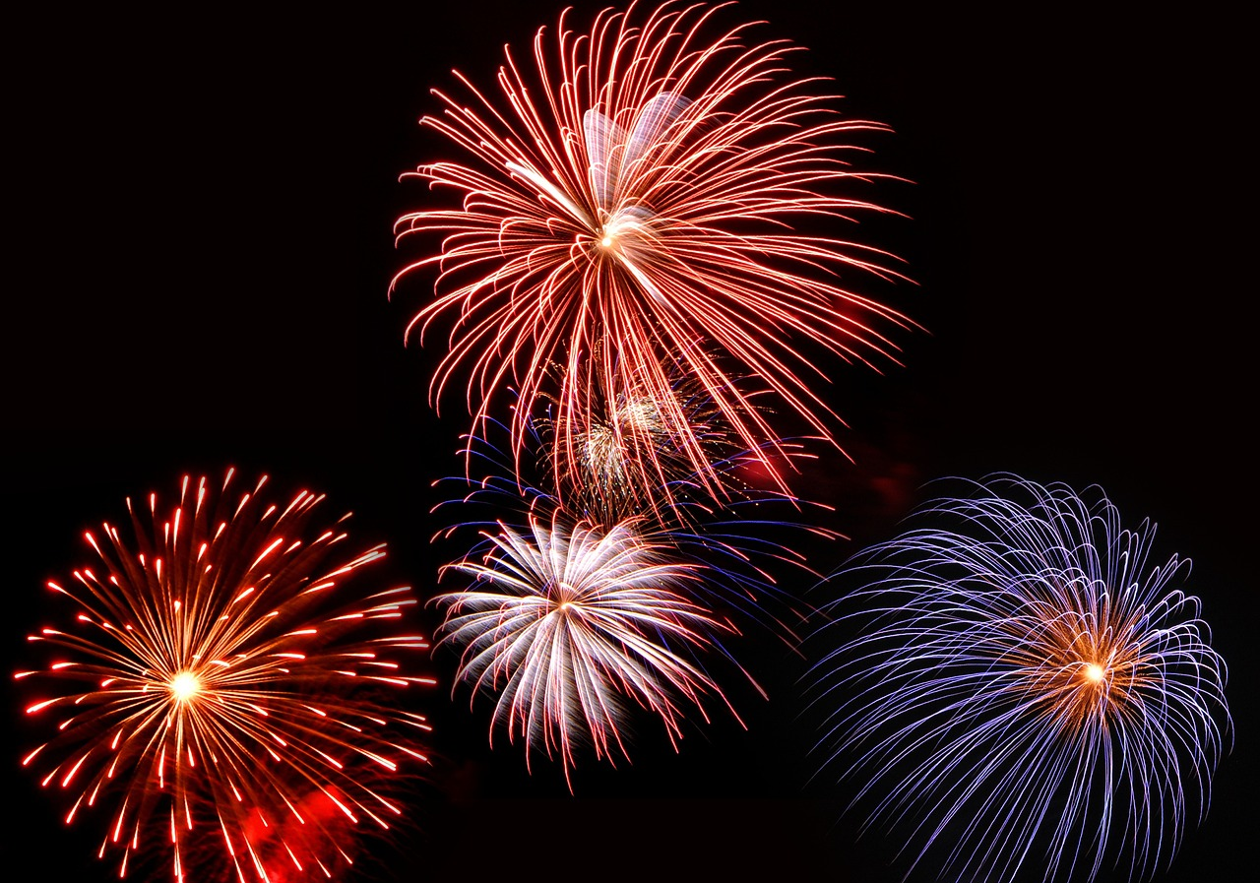
How do fireworks make you feel?
Notes:
Ask learners how fireworks make them feel:
-happy?
-excited?
-scared?
Then ask the class when they usually see fireworks, e.g. Halloween, Bonfire night, Christmas, Birthdays, New Year’s Eve and religious celebratory dates.

Slide 4
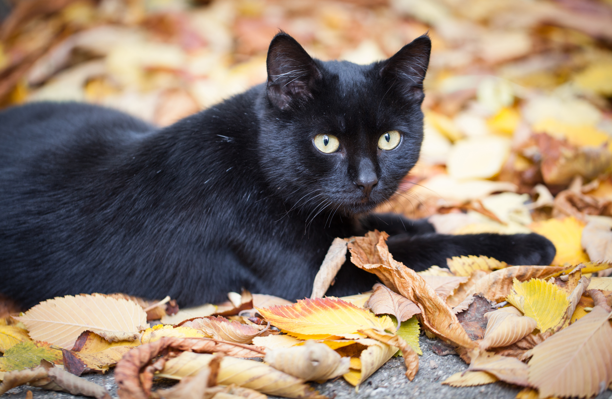
How do you think fireworks make our pets feel?
Notes:
Ask learners how they think fireworks make our pets feel.
Some learners may assume that their pet likes them because they like. Others may have prior learning or experiences that leads them to believe that their pet does not like them.
Don’t share any answers at the moment – answers revealed on the next slide.

Slide 5
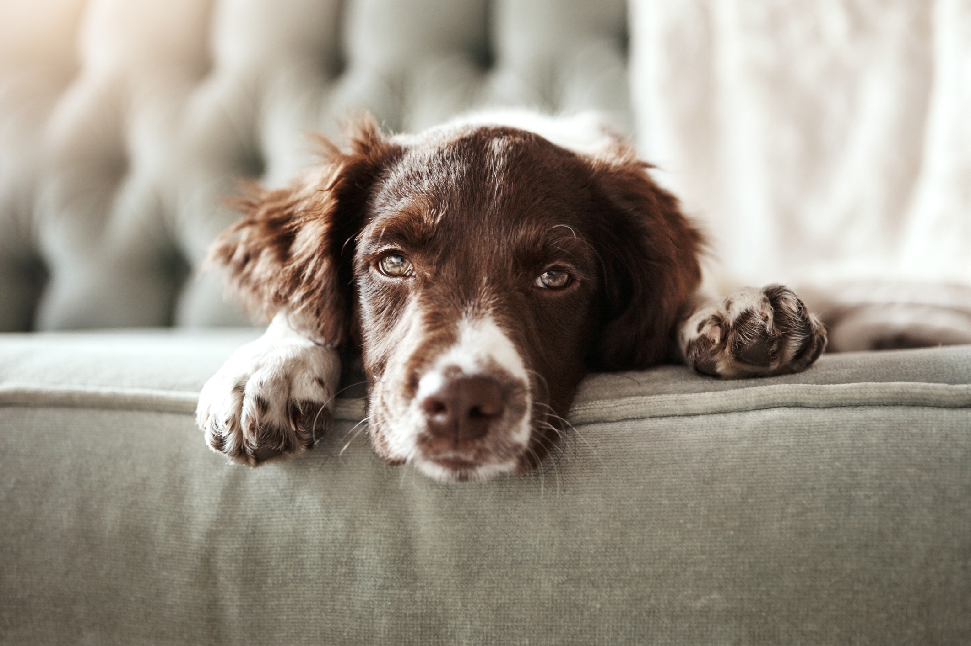
How fireworks can make our pets feel
Scared
Concerned
Worried
Upset
Anxious
Frightened
Notes:
Use the different words around the image to explain to learners how pets may feel during the fireworks

Slide 6
Why can fireworks be scary for pets?
They have better hearing than us: cats, dogs and small animals hear sounds much louder than we do! A dog’s hearing can be up to 4x more sensitive than a human’s
Bright light and flashes: our pets can become easily spooked by the bright displays that we find beautiful! To them, they can be threatening and may make them feel anxious
Funny smells: fireworks can release smoke and other scents which can be worrying for pets as they have a very strong sense of smell
Unpredictable: the timing and intensity of the bangs can be unpredictable, making it hard for our pets to get used to the noises!
Notes:
Introduce some facts to help the children understand why fireworks can be scary for our pets.
Emphasise that our pets have very very sensitive hearing and that loud noises can make them scared.
41% of dog owners in the PDSA Animal Welbeing (PAW) Report, which is a big questionnaire of all pet owners in the UK, said their dog is afraid of fireworks and 30% of cat owners said their cat is afraid of fireworks - that’s 4.1 million dogs and 3.3 million cats across the UK that feel scared.

Slide 7
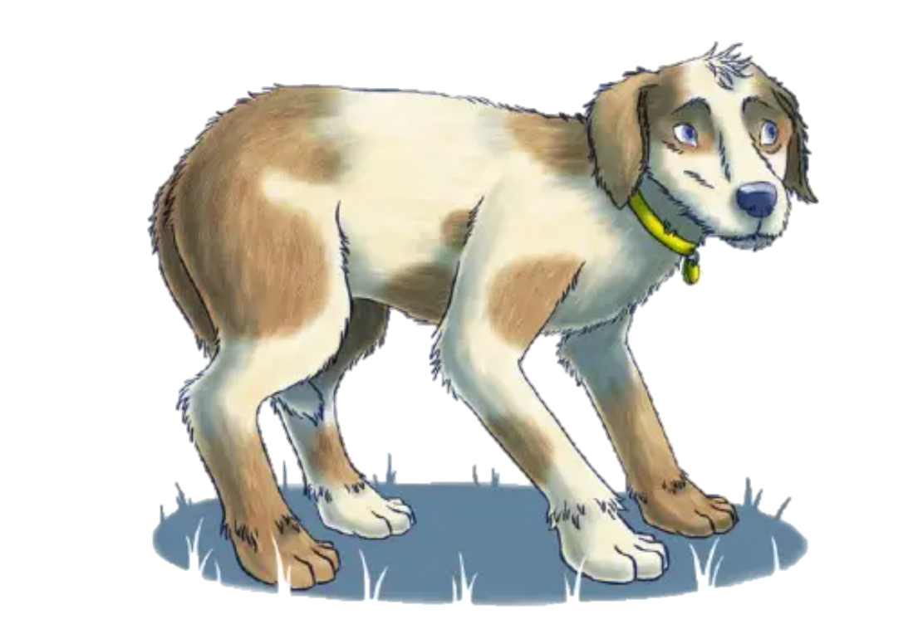
Signs of a scared dog
Panting
Pacing
Shaking
Going to the toilet where they shouldn’t
Barking
Refusing to eat
Hiding
Notes:
Take the learners through the basic signs of fear in dogs. Hopefully this will help them be able to identify it in their own pet
Explain that we are quite lucky with dogs as they often show us when they are feeling scared… this will lead on as we go through the animals. Cats can be trickier, and small pets even harder!
Further information about these behaviours can be found here: https://www.pdsa.org.uk/pet-help-and-advice/pet-health-hub/other-veterinary-advice/dogs-and-fireworks

Slide 8
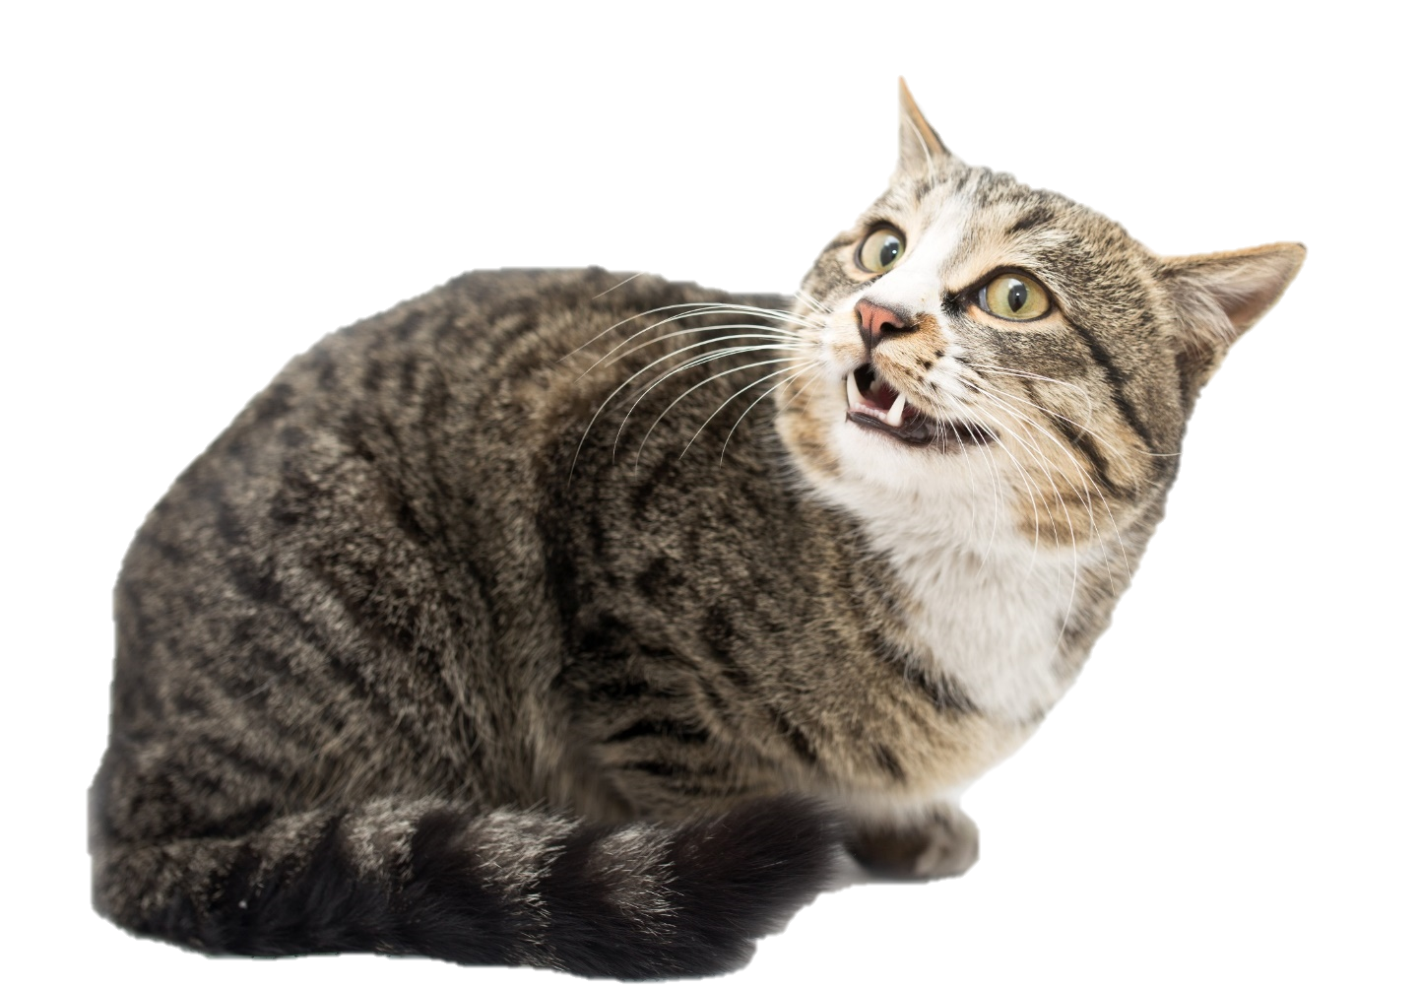
Signs of a scared cat
Going to the toilet where they shouldn’t
Hiding behind or on top of furniture
Trying to run away
Refusing to eat
It can be trickier to tell if a cat is scared, as they are skilled at hiding their fear
Notes:
Explain to learners that it can be a bit more tricky to identify the signs of fear in cats as they hide it better! More subtle signs than dogs.
Further information about these behaviours can be found here: https://www.pdsa.org.uk/pet-help-and-advice/pet-health-hub/other-veterinary-advice/cats-and-fireworks

Slide 9
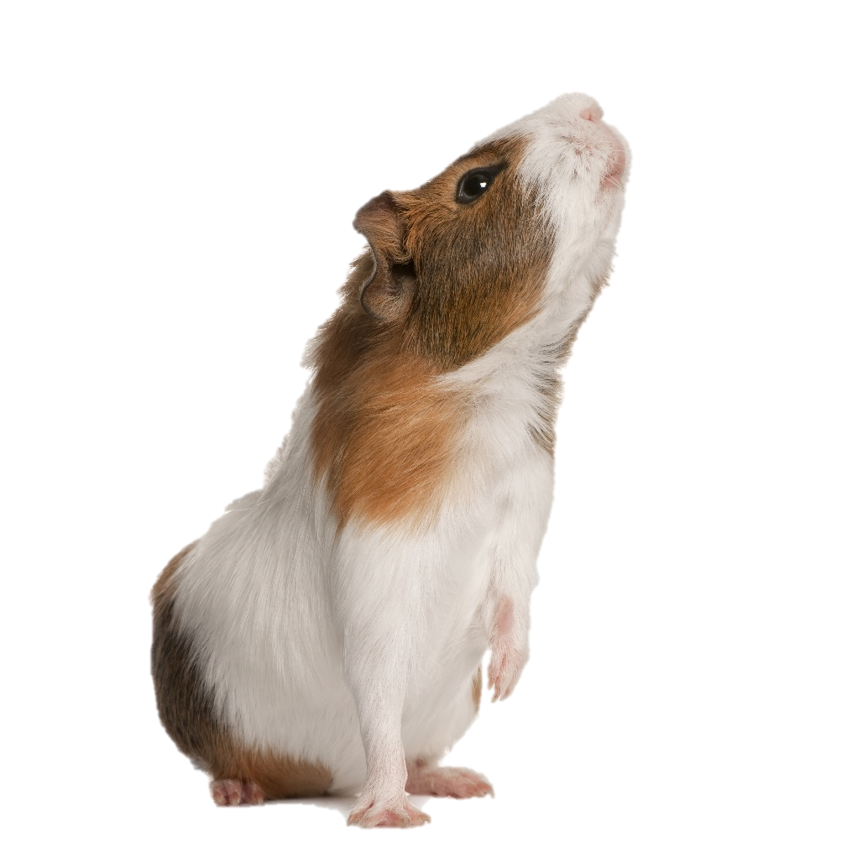
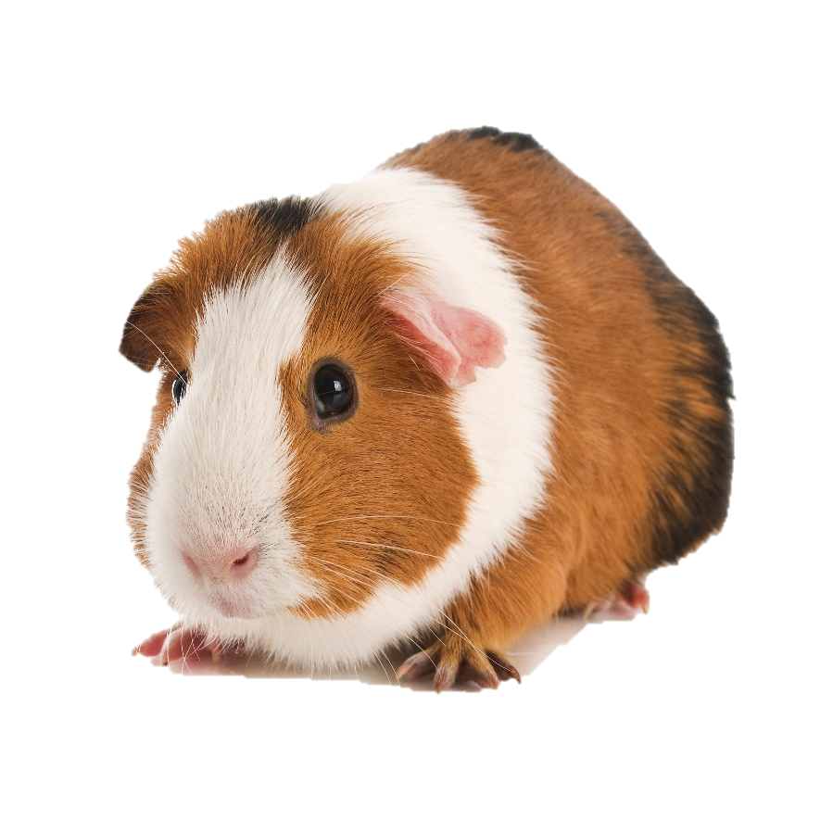
Signs of a scared small pet
(such as hamsters, gerbils, rats, guinea pigs and rabbits)
Trying to run away
Hiding
Breathing faster
Tooth grinding
Stamping their back feet (rabbits and guinea pigs)
Standing very still
Notes:
Emphasise that small pets hide signs of fear/distress very well. They are often prey species, and so try and hide fear and pain to stop predators attacking them. Learners need to know that their small pet will likely be scared of fireworks even if they show no signs/subtle signs.
Small pets can become very unwell if they’re scared.
Further information can be found here: https://www.pdsa.org.uk/pet-help-and-advice/pet-health-hub/other-veterinary-advice/small-pets-and-fireworks
The images show guinea pigs showing the following behaviours:
Freezing: A guinea pig that is startled or uncertain about something in its environment will stand motionless.
Aggressive Actions: These can include raising their head and/or rising up on their hind ends with stiff legs, shuffling side to side on stiff legs, fluffing out their fur, and showing their teeth (yawning). These actions are often accompanied by hissing and/or teeth chattering. If your guinea pigs do this with each other, be on high alert for fighting.

Slide 10
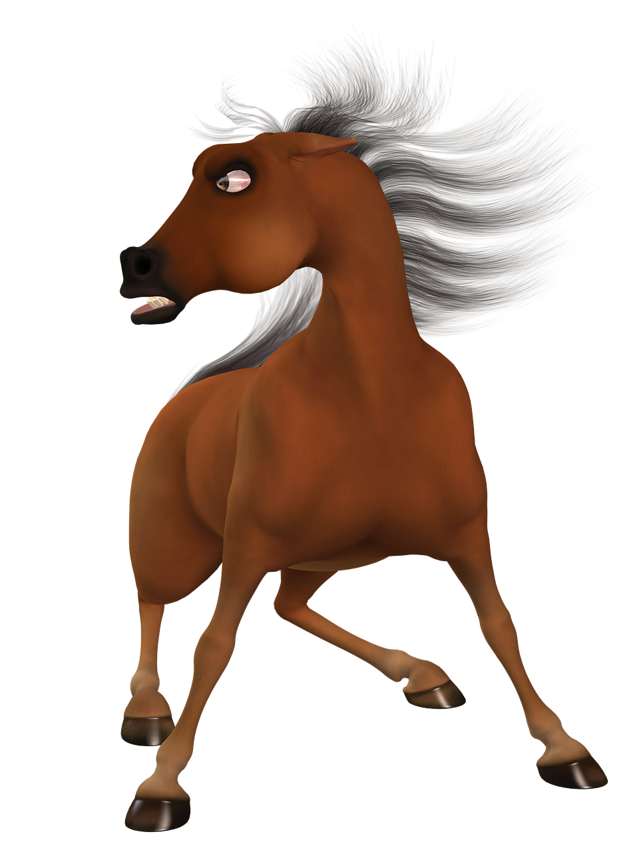
Signs of a scared horse
Restless or pacing
Making a whining noise
Galloping or kicking
Shaking
Breathing faster
Wide eyes and flared nostrils
Loss of interest in food or water
Sweating

Slide 11

Group work!
10
min
Notes:
Split the class into groups
Assign each group a species of pet - dog, cat or a small animal
Ask the learners to write down (on paper or whiteboards) how we could reduce fear for those animals around the time of fireworks.
After 10 minutes get each group to read out their ideas to the teacher/group leader

Slide 12
Tips to help our pets feel safe…

Slide 13

Dogs:
Block out flashes and bangs: close the windows, curtains and blinds.
Put TV or music on: this can help distract them
Stay calm and relaxed: if you are calm and relaxed this can be comforting to your dog
Keep them in the house: Lock the doors and keep your dog inside during fireworks
Walk them earlier in the day: walk your dog earlier in the day before the fireworks start
Notes:
More information can be found at:
https://www.dogstrust.org.uk/dog-advice/life-with-your-dog/seasonal/fireworks
https://www.bluecross.org.uk/sites/default/files/d8/downloads/PA_FIREWORKS.pdf

Slide 14


Make a den: provide a safe area. Ideally an open dog crate with a cover over it or a table with a cover over it so they can get underneath. Do not disturb them when they are in their safe space
Try not to cuddle them: reassure dogs if they need comforting, but avoid cuddling them as this can be worrying for them
Ask an adult to make sure your dog is microchipped:
in case they manage to escape or run off. A microchip is a tiny data chip that is inserted under a pet’s skin. It doesn’t hurt as it is only as big as a grain of rice. This special chip tells the vet where your pet lives when it is scanned, making it easier to reunite pets with their owners.
Notes:
More information can be found at:
https://www.dogstrust.org.uk/dog-advice/life-with-your-dog/seasonal/fireworks
https://www.bluecross.org.uk/sites/default/files/d8/downloads/PA_FIREWORKS.pdf

Slide 15
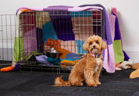
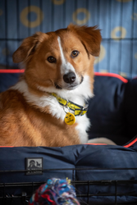
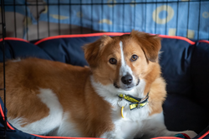
Notes:
Example of a den that the kids can make for their own pets!

Slide 16


Cats:
Keep them in the house: lock the cat flap so that your cat stays inside during the fireworks
Block out flashes and bangs: close the windows, curtains and blinds
Make a den: this allows them to hide and feel safe
Pheromone spray: pheromones are chemical messages cats use to communicate with each other, some of which can be calming. Using a diffuser or spray with happy pheromones can help relax your cat
Put TV or music on: this can help distract them
Stay calm and relaxed: if you are calm and relaxed this can be comforting to your cat

Slide 17
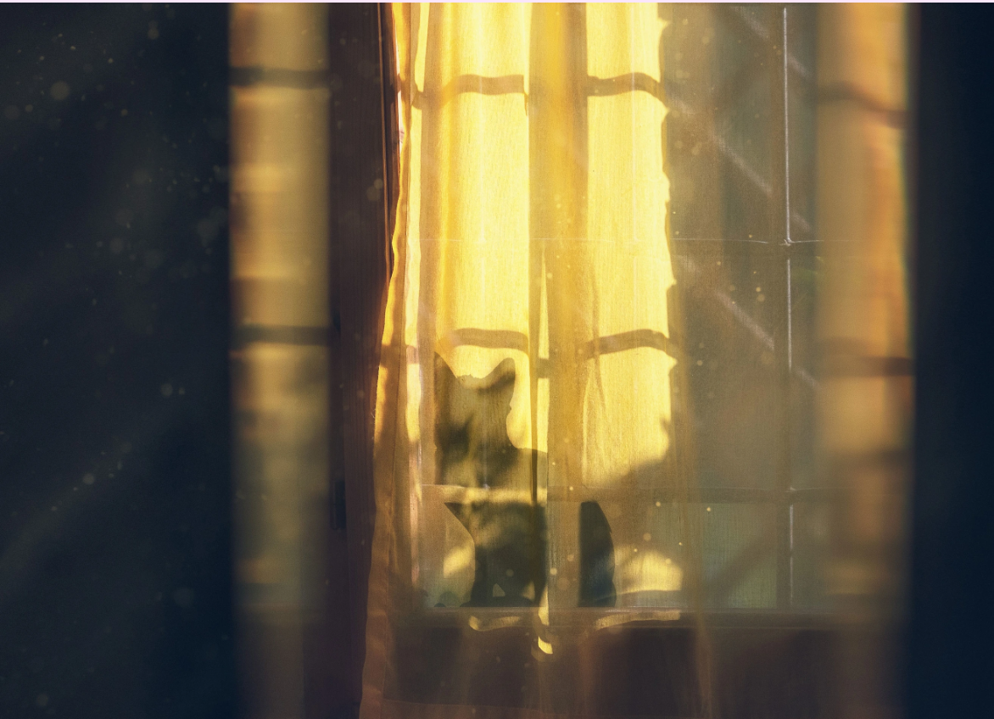
Notes:
Check with CP that we can use their image

Slide 18


Small animals:
Bring them indoors: hutches, cages and enclosures should be brought indoors or into a garage, if possible
Give extra bedding: give extra burrowing material so that they can bury themselves deep to feel safe
Cover the hutch: if you cannot bring them indoors, cover their hutch/pen with blankets or a duvet to block the sounds and sights of the fireworks (but make sure they still have good ventilation)

Slide 19
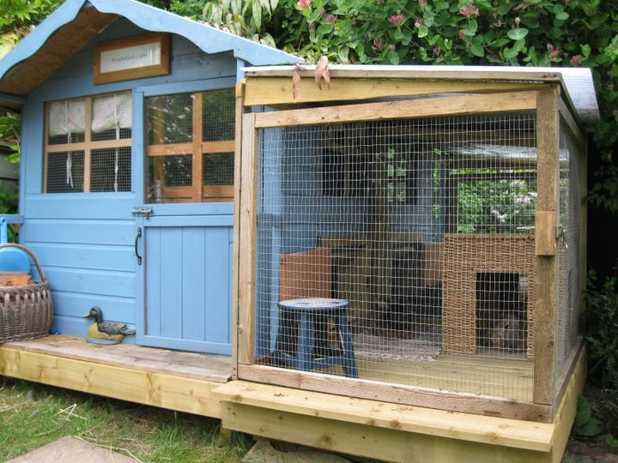
Notes:
An example of an ideal home for rabbits

Slide 20

Horses:
Make sure your horse feels safe keep them in a place they know well and follow their usual routine. If your horse is used to staying in the stable, keep them there. If they normally stay in a field, it’s okay to leave them there as long as it’s far away from fireworks and safe.
Ask an adult to stay with them: it's important for someone who knows horses to stay with them if fireworks are going off. That way, they can watch how the horse is feeling and help keep them calm.
Ask a vet for help: if your horse gets really scared by loud noises, ask an adult to talk to a vet or think about moving them somewhere quieter for the night.
And remember, don’t ride your horse if you think fireworks will be set off - it’s not safe!
Notes:
More information can be found at:
https://www.bluecross.org.uk/advice/horse/horses-and-fireworks
There is also a free downloadable poster on this webpage

Slide 21
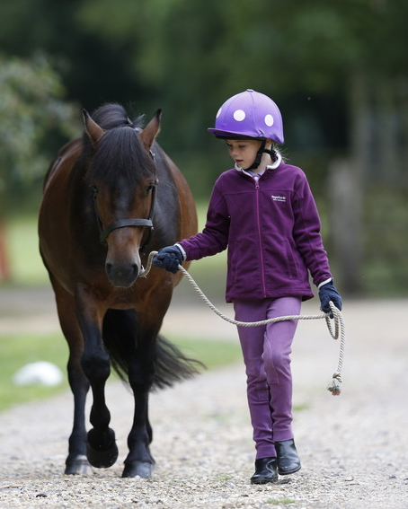
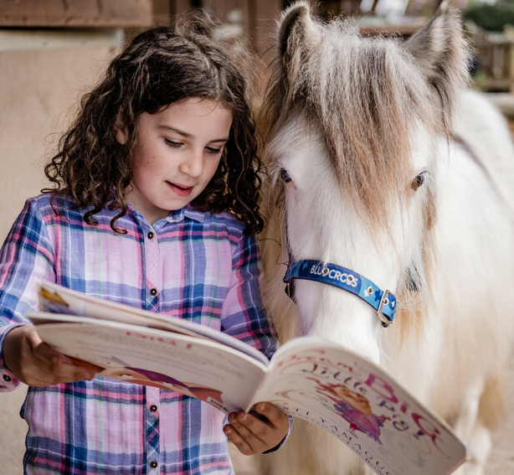

Slide 22

What have we learnt so far?
We know when fireworks are most likely to go off: bonfire night, birthdays, New Year’s Eve, religious ceremonies and parties nearby
We understand that fireworks can be very scary for our pets
We can take steps to make our pets feel more comfortable

Slide 23
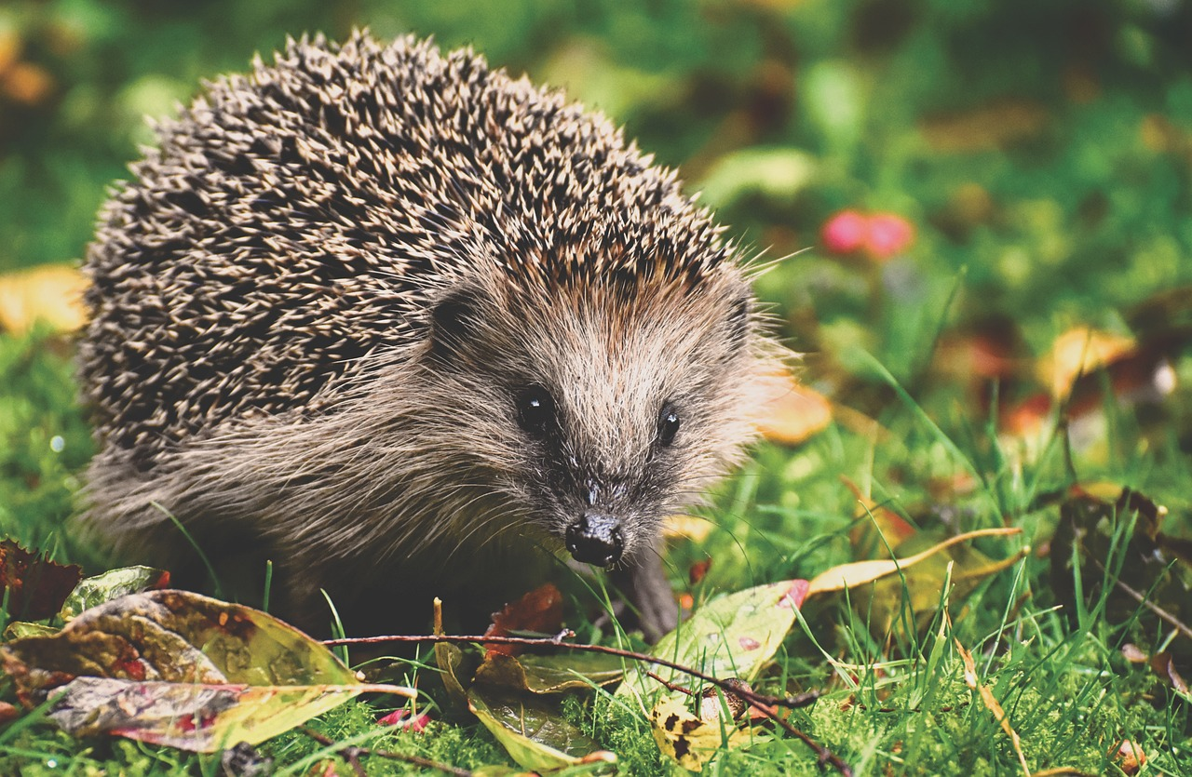
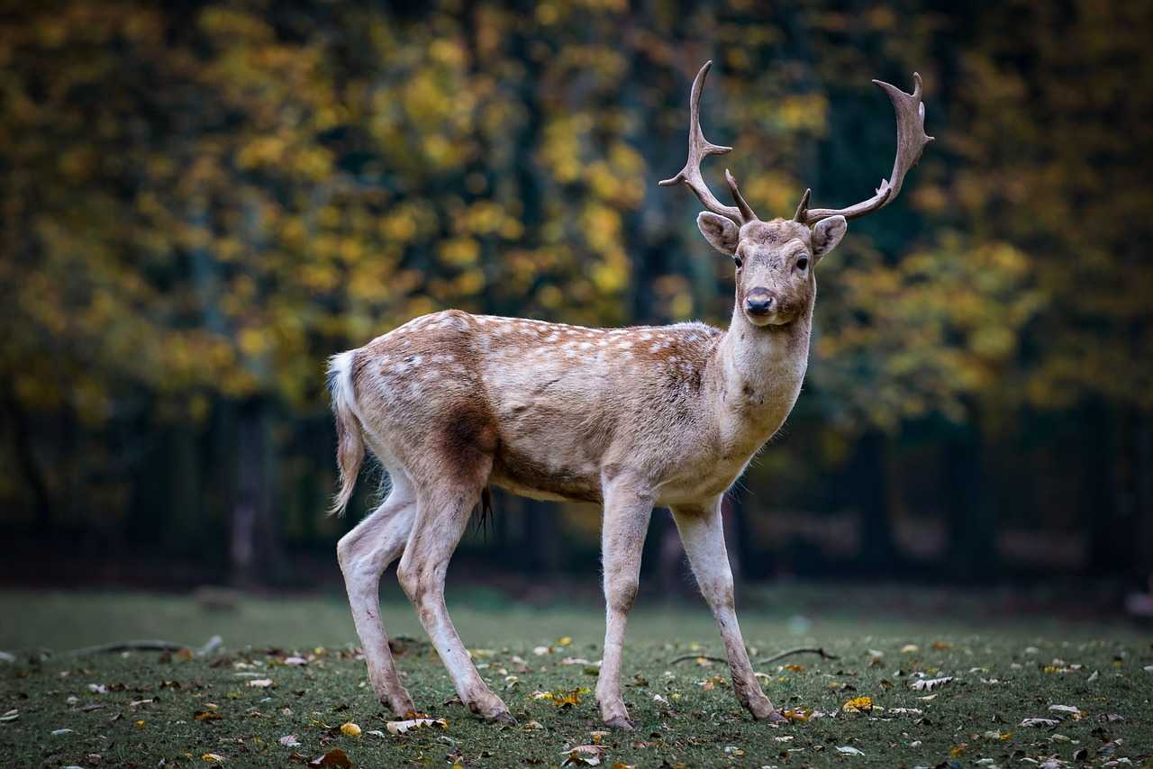
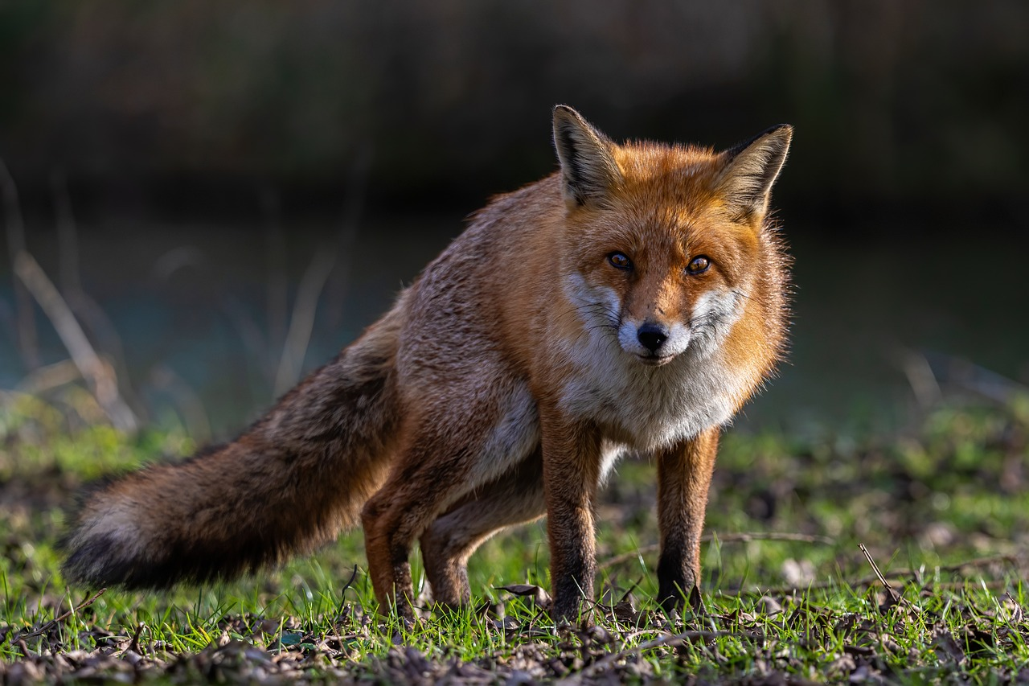
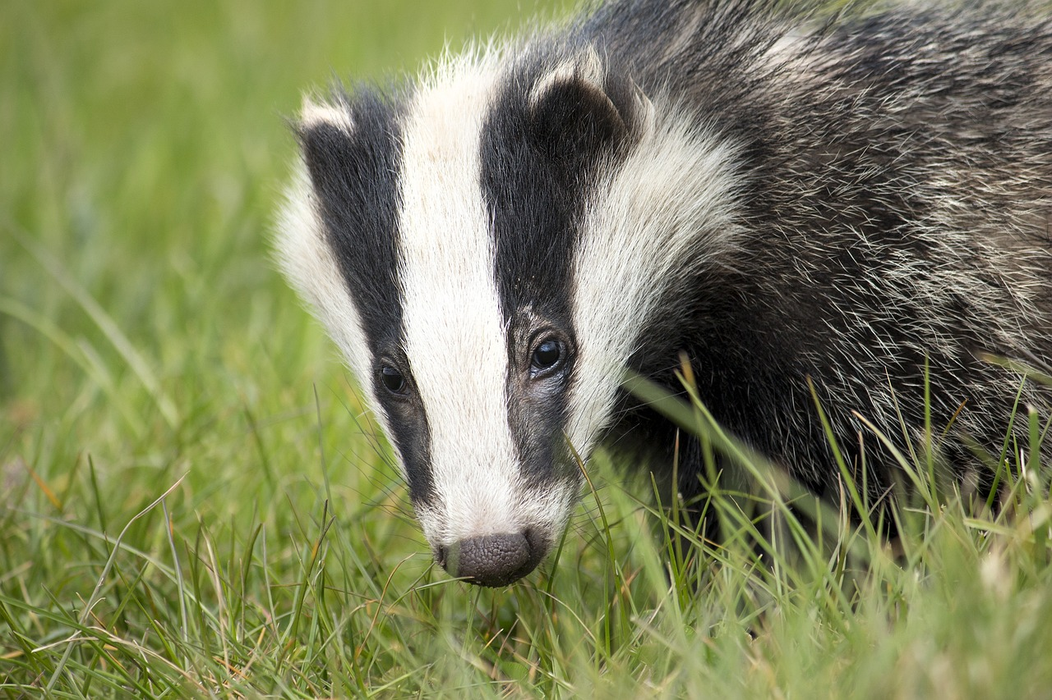
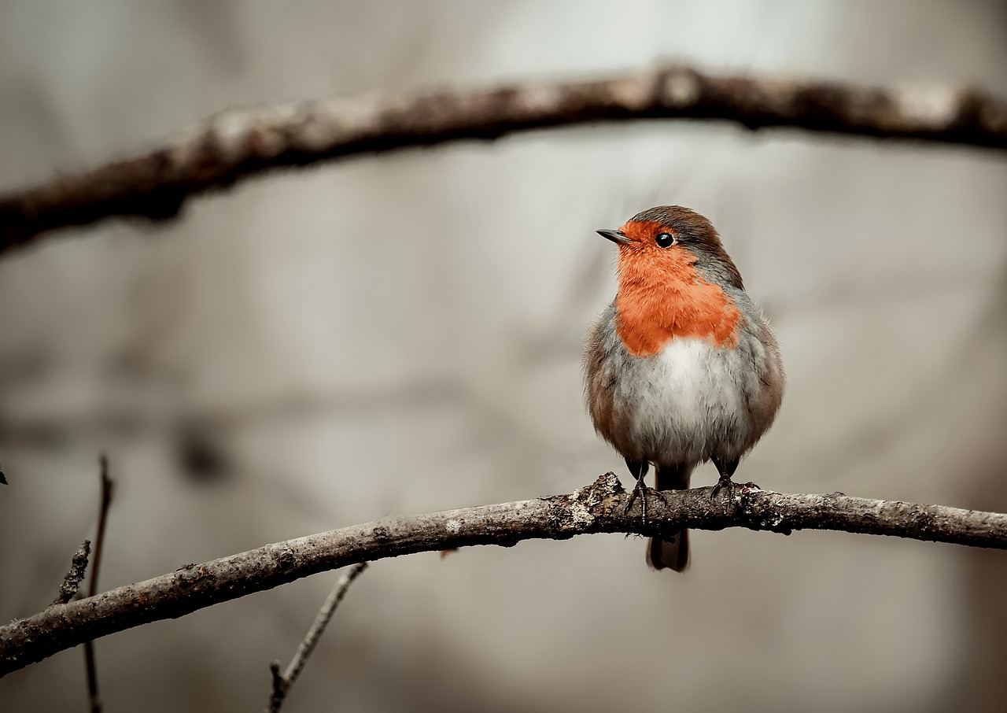
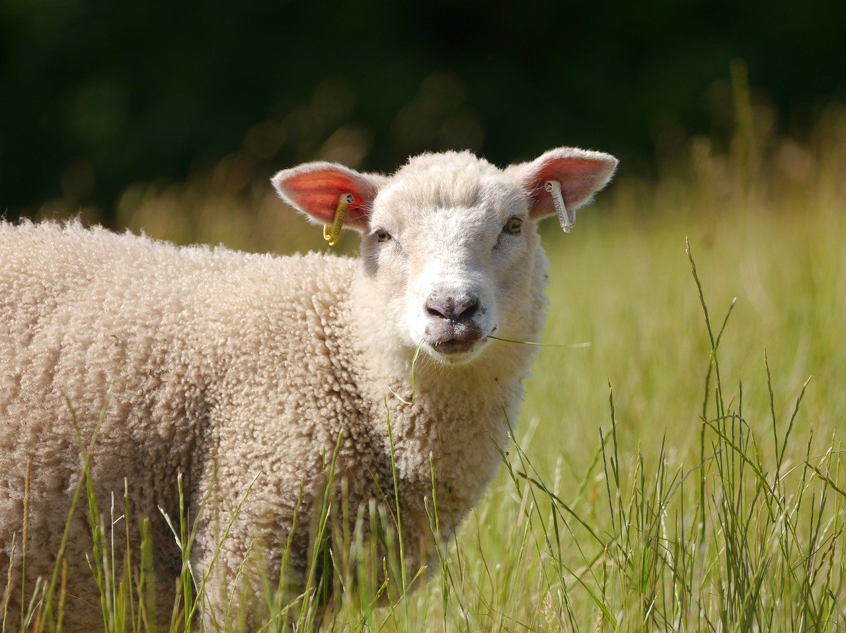
But what about….
Notes:
Now want the kids to start thinking about the forgotten animals… wildlife! They don’t have an owner to protect them… so should we be using fireworks at all?
And cattle…can we expect farmers to shelter a whole flock of sheep from the bangs? Sheep may try to jump or break through fences and gates, which can result in them getting hurt.

Slide 24
Fireworks & wildlife
Fireworks can cause birds to flee and fly off into the night, where they become lost and disorientated
Adult animals may run away and forget where they left their young
Hedgehogs may nest in unlit bonfires. Which can be serious if they are not found
The loud noises are scary! Just as before, wild animals still find the sounds very frightening
Notes:
Help the learners understand that fireworks can be very stressful for wildlife not just companion animals

Slide 25

How can we help?
Safely tidy up after using fireworks!
Promote firework alternatives
Create temporary shelters/dens in your garden
Encourage others not to use fireworks
Ask an adult to check unlit bonfires for hedgehogs!
Avoid using fireworks near woodland, wetland or other wildlife areas

Slide 26
Can you think of any alternatives to using fireworks?
Notes:
Ask learners to create a mind map of ideas that could be used instead of fireworks

Slide 27
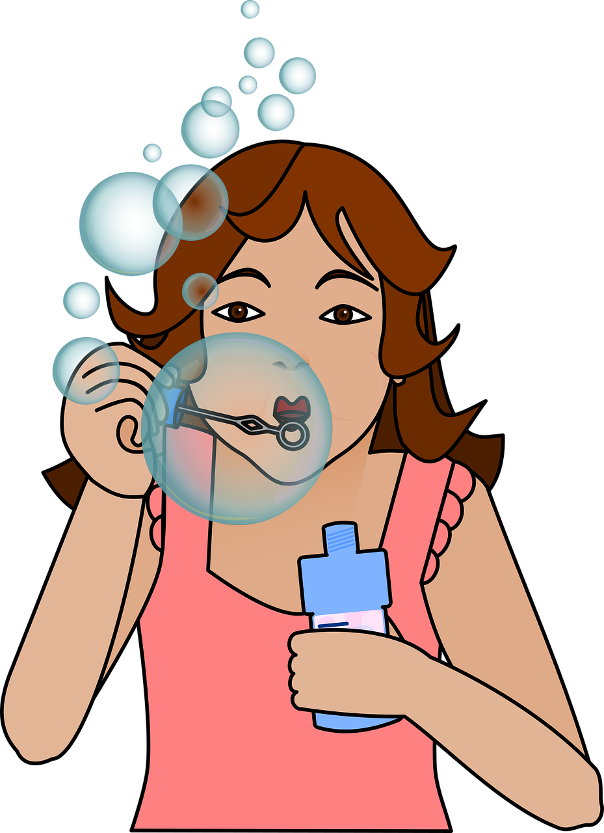
Biodegradable confetti cannons
Bubbles
Drone light shows
Glowsticks
Pinatas
Organise a nature event!
Street party
… but make sure you tidy up!
Notes:
Share the examples on the slide and explain that there are many more things that they could do as an alternative way of celebrating.
Make sure to tell learners that many of these still need to be cleared up after, so that we can have an environmentally friendly future

Slide 28

Task time!
Scenario: Mr/Miss/Mrs X (insert the head teacher’s/group leader’s name) is planning a large firework display to celebrate the end of the year. The school is located near a large wetland that is home to many migratory birds and there is a boarding kennels near by.
Task: Write a letter to the head teacher persuading them that this may not be the best idea and explain why. Suggest some alternatives that may be better for the animals, but will still allow everyone to have fun.
Notes:
Example of a task that could be added at the end of the presentation just to reinforce the learning and encourage deeper thinking

