Slide 2
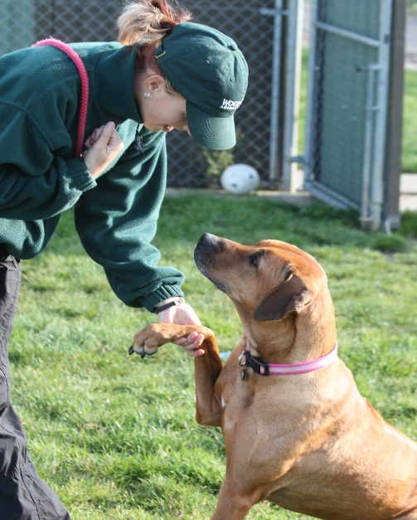
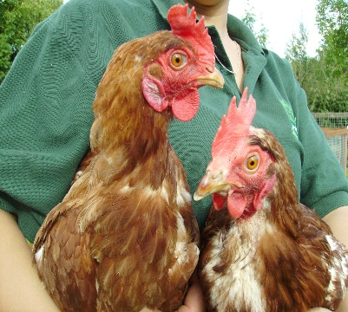
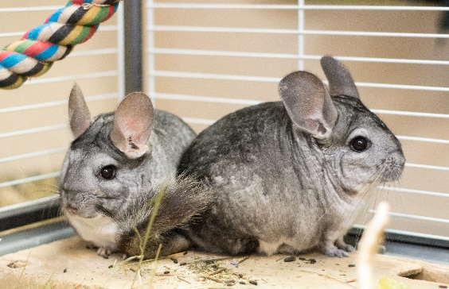
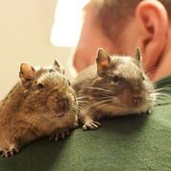
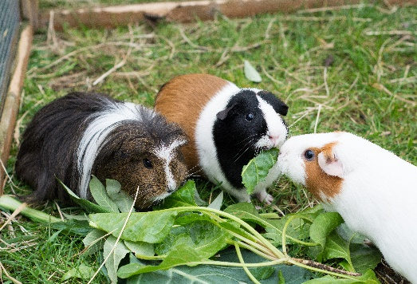
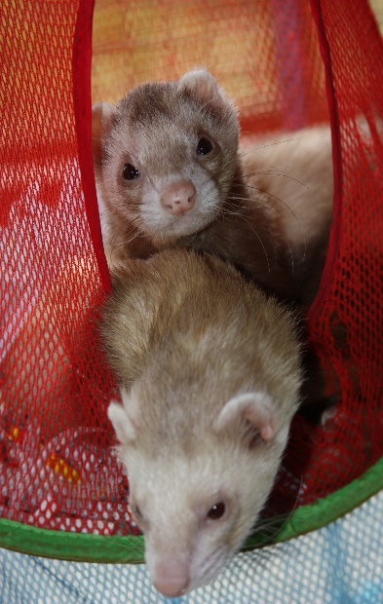
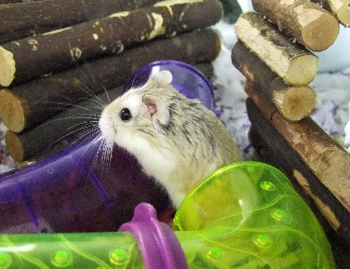
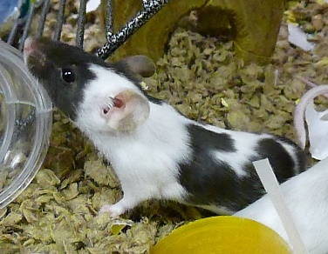
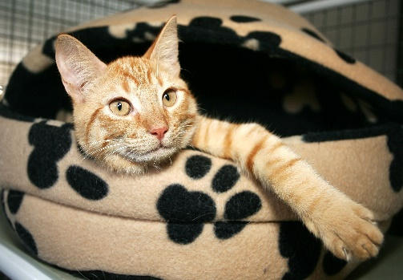
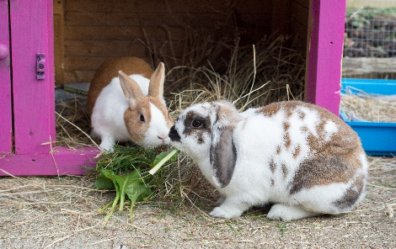
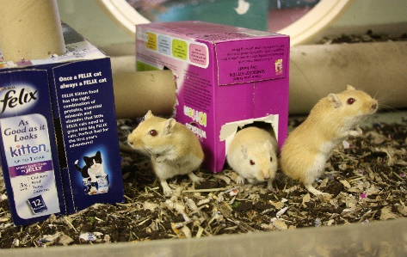
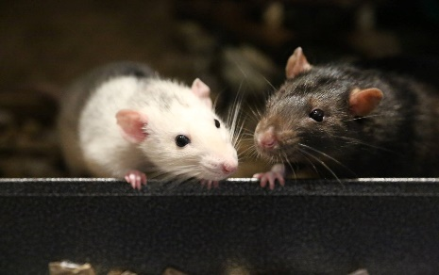
Dog Safety KS2
12 types of animal!

Slide 3
Meet Woody
Dog Safety KS2

Slide 4
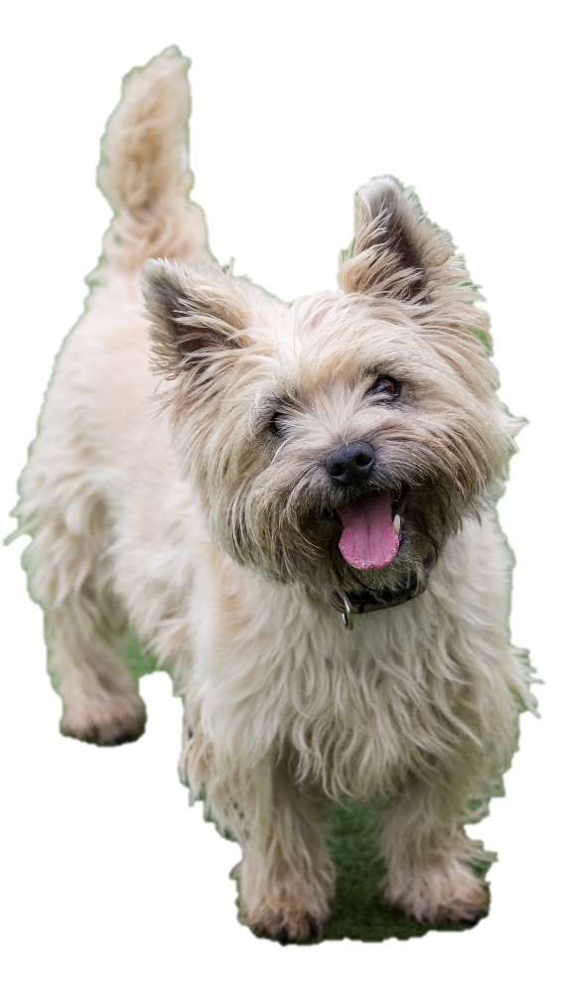
Dog Safety KS2
Dogs like walks
True!
Sit down = FALSE
Stand up = TRUE

Slide 5
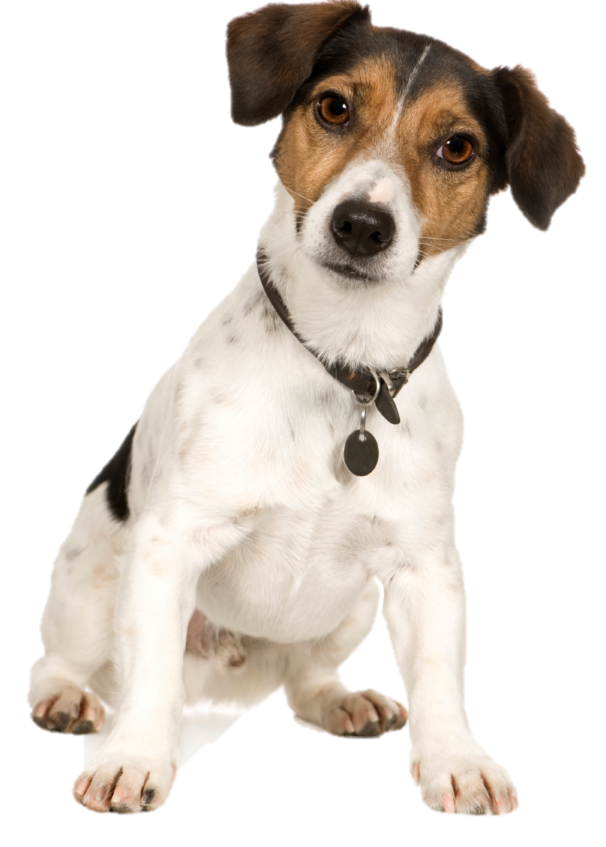
Dog Safety KS2
Dogs like being
picked up
False!
Sit down = FALSE
Stand up = TRUE

Slide 6
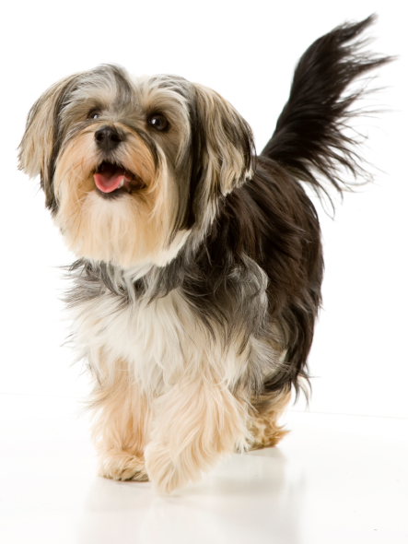
Dog Safety KS2
Dogs like big
kisses and tight cuddles
False!
Sit down = FALSE
Stand up = TRUE

Slide 7
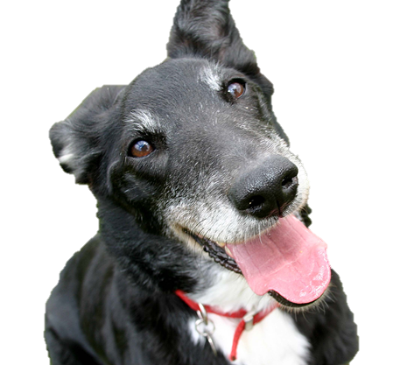
Dog Safety KS2
Dogs have feelings just like humans
True!
Sit down = FALSE
Stand up = TRUE

Slide 8
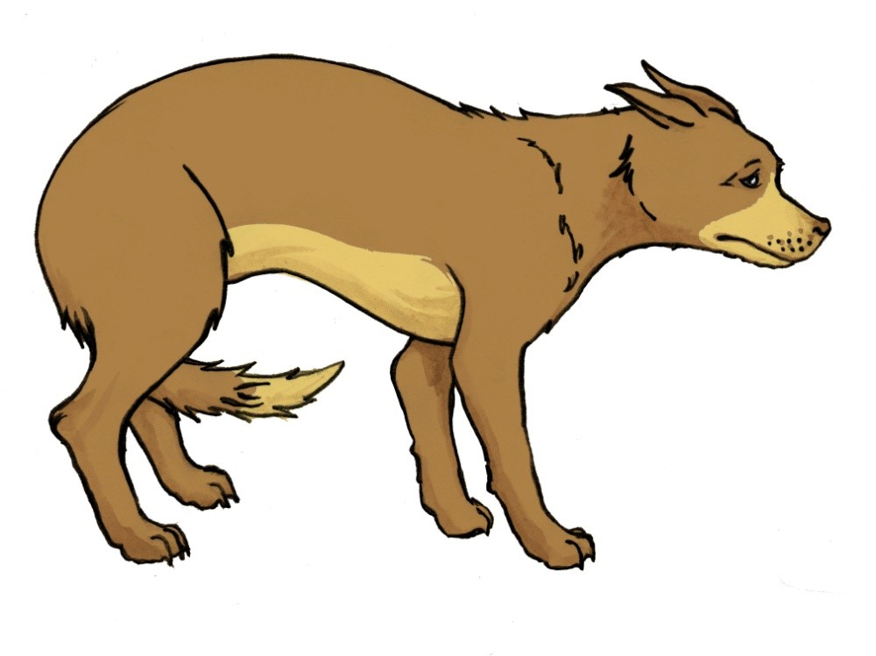
Dog Safety KS2
Dog body language

Slide 9
Dog Safety KS2

Slide 10
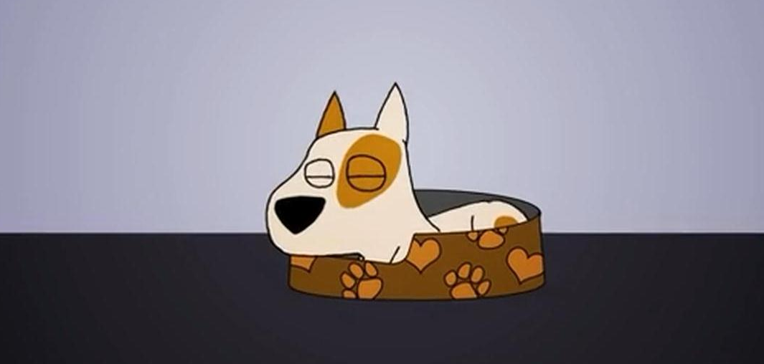
Sleeping
Dog Safety KS2
Thumbs up = he would like to play
Thumbs down= he wouldn’t like to play

Slide 11
Poorly
Dog Safety KS2
Thumbs up = he would like to play
Thumbs down= he wouldn’t like to play

Slide 12
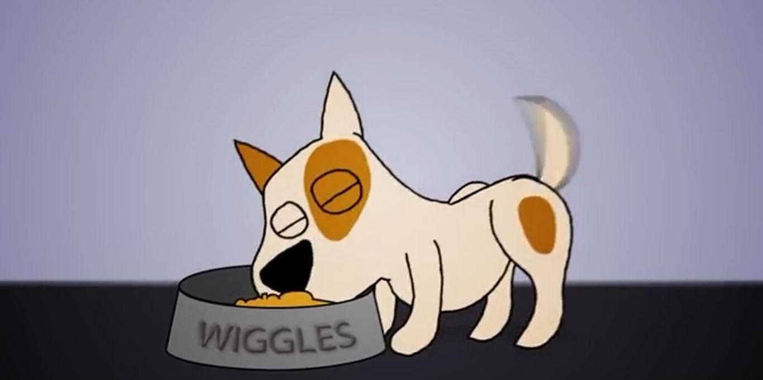
Eating
Dog Safety KS2
Thumbs up = he would like to play
Thumbs down= he wouldn’t like to play

Slide 13
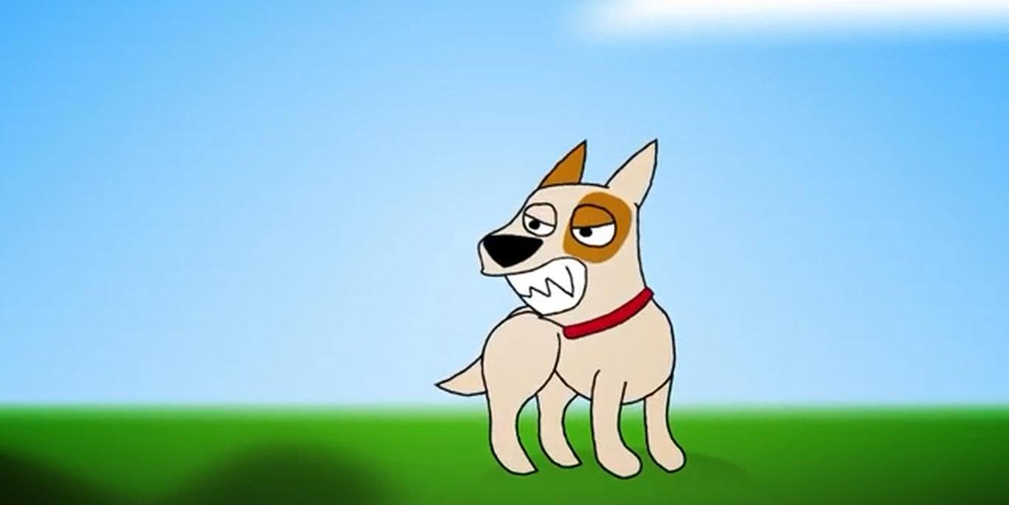
A growl
Dog Safety KS2

Slide 14
Dog Safety KS2

Slide 15
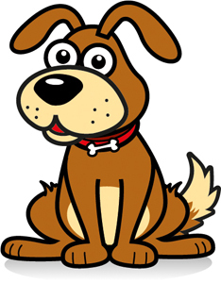
Dog Safety KS2
WHAT WOODY WANTS
Wait for the dog to come to you
Watch for a
Wag

Slide 16
Dog Safety KS2

Slide 17
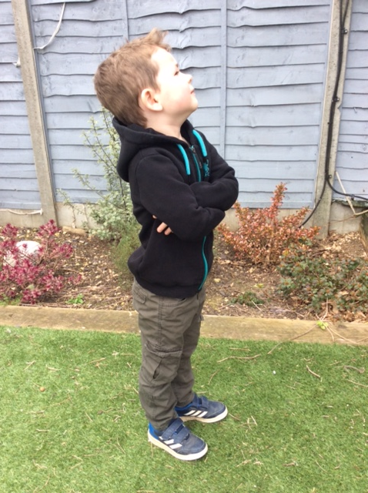
Stand like a statue
Dog Safety KS2

Slide 18
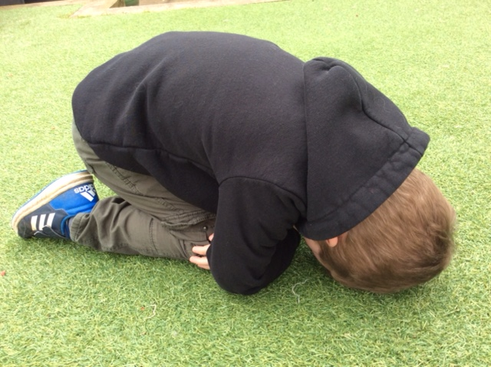
Be a tortoise
Dog Safety KS2

Slide 19
Dog Safety KS2

