Slide 2
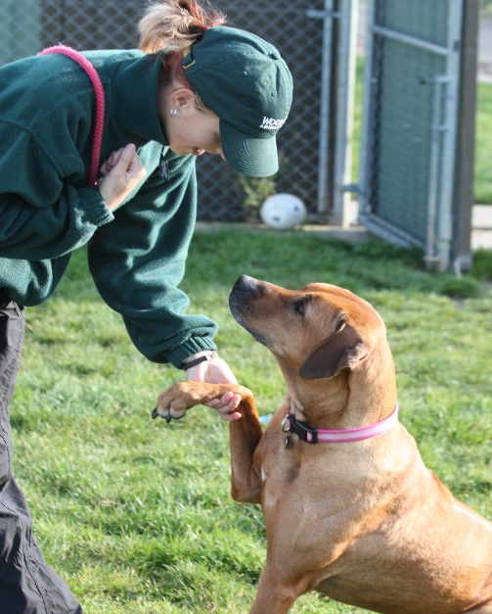
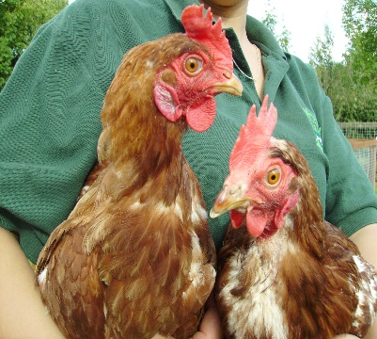
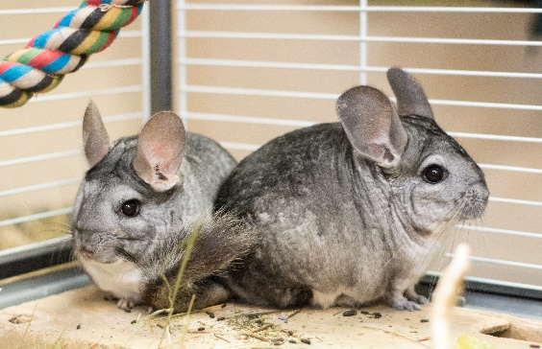
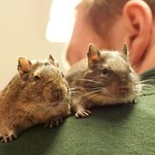
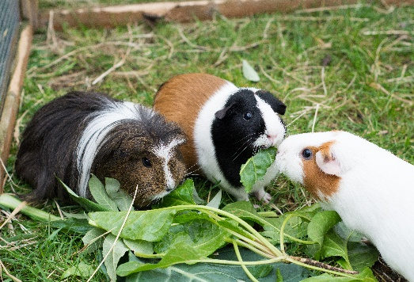
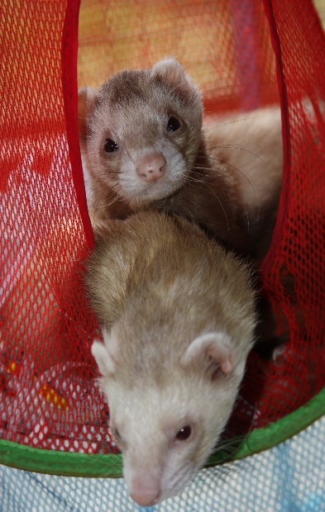
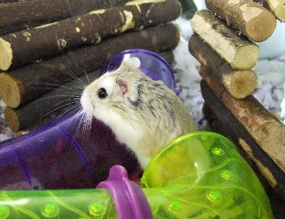
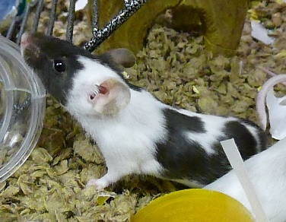
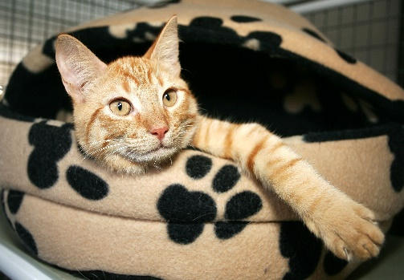
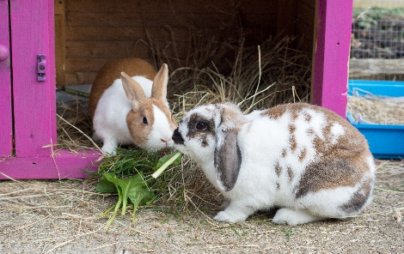
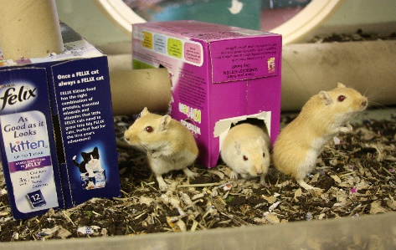
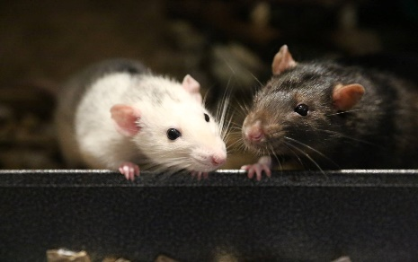
Dog Safety KS1
12 types of animal!

Slide 3
Meet Woody
Dog Safety KS1

Slide 4
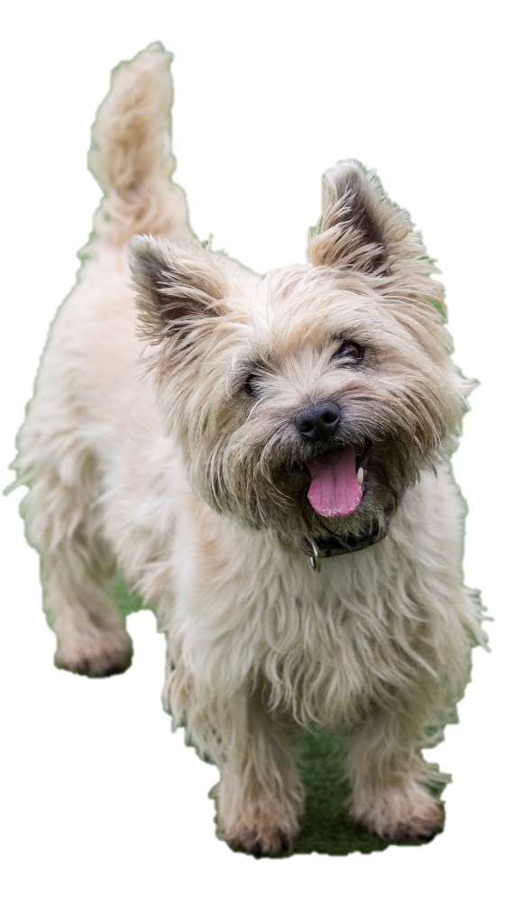
Dog Safety KS1
Dogs like walks
True!
Sit down = FALSE
Stand up = TRUE

Slide 5
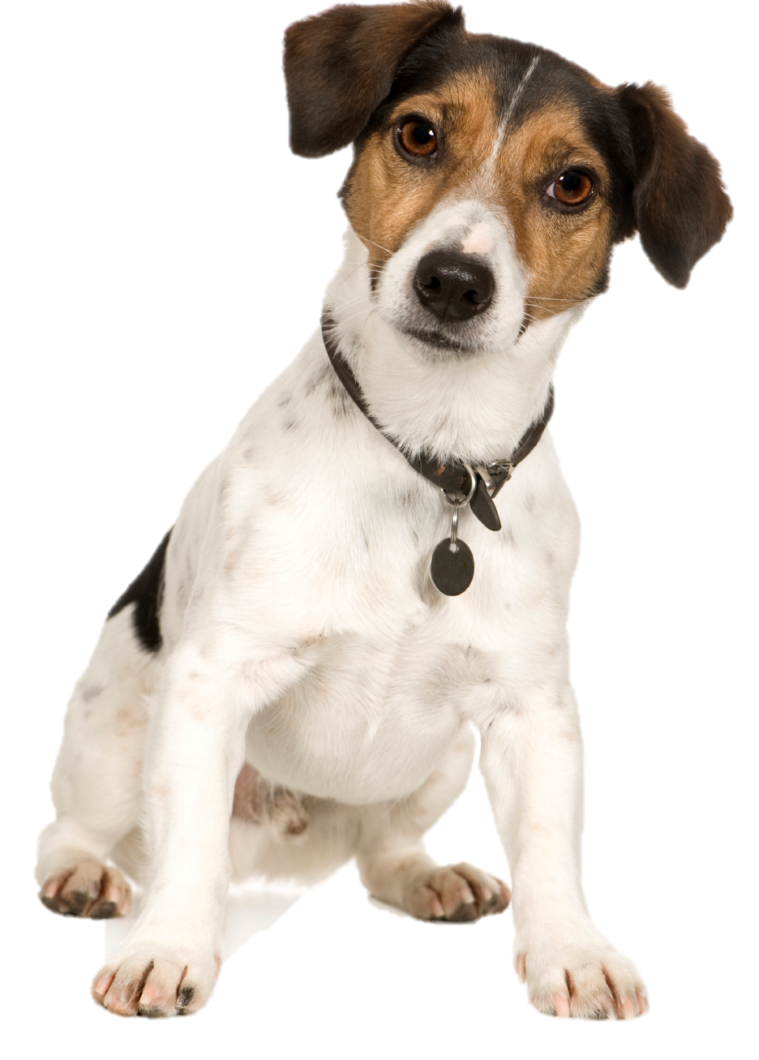
Dog Safety KS1
Dogs like being
picked up
False!
Sit down = FALSE
Stand up = TRUE

Slide 6
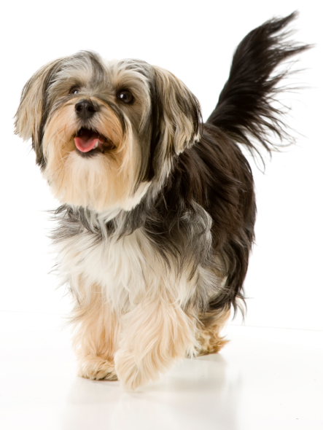
Dog Safety KS1
Dogs like big
kisses and tight cuddles
False!
Sit down = FALSE
Stand up = TRUE

Slide 7
Dog Safety KS1

Slide 8
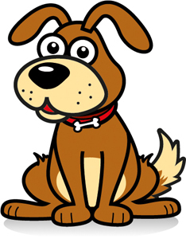
Dog Safety KS1
WHAT WOODY WANTS
Wait for the dog to come to you
Watch for a
Wag

Slide 9
Dog Safety KS1

Slide 10
Sleeping
Dog Safety KS1
Sit down = he would like a play
Stand up = he wouldn’t like a play

Slide 11
Poorly
Dog Safety KS1
Sit down = he would like a play
Stand up = he wouldn’t like a play

Slide 12
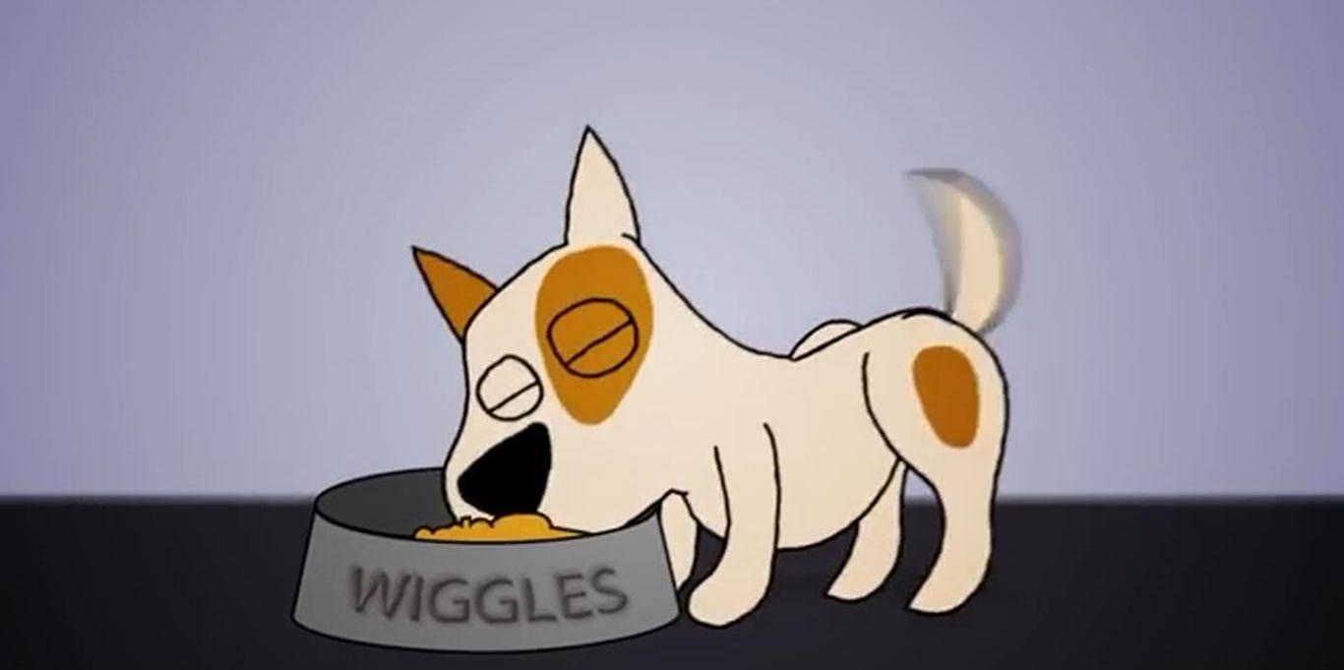
Eating
Dog Safety KS1
Sit down = he would like a play
Stand up = he wouldn’t like a play

Slide 13
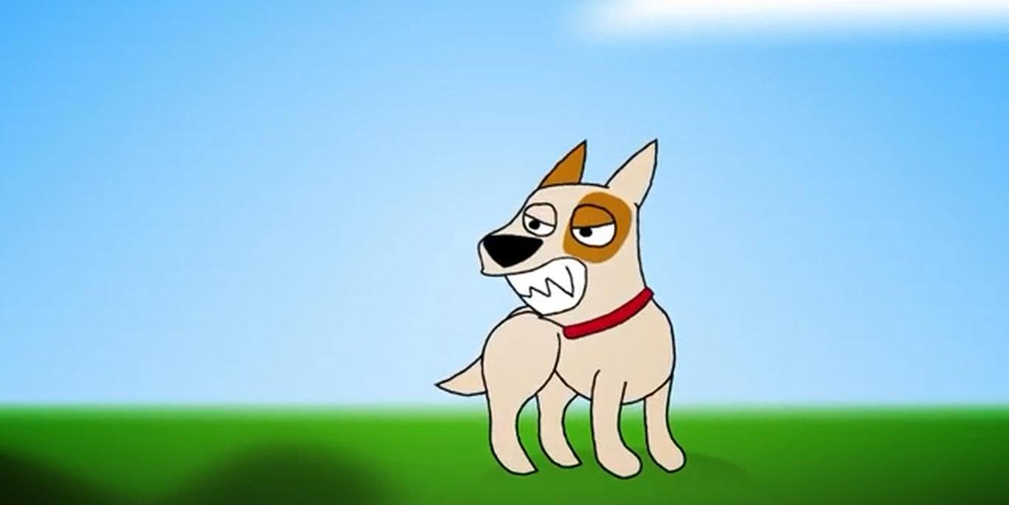
Dog Safety KS1
A growl

Slide 14
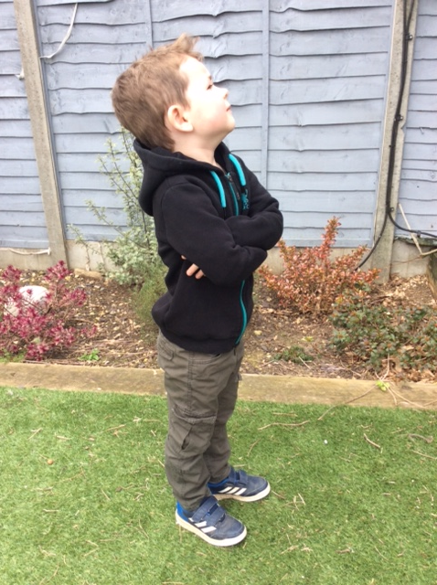
Stand like a statue
Dog Safety KS1

Slide 15
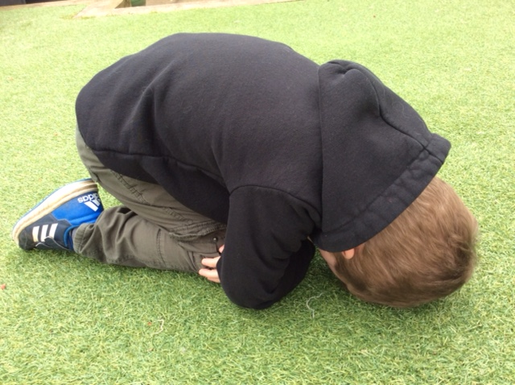
Be a tortoise
Dog Safety KS1

Slide 16
Dog Safety KS1

