Slide 1

Cat
Communication
with
PDSA

Slide 2
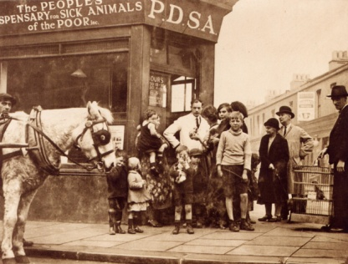

PDSA - The UK’s leading vet charity
PDSA provide free and low cost care to the sick and injured pets of people in need
Our charity is over 100 years old. We’ve been treating sick and injured pets since 1917
We have 48 Pet Hospitals across the UK
It costs more than £1 million every week to do our work
We treat hundreds and thousands of pets every year

Slide 3





1
The 5 Welfare Needs
Home
Exercise & Fun
Health
Food & Water
Friends
Notes:
5WN CAN BE LISTENED TO IN ANY ORDER

Slide 4
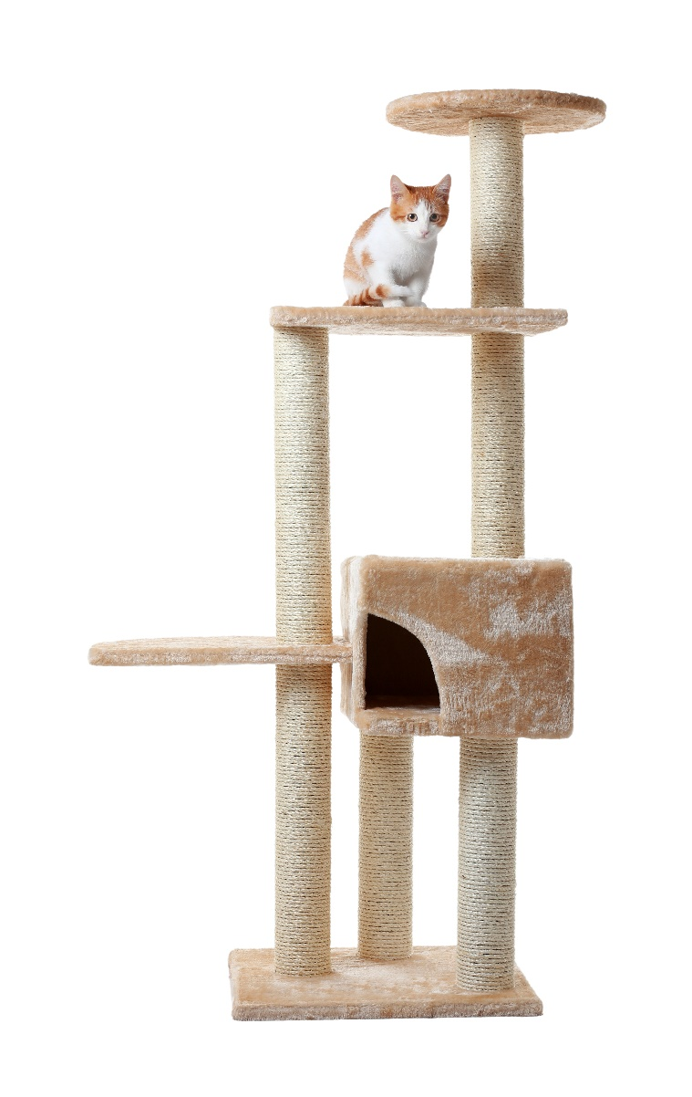
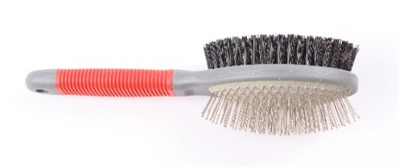
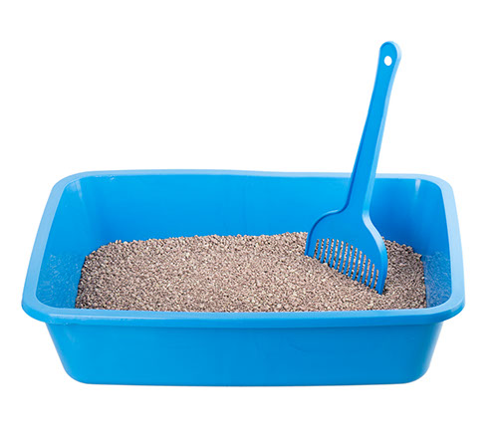
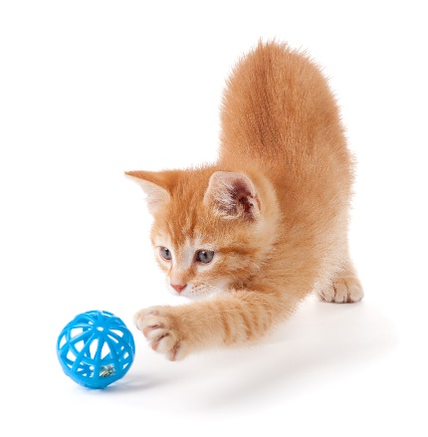

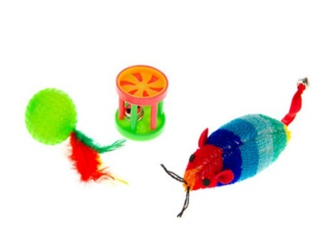
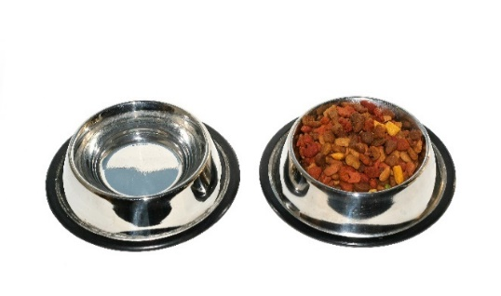
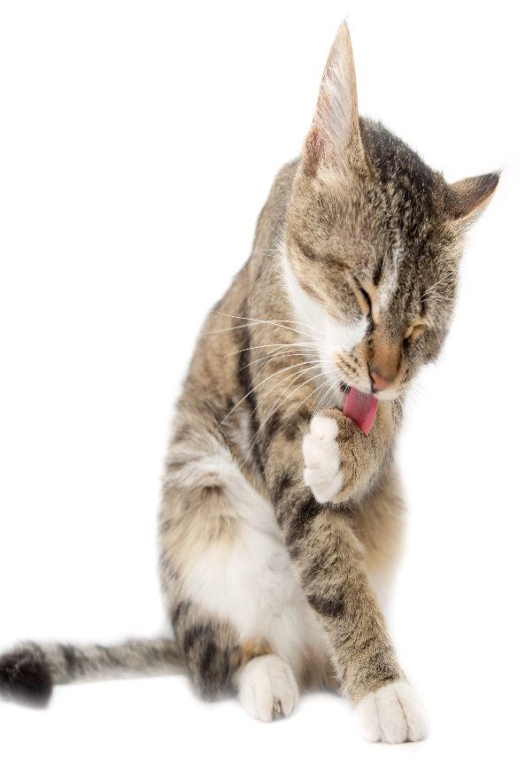
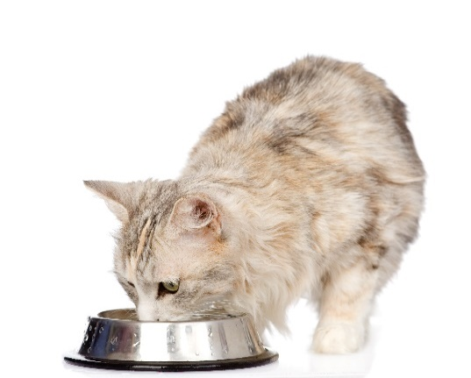
What do cats need?

Slide 5
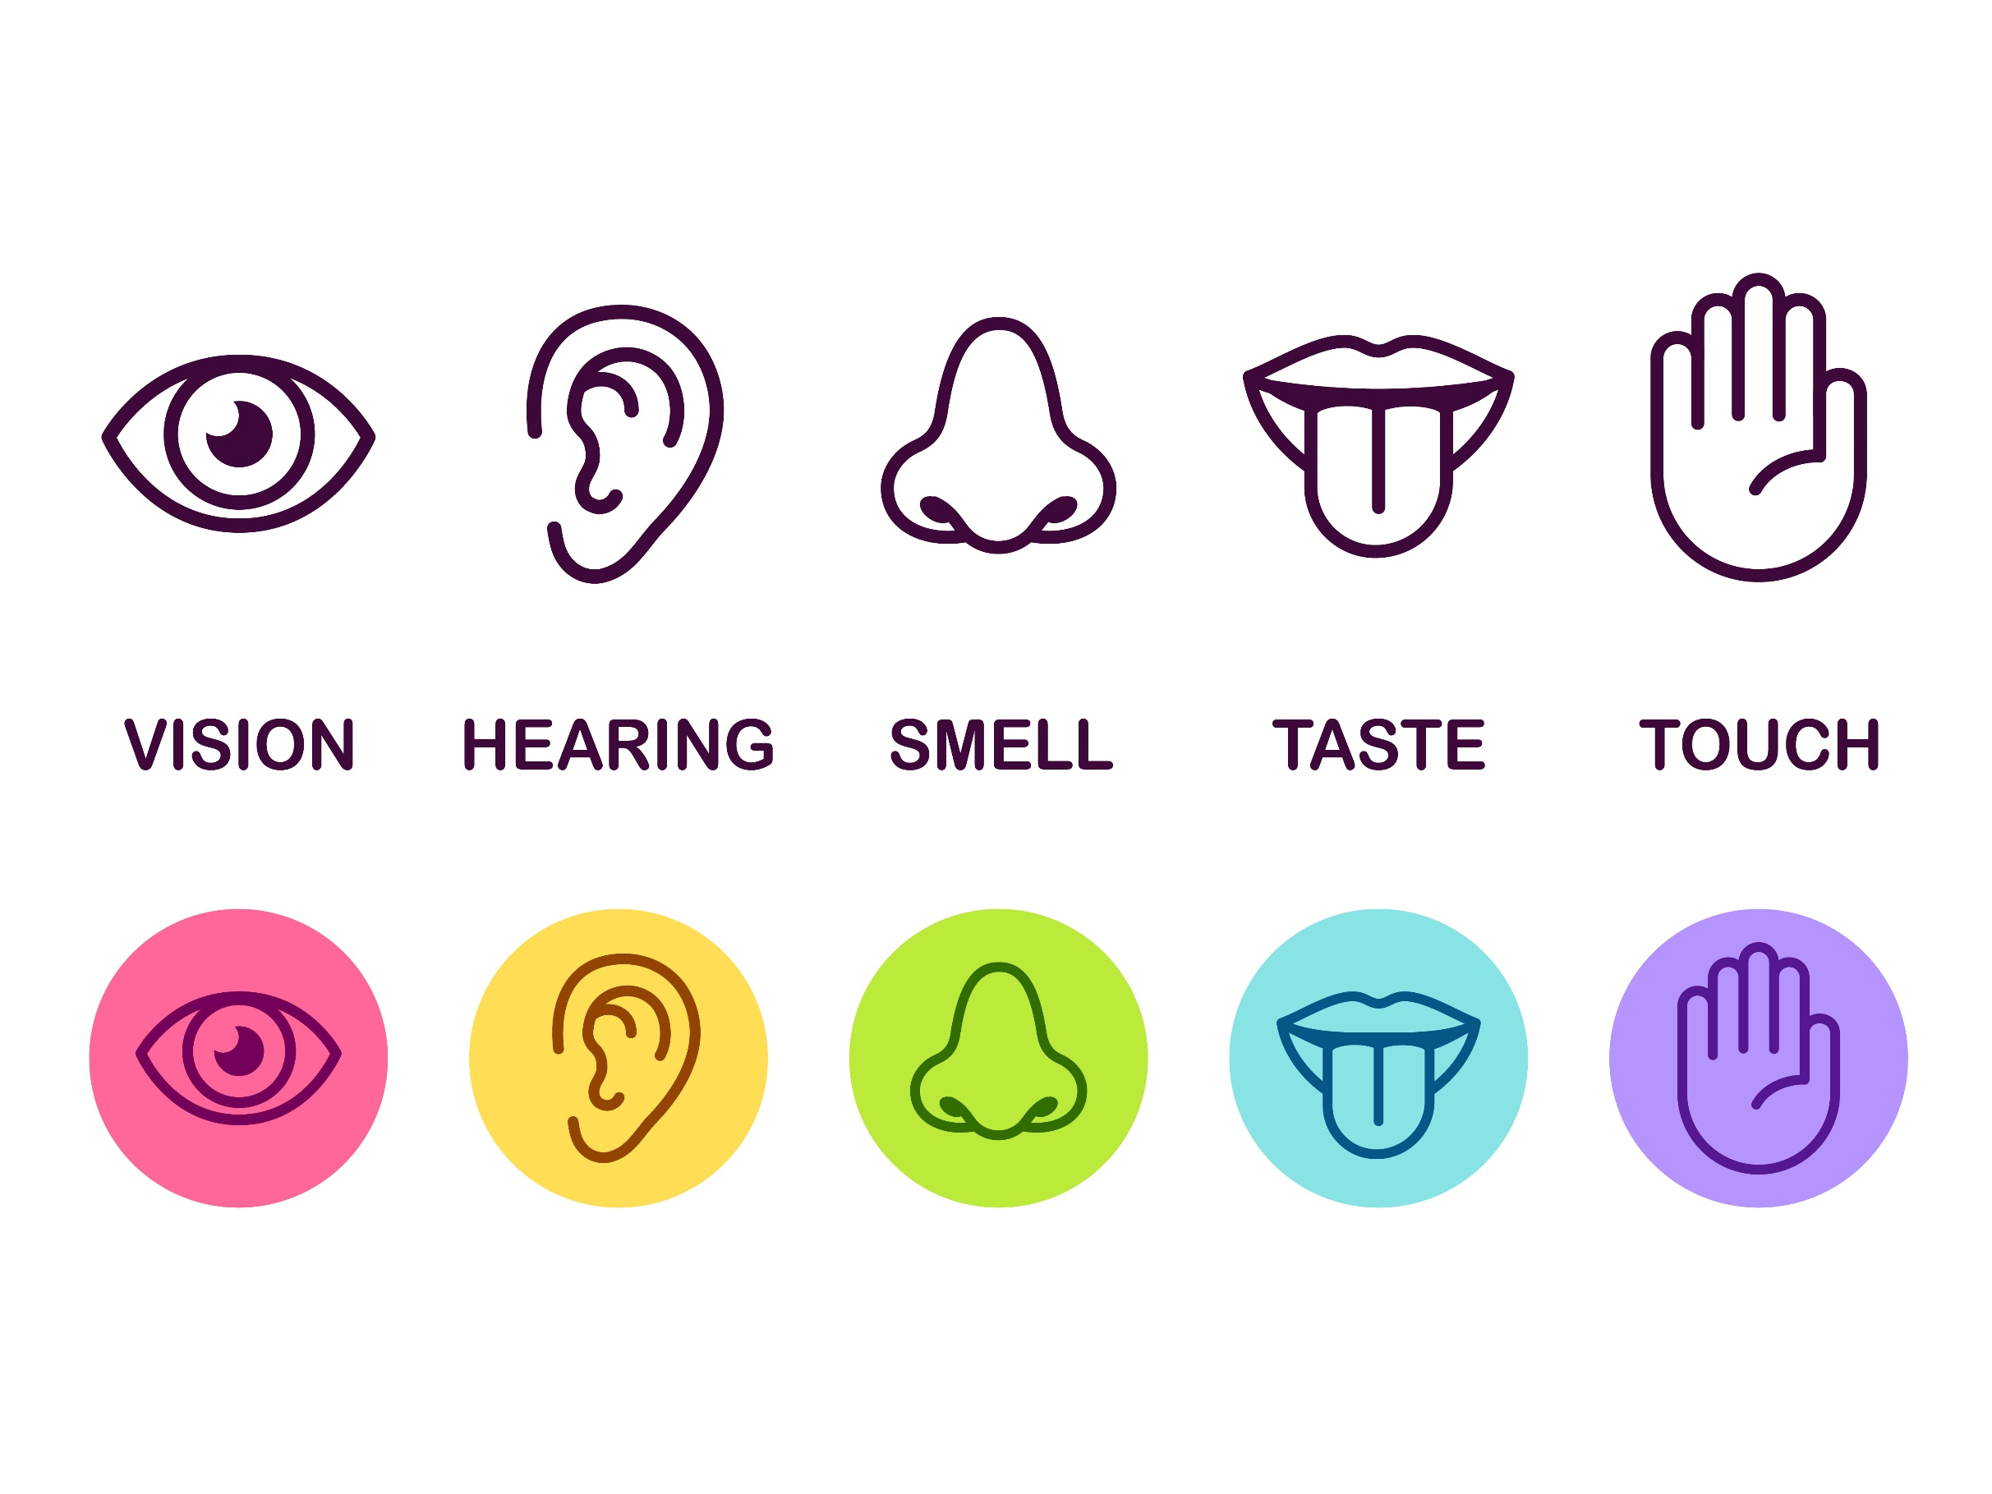
The 5 Senses
Taste
Smell
Touch
Sight
Hearing

Slide 6
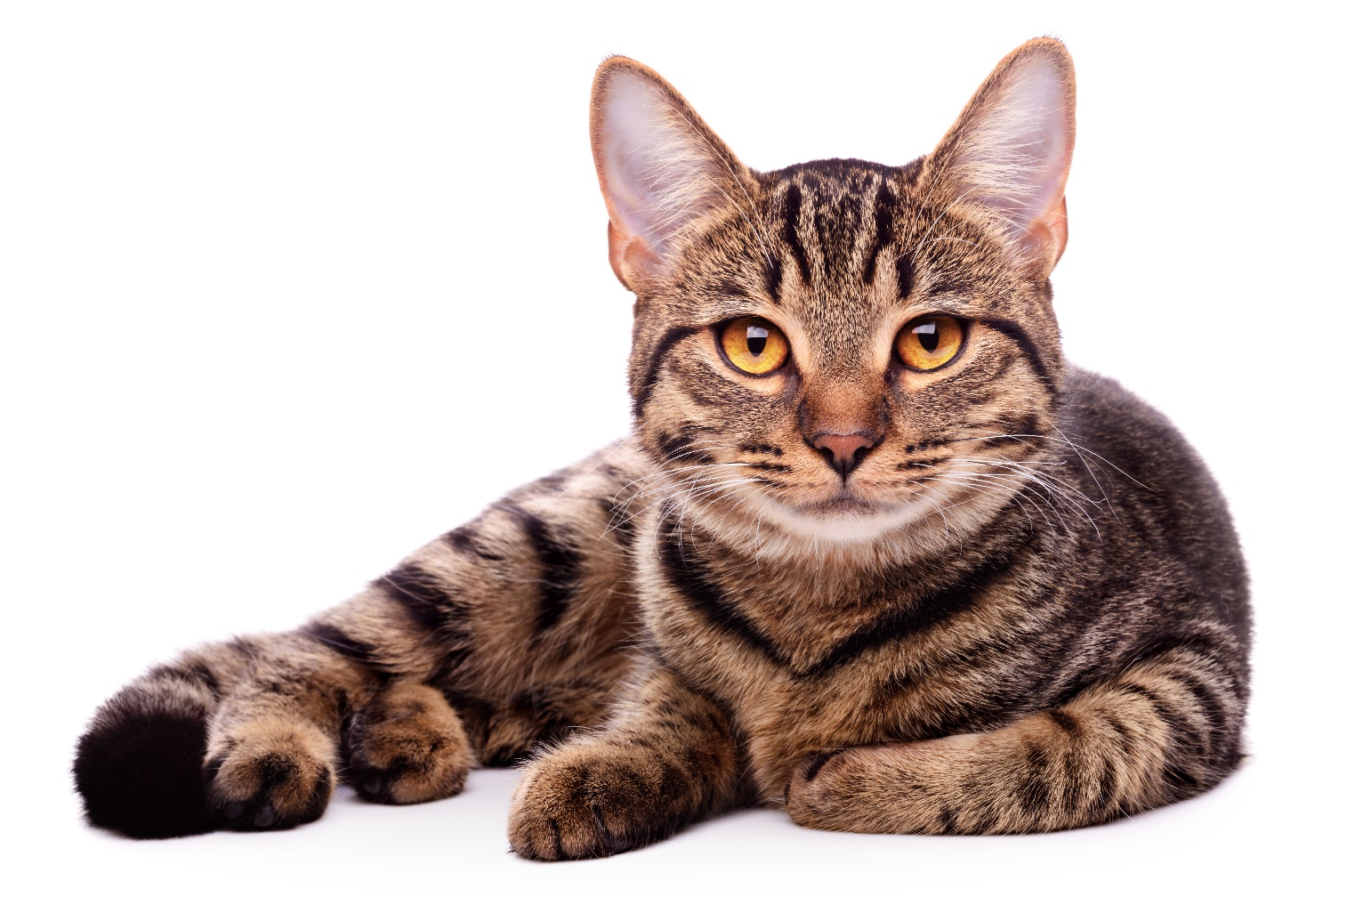
Hearing
Cats and humans have similar hearing when it comes to low-pitched sounds.
Cats can hear high pitched sounds that humans, and even dogs, cannot hear.
Their ears can turn on their own to face where the sound is coming from.
Notes:
Cats and humans have a similar hearing range on the low end of the scale but cats can hear much higher pitched sounds than humans. They can even hear higher sounds than dogs. When listening for something, a cat's ears will swivel in that direction; a cat's ear flaps can independently (one at a time) point backwards as well as forwards and sideways to locate where the sound is coming from.

Slide 7
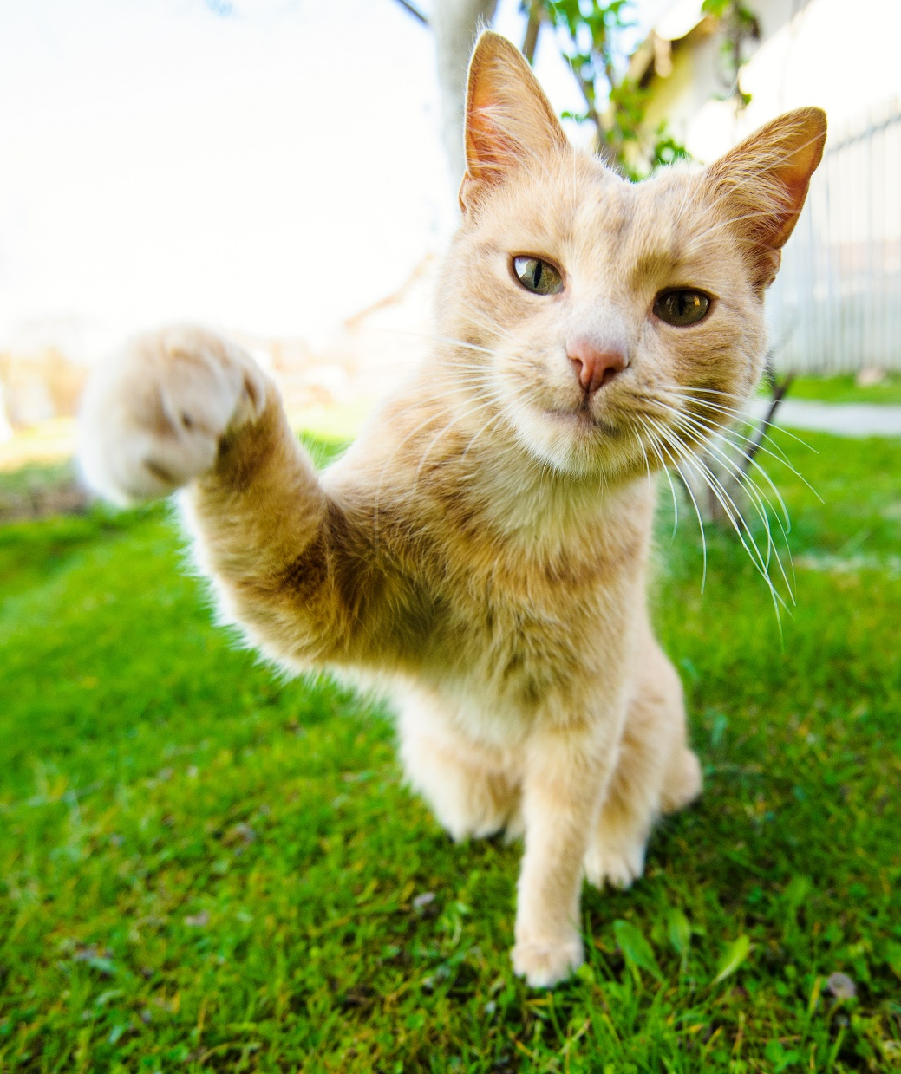
Touch
Cats use their whiskers to touch.
They have whiskers on their upper lip, cheeks, over their eyes, under their chin and on the back of their legs.
Whiskers provide the cat with information about their surroundings.
Notes:
Cats have around 24 moveable whiskers in four sets (on each upper lip on either side of their nose). There are also a few on each cheek, over their eyes, under their chins and on the back of their legs.
Whiskers give a cat detailed information about nearby air movements and any objects they come into contact with. This means they can avoid obstacles without needing to see them.

Slide 8
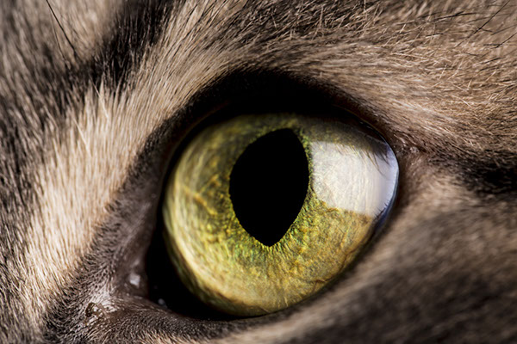
Sight
Cats can see better than humans in the dark.
Their field of vision is wider than ours – they see the bigger picture.
They can see some colours such as red, blue, yellow and green.
They have a third eyelid!
They don’t need to blink.
Notes:
Cats, like dogs, have a reflective layer behind their retina, meaning they can see in the dark better than humans.
Cats have a visual field of 200 degrees – as opposed to 180 degrees in humans.
They can see some colours and can tell the difference between red, blue, yellow and green lights.
Cats have a third eyelid which closes from the side of their eye. You might see this if your cat is feeling ill or tired.
Cats don’t need to blink, unlike humans. This plays an advantage when hunting. They might squint their eyes as a sign of affection though.

Slide 9
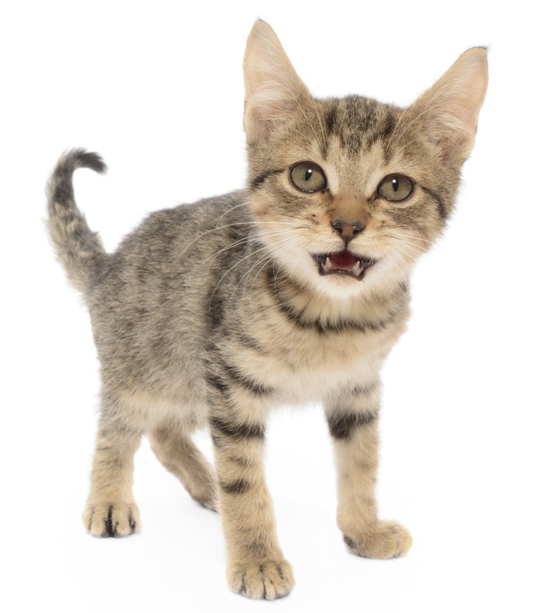
Smell
A cat’s sense of smell is 14 times stronger than a human’s.
They can also smell through their mouths using a special organ called Jacobson’s Organ. When a cat opens their mouth to smell, they’re trying to take in the smell.
Notes:
A domestic cat’s sense of smell is 14 times stronger than humans.
They have a scent organ in the roof of their mouths called Jacobson’s Organ so if you see a cat with their mouth open like this they’re trying to take in the smell.

Slide 10
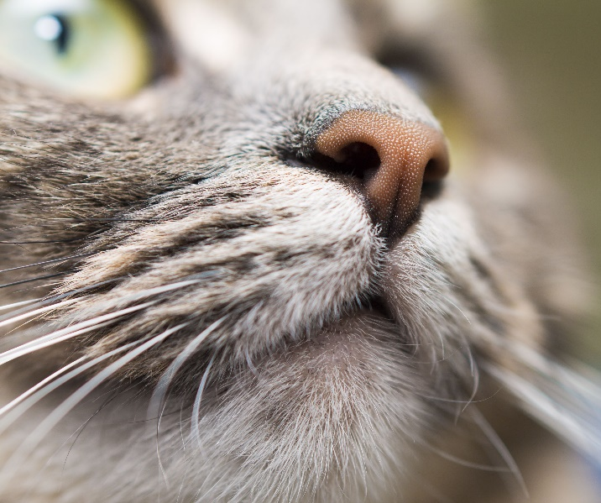
Taste
Cats are carnivores and are driven to consume meat.
They don’t need to eat sugar or carbohydrate so they lack a sweet taste receptor.
Cats are able to detect fat.
They like their food temperature to replicate that of their prey.
Notes:
Cats are obligate carnivores and driven to consume meat. They do not need to eat sugar or carbohydrates (that turn to sugar), thus there is no reason for them to have a taste for it . . . or a sweet tooth, if you will. Essentially, the taste receptors that react to meat and the fats contained therein, are what drive a cat’s appetite.
Many people say they have cats that are attracted to candy, ice cream, pudding, etc. They are sure their cat loves sweets, but it is probably the fat content of the food that they are drawn to. Cats are easily able to detect fat.
The bitter and sour taste sensors are important in that they warn a cat of harmful and/or poisonous foods or objects.
Food temperature is also important to a cat, with preferences usually toward warmer food, approximately 100 degrees Fahrenheit, which simulates the temperature of freshly killed prey. Most cats will reject a cold dish of food just taken from a refrigerator.

Slide 11
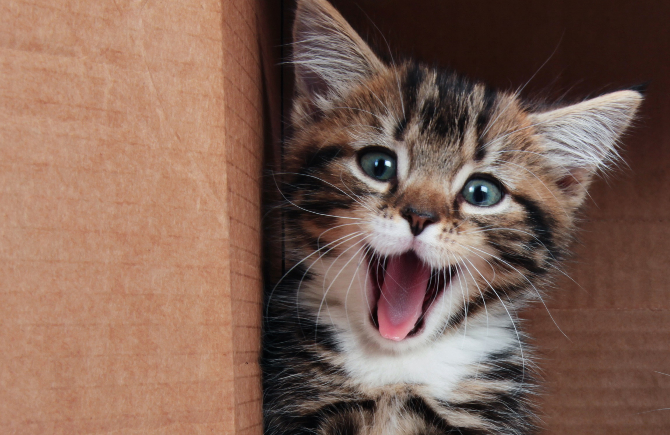
Body language
Notes:
Just like in people, body language can give us a lot of information about how cats may be thinking or feeling. The difficulty with cats is that they are much more complicated and subtle in how they do this which often leads to a misunderstanding on our behalf.
In addition, compared to wolves and dogs, cats have relatively immobile and flat faces which somewhat limits facial expressions. This can often lead to people assuming that they’re less affectionate than dogs and can mean that their faces are much harder to read than dogs.

Slide 12
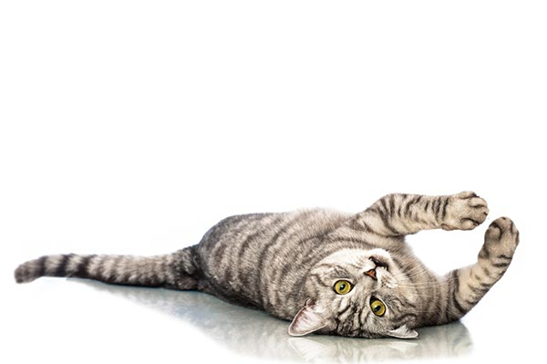
What we look for…
Ears
Tail
Posture
Vocalisation
Notes:
Cats haven’t developed the facial expressions to the extent of the dog so their communication signs are very different
Best indicators – ears, tail, posture, vocalisation
Ask if they want to learn how to recognise what cats are trying to say

Slide 13
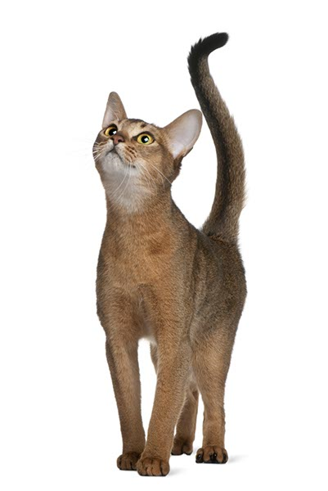
Happy
Tail
Up
Ears
Facing forward
Eyes
Slow blinking
Posture
Relaxed, may arch back, flat fur
‘Life’s great’
Notes:
Signs of a happy cat…
Sitting relaxed and upright
Ears pointed up and forward, but relaxed
Lying down with their paws tucked neatly underneath them
Stretched out on their side or back, with legs spread outwards
Snoozing with their eyes closed or half open –like they’re daydreaming
Relaxed whiskers
Still tail – or held high with a slight curl if they’re standing to say hello to you
If you stroke your cat, their eyes may close and they will gently purr
‘Kneading’
Rubbing against you

Slide 14
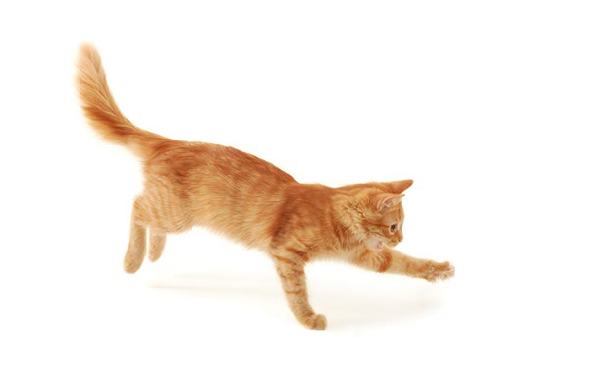
Playtime
Tail
Up, fur flat
Ears
Forward, straight
Eyes
Focused
Posture
Relaxed, can be arched, fur flat
‘Wanna see my skills?’
Notes:
When cats play it’s their way of acting out their normal hunting/predatory behaviour so will often play with their claws exposed – so watch your exposed skin, they’ll also bite at they ‘catch their prey’ so make sure you have suitable toys to hand to channel these natural behaviours

Slide 15
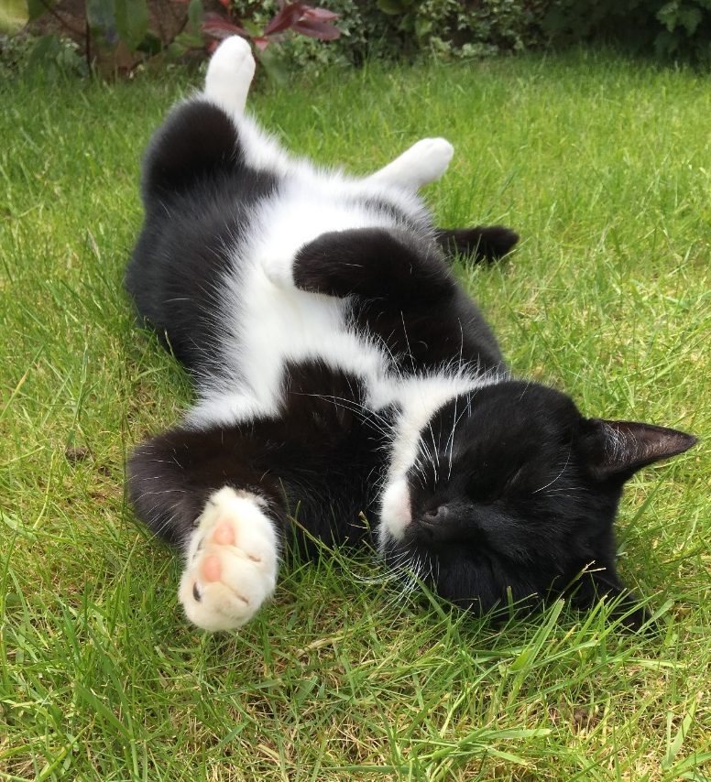
Chillaxin’
Tail
Up or down, relaxed, flat fur
Ears
Facing forward or rotated to side slightly
Eyes
Slow blinking or closed
Posture
Relaxed, may expose tummy, loose limbs
Vocalisation
Purring
‘No worries…’

Slide 16
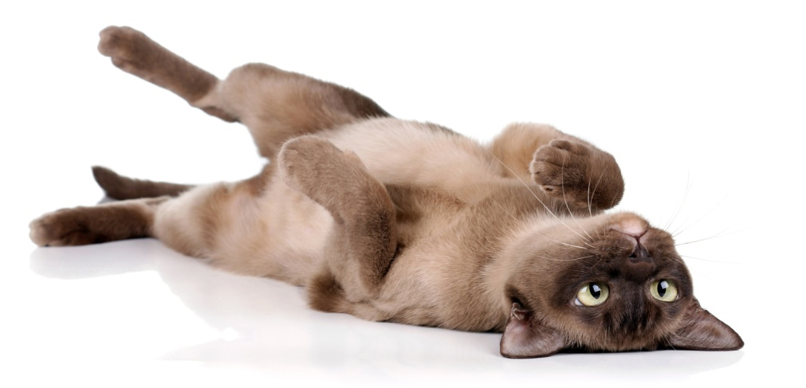
Misconceptions
Notes:
Has anyone ever experienced a cat rolling on its side, showing its belly?
This is another greeting behaviour but can often be misinterpreted as them wanting a belly rub and often will result in the cat wrapping its paws around your arm or even biting. What the cat is doing is showing that its relaxed and at ease in your presence and rubbing its belly is almost an abuse of that trust. The best thing to do here is to give it a nice head rub.

Slide 17
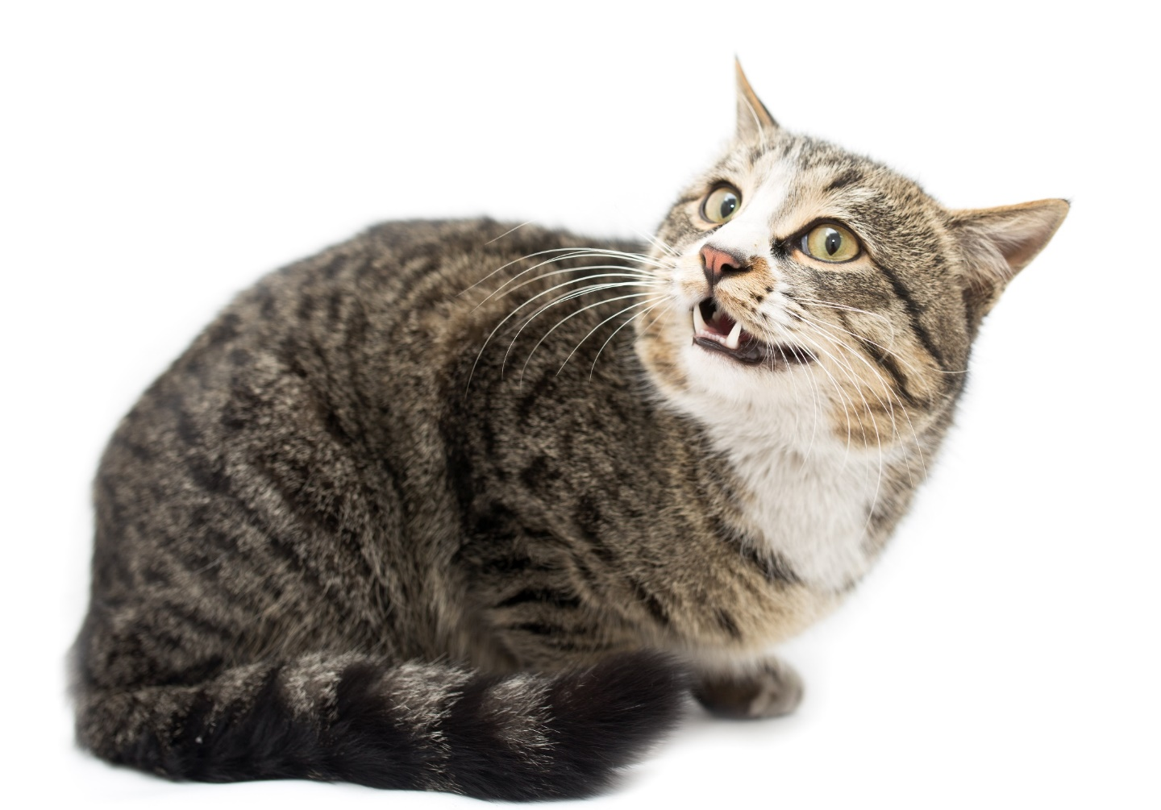
Anxious
Tail
Still or moving slowly from side to side
Ears
Scanning for more information or flat
Eyes
Open, not blinking
Posture
Low head, cowering or arched back
‘I’m feeling anxious’
Notes:
Cats can be very sensitive, especially to change. It can take some time for them to settle after unexpected changes, so learning to read the symptoms of anxious cat behaviour can help you to help your cat get back to a relaxed state. The sooner you recognise the cat body language signs, the sooner you can offer a stroke when they approach you for reassurance and some attention Cats can take anywhere from a few days to a few weeks to get used to big changes, become accustomed to them and to return to normal.
Some cats cope much better with change than others, but all cats will become anxious with changes such as:
A house move
The introduction of another pet into the household
A new baby or strangers in the household
Noise and disruption
Signs of anxious cat behaviour
Your cat's eyes will be open and not blinking, with pupils dilated into an oval or circle.
Their ears might move from their relaxed forward position to scan for more information, swivelling around independently from each other. If they are very anxious, their ears may even flatten back to their head.
Their head will begin to lower, with whiskers pulled back to the side to appear small and non-threatening – or even be swept forward on alert.
As anxiety increases, your cat might start to cower, or their back might arch to prepare to run.
Cat tail language is very important – it might be still or moving slowly side to side at the tip, which is a sign of anxiety.

Slide 18
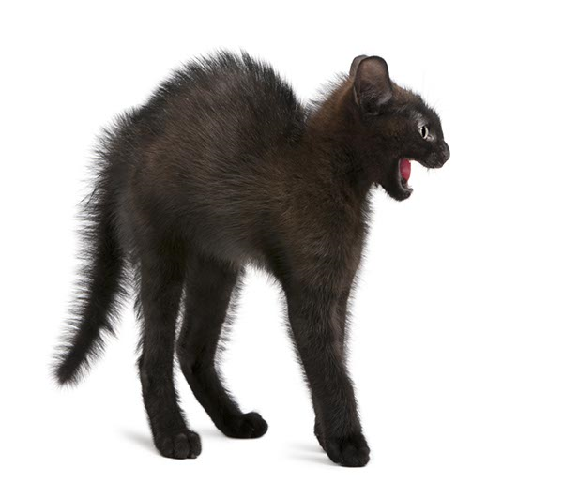
Scared
Tail
Trashing back & forth
Ears
Flat, back or outward (airplane ears)
Eyes
Pupils dilated
Posture
Arched back, fur standing on end
Vocalisation
Hissing
‘Erm, back off…please’
Notes:
Anxious cat behaviour might be subtle, but when your cat is afraid, it should be easier to spot – if they’re scared by something such as loud noises, your cat won’t be reassured by a stroke and it’s likely that even their favourite treat might not do the trick. Their body language is telling you that they’re frightened, and it will only return to normal when they feel safe. Try not to move quickly to try and comfort them, as you could be seen as another threat. Instead, remove anything that could be causing their fear if you can, and wait for them to calm down. Giving them access to safe places to hide, especially high up, is really important in reducing their fear – allow them as much hiding time as they need and don’t try to rush them. They will come round in their own time.
Signs of fearful cat behaviour
Your cat’s ears will be flattened back against their head, which might be lowered with their gaze angled upwards.
They may run away, or stand or crouch very still if this isn’t possible.
Their eyes will be open very wide, with pupils fully dilated and whiskers flattened or bristling.
They may hiss or spit at close threats, growl or strike with claws out.
Some cats will straighten their front legs to make themselves look taller, or arch their backs and fluff themselves up to look bigger.
Their tail may be held under their body, or be slashing vigorously from side to side.

Slide 19
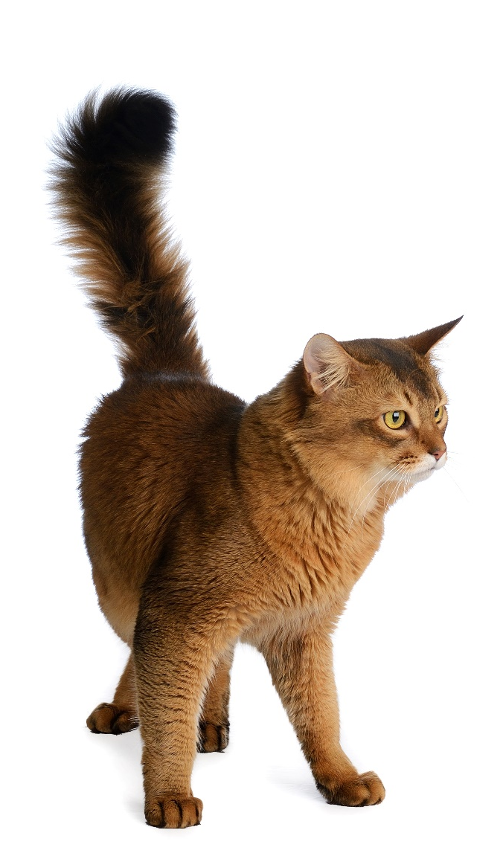
Tail
Thrashing back & forth
Ears
Flat, back or outward (airplane ears)
Eyes
Pupils dilated, staring
Posture
Stiff, poised, fur standing on end
Vocalisation
Hissing, spitting, yowling
Angry
‘You have been warned!’
Notes:
Signs of an angry cat…
Rigid body
Tail held out stiff and straight or curled around and under their body.
Acting differently to usual
Silent, hissing, spitting or growling
Trying to look big
Crouching in a threatening way
Tense ears and flat back against their head
Stiff whiskers, held away from their face
Focused eyes with narrow pupils or round, unblinking eyes

Slide 20
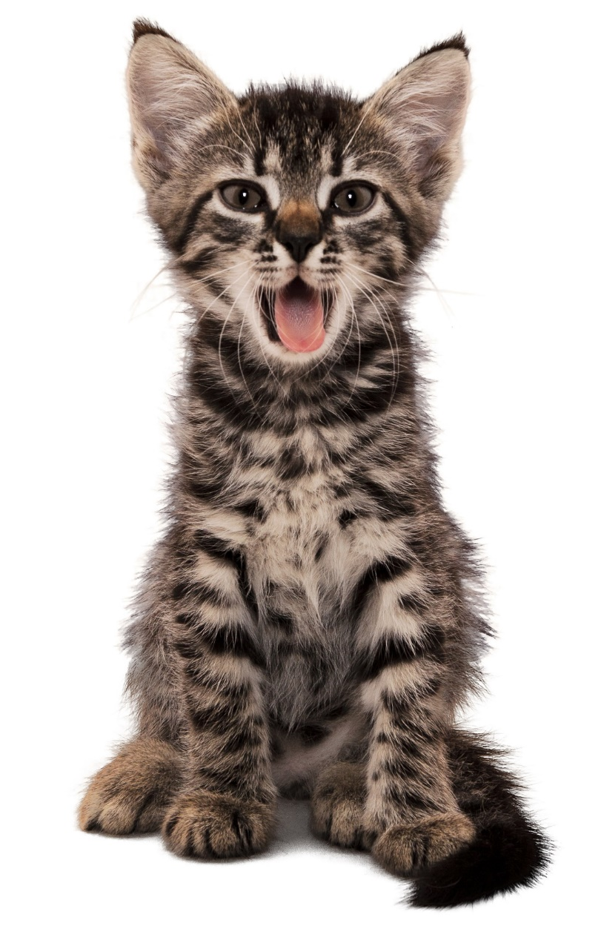
Cat vocals
Meow
Purring
Chirps & Trills
Growling, hissing, spitting
Yowl or howl
Chattering/twittering
Notes:
Smooth Talking
Cats can make around a hundred different sounds.
The Cat Phrase Guide:
Meow – This can mean a number of things, such as: ‘Hello. How are you?’, ‘More food now’, ‘Touch me at your own risk’ or ‘Here’s your mouse’.
Chirp – Follow me.
Purr – I’m happy / I feel sick/ I’m in pain
Growling, hissing or spitting – Leave me alone!
Howl – I’m in distress, help me/I’m having a fight with the cat next door
Chattering – I’ve seen something I want to eat but it’s outside

Slide 21
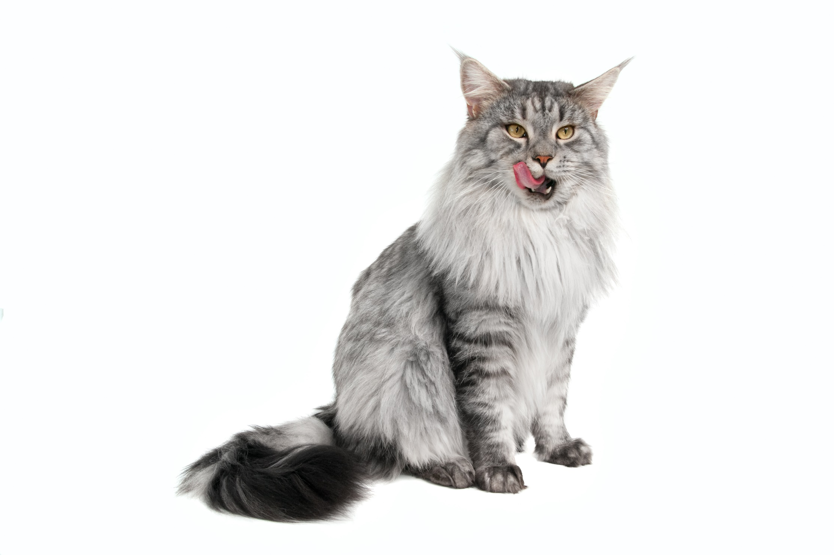
Misconceptions
Notes:
Another behaviour that can have a number of meanings is lip licking. Cats will often do this just after eating, but also as a sign that they are stressed or feeling sick. In addition, cats will only ‘pant’ if they’re very stressed.

Slide 22
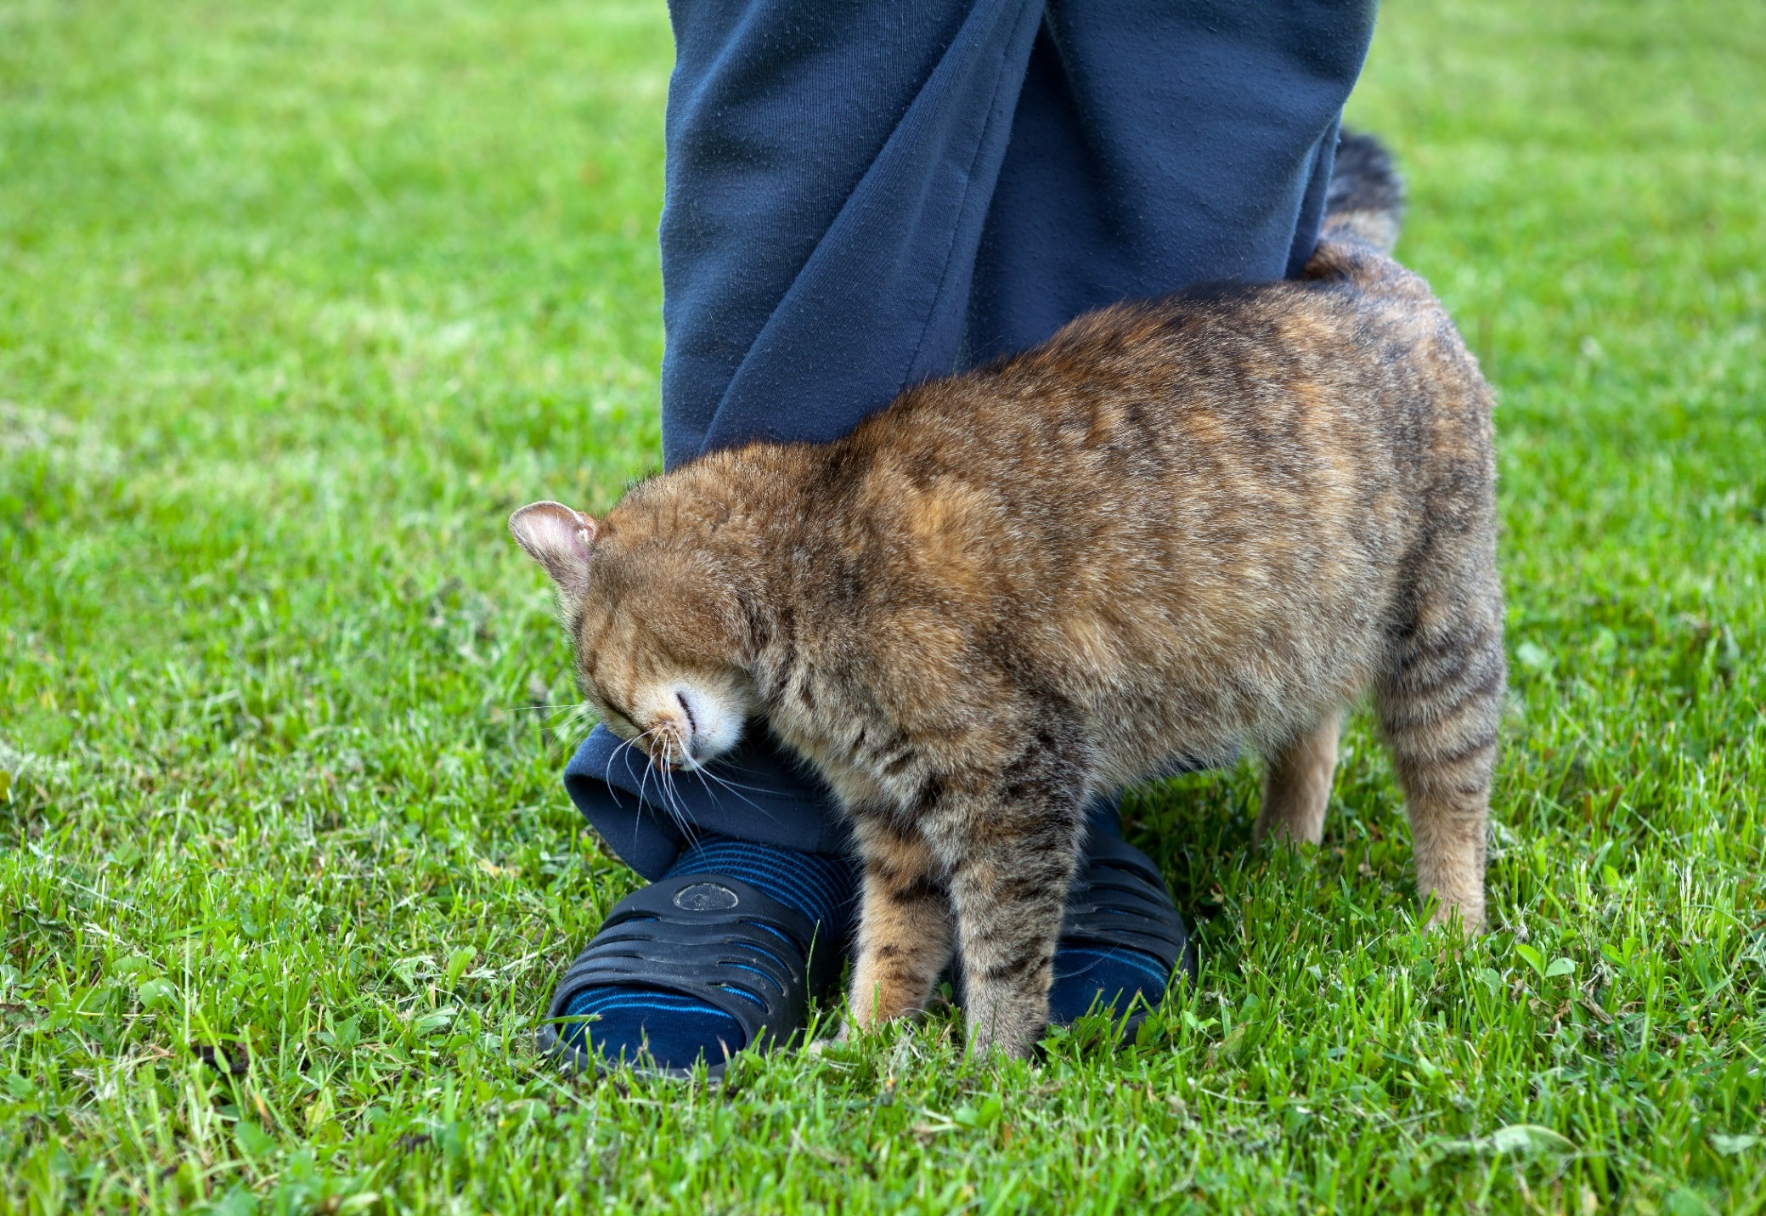
Scent-marking
Notes:
When we see cats rubbing around ourselves or objects in their environment, why are they doing this?
They are actually doing is depositing scent using their cheeks, foreheads and sides of body. A common time we see this is when we arrive home and this may be because we smell a bit different after being out or perhaps when there is some new furniture in the home they are simply trying to make us smell a bit more familiar. It also may be an attempt for your cat to show other cats that you belong to them!

Slide 23
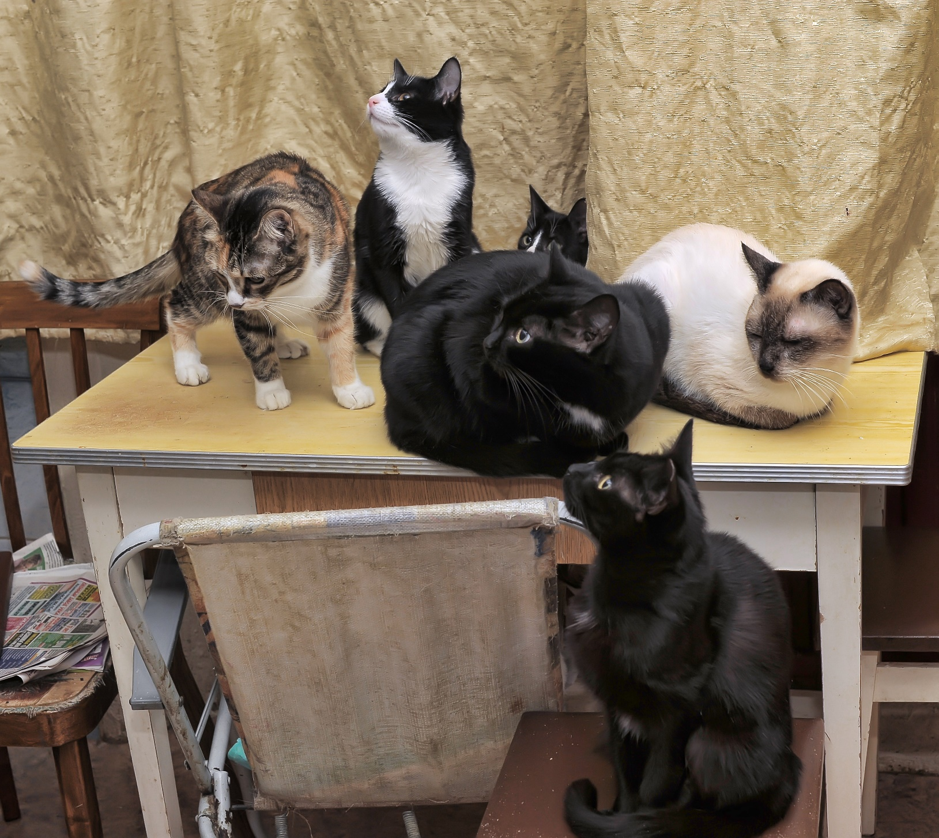
Multi-cat households
Notes:
Tips for keeping the peace:
Have enough resources for one each plus a spare - Cats don’t share important resources. These resources include everything a cat may need to survive and thrive, ie, food bowls, water bowls, litter trays, beds, high resting places, private areas, scratching posts, entry/exit points and toys.
Create plenty of space for the cats so they can get away from each other when they want to be alone. If you have plenty of snuggle spots, your cats won’t need to fight for the bed.
When you have two, three, four, or more cats in your home, things can get complicated. But by giving your cats plenty of space, resources, and love, you can keep the peace in your multi-cat household.

Slide 24


PDSA Animal Awards Programme
PDSA
Dickin Medal
PDSA
Order of Merit
PDSA Gold Medal
Notes:
Our founder, Maria Dickin, believed very passionately in raising the status of animals in society – one of the ways she did this was through our animal awards programme.
We have 3 awards:
PDSA Dickin medal
PDSA Gold Medal
PDSA Order of Merit

Slide 25
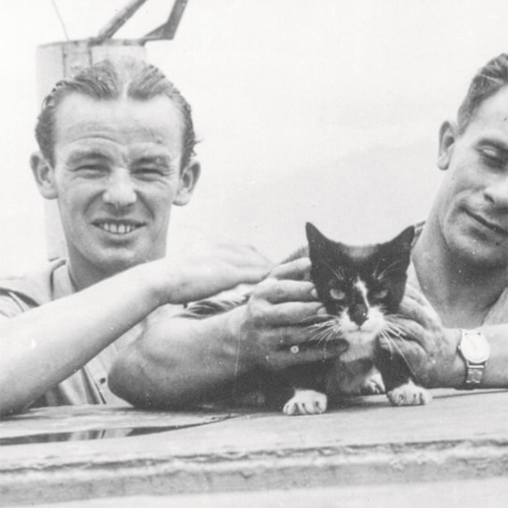
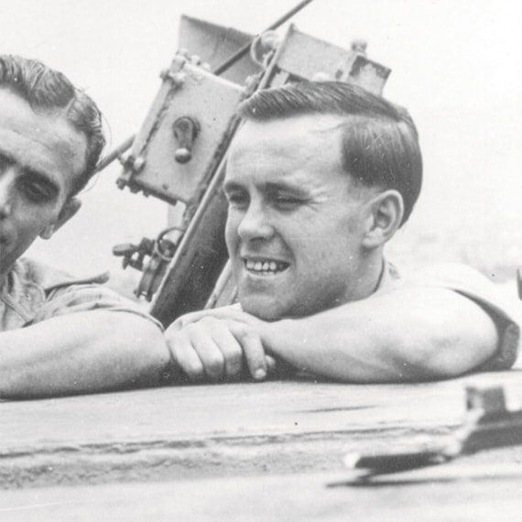
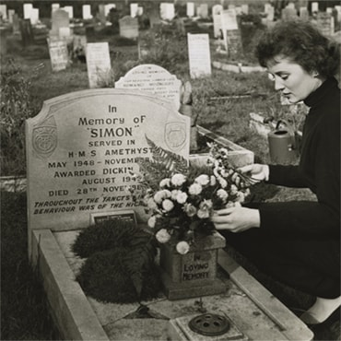

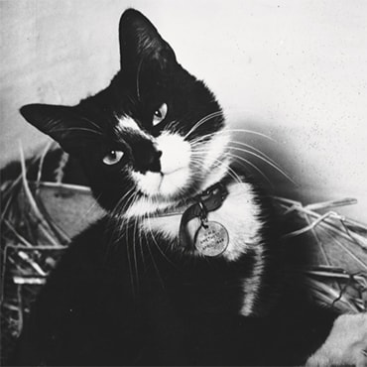
Simon - DM 54
Notes:
Simon is the only cat to have been awarded the Dickin Medal.
He was the Captain’s cat on board HMS Amethyst during the Yangtse Incident (Chinese Civil War) in 1949. He, like many of the crew, was injured when the ship came under attack. The ship was stranded mid-river for almost 10 weeks. Hot and humid conditions created a perfect breeding ground for rats. After licking his wounds, Simon set about controlling the rat population on board the ship to protect the essential food supplies. These were very big rats and had even attacked some of the crew!
As well as protecting the food supply, Simon also helped to boost morale on board the ship.
He was awarded the DM in 1949. When Simon died he was buried at our Pet Cemetery in Ilford – where many DM recipients have been laid to rest. Every year on Remembrance Day a member of the Navy comes to lay a wreath for Simon, on his grave.
PDSA Dickin Medal for Simon the cat – PDSA

Slide 26
Thank you for listening!
Any questions?
Email:
education@pdsa.org.uk

