Slide 1
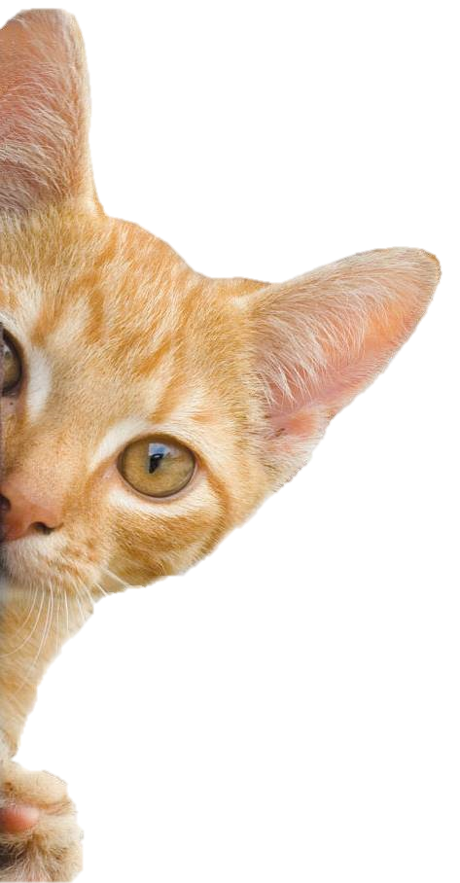
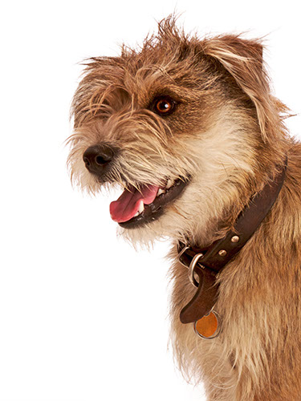
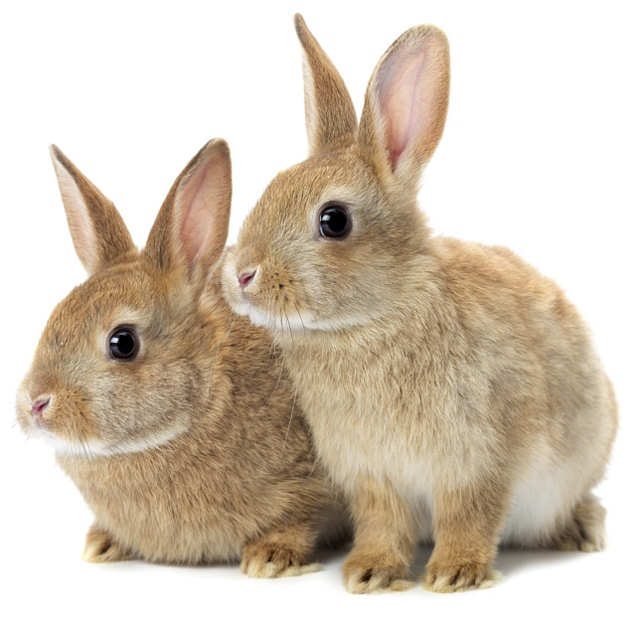
Are you Alive?
Notes:
Share:
Introduce the session and PDSA.
Tell children that PDSA treat the sick and injured pets of people in need...
Explain that PDSA is a special kind of vets, because they’re a charity. Discuss what a charity is and explain that PDSA looks after pets when owners can’t afford vet treatment.
Ask:
If they think it’s important to help sick and injured animals to get better?
What would happen to all the sick and injured pets PDSA treat if they weren’t around?
Share:
Tell them that today, you’re all going to learn about what pets need to be healthy and happy and also about some of the pets that PDSA has helped in their Pet Hospitals.

Slide 2
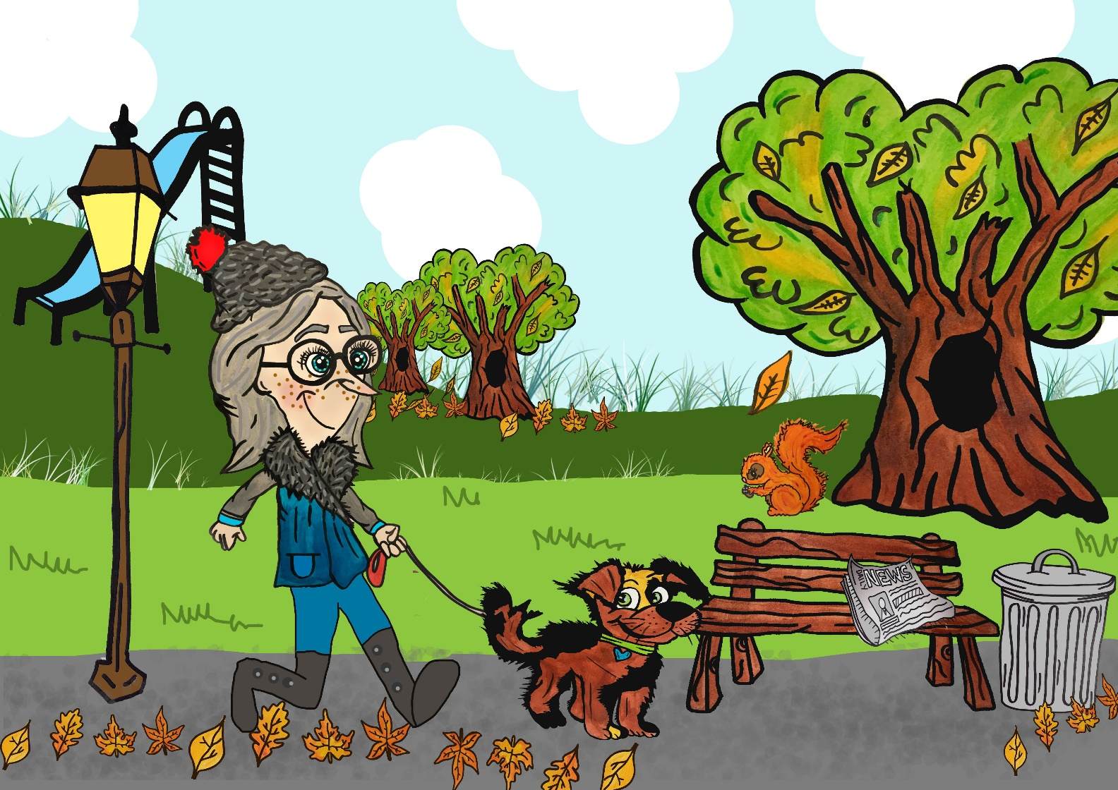
Can you find all the items that are:
alive
dead?
Notes:
Share:
Introduce the session and PDSA.
Tell children that PDSA treat the sick and injured pets of people in need...
Explain that PDSA is a special kind of vets, because they’re a charity. Discuss what a charity is and explain that PDSA looks after pets when owners can’t afford vet treatment.
Ask:
If they think it’s important to help sick and injured animals to get better?
What would happen to all the sick and injured pets PDSA treat if they weren’t around?
Share:
Tell them that today, you’re all going to learn about what pets need to be healthy and happy and also about some of the pets that PDSA has helped in their Pet Hospitals.

Slide 3
Learning Objectives
I will understand that animals, including humans, are alive.
I will be able to sort living and non-living objects into categories.
Learning Outcomes
P
I can explain how I know that a human or animal is alive.
I can sort objects into groups and explain my choices.
I can identify dead objects that were once alive and use a Venn diagram.

Slide 4
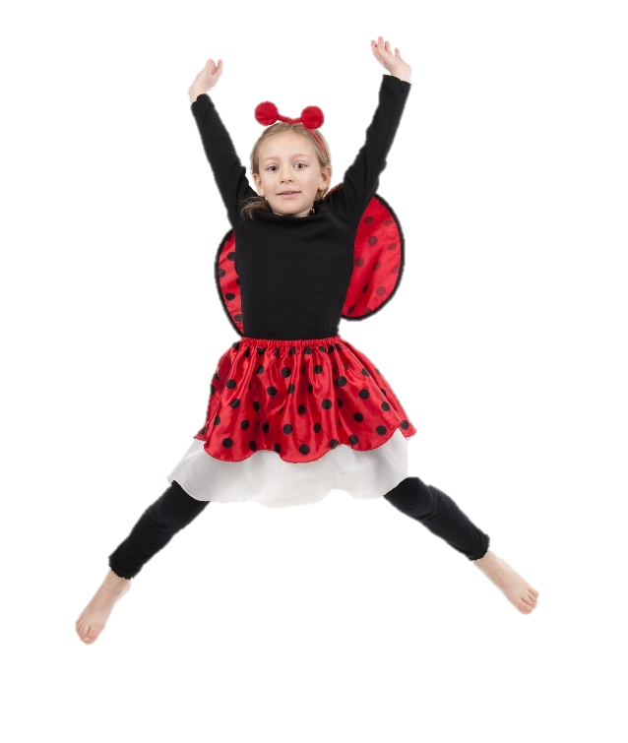
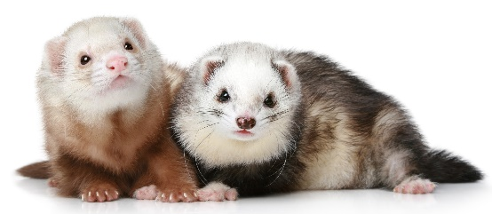
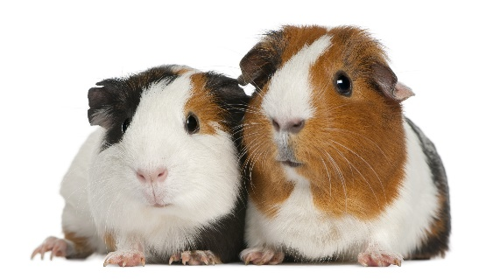
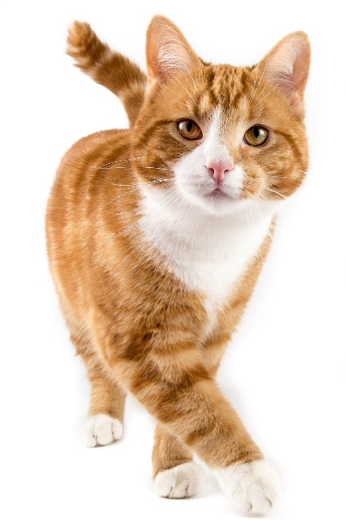
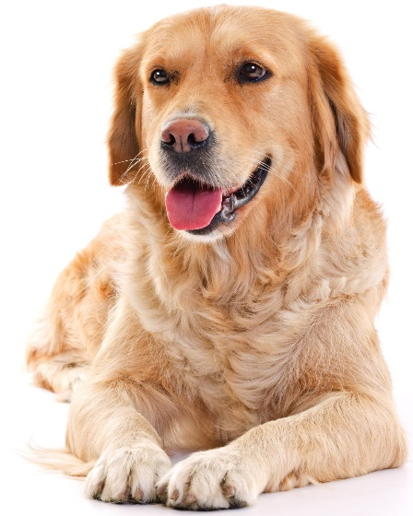
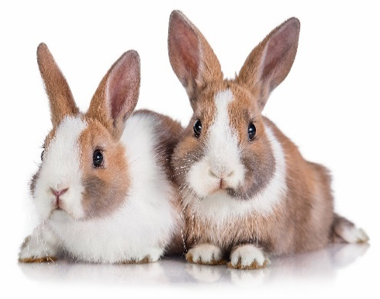
Animals and people are living things

Slide 5
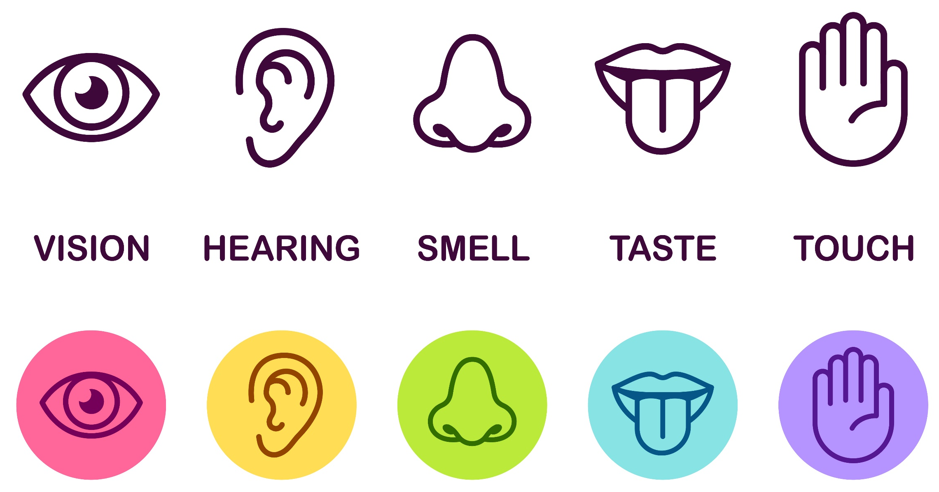
The Senses
Notes:
Discuss human senses

Slide 6
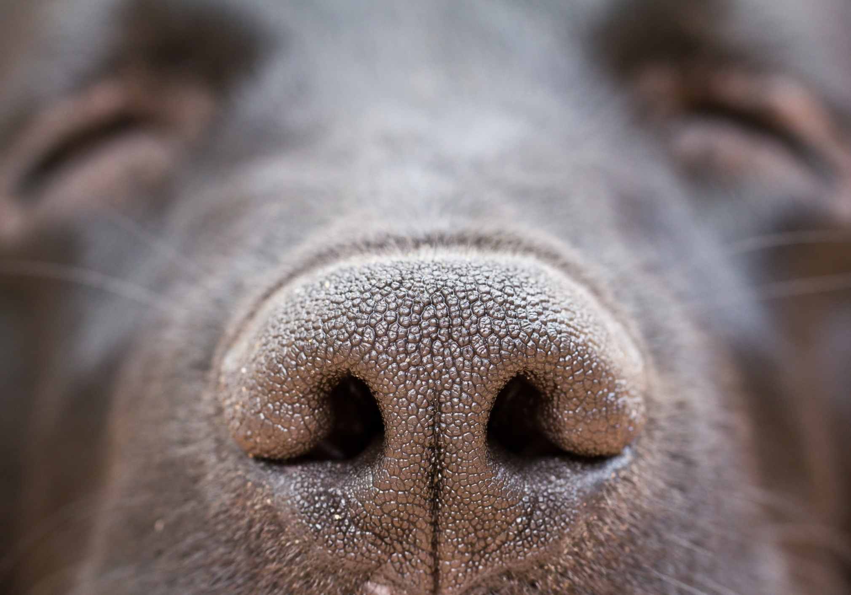
Notes:
Ask children to sniff the person next to them and tell you:
What they had for breakfast
What mood they’re in
Where they’ve been today
Explain that dogs can tell all these things about you just by smelling – they can even tell if we’re poorly!
Explain that dogs have senses that are very different to ours. People and dogs have the same three senses – sight, hearing and smelling. People normally communicate by hearing, seeing, then smelling. How do you think dogs communicate? They normally communicate through smelling, seeing and lastly hearing. Let’s take a look at their senses and show just how special dogs really are...
Dogs use their nose and their sense of smell to work out what’s going on in the world – and it really is amazing! Did you know that the part of the brain that controls smell is 40 times larger in dogs than in humans! A dog’s sense of smell is up to 10 million times more sensitive than a human’s. Ever wondered why your dog’s nose is wet? The mucus on a dog’s nose actually helps it’s sense of smell by capturing scent particles!
Did you know - dogs can smell week-old human fingerprints and detect scents up to 40 feet underground, just two examples of their incredible smelling abilities.
When a dog smells something they don’t just get a smell, they get a story. They can even smell pheromones – something people can’t smell – and from pheromones they can tell lots about another dog or a person, like if they’re male or female, what they ate, where they’ve been, what they’ve touched and what kind of mood they’re in! Dogs have even been know to smell cancer on people, alerting them and saving their lives. So if you see a dog sniffing a person, or a tree in the park, they’re not just sniffing something really interesting – they’re reading a story. Dogs can even move their nostrils one at a time – can you do this? This means that they can tell which direction a smell is coming from!

Slide 7
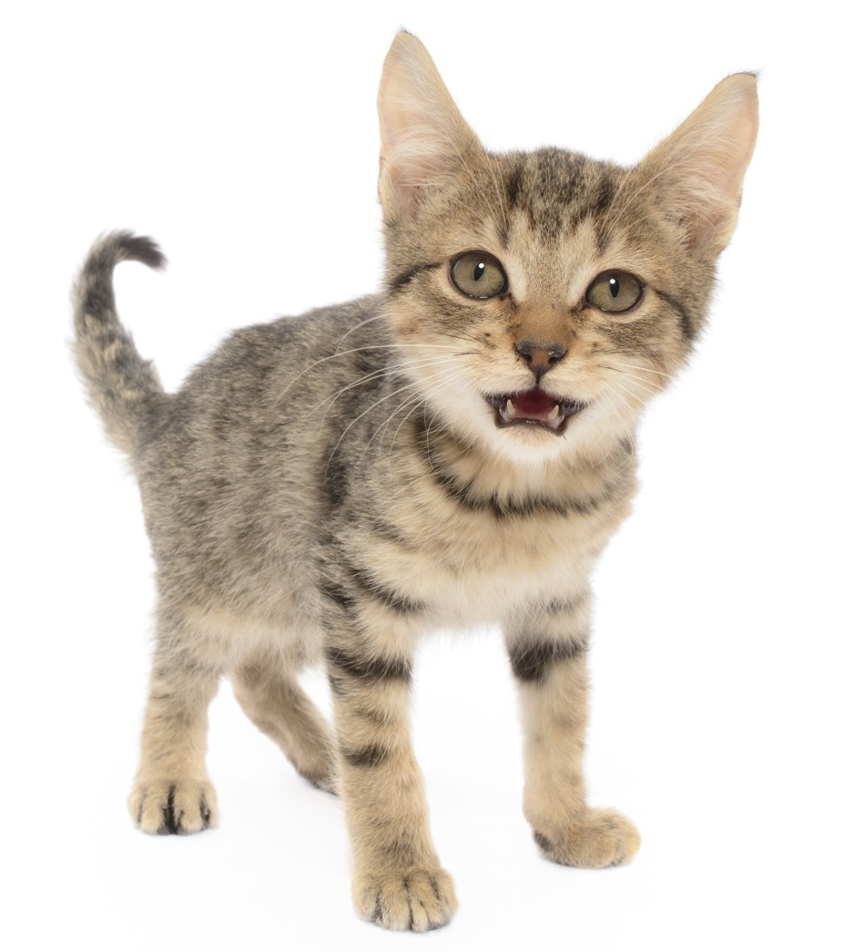
A cat’s sense of smell is 14 times stronger than a human’s.
They can also smell through their mouths using a special organ called Jacobson’s Organ. When a cat opens their mouth to smell, they’re trying to take in the smell.
Smell
Notes:
A domestic cat’s sense of smell is 14 times stronger than humans.
They have a scent organ in the roof of their mouths called Jacobson’s Organ so if you see a cat with their mouth open like this they’re trying to take in the smell.

Slide 8
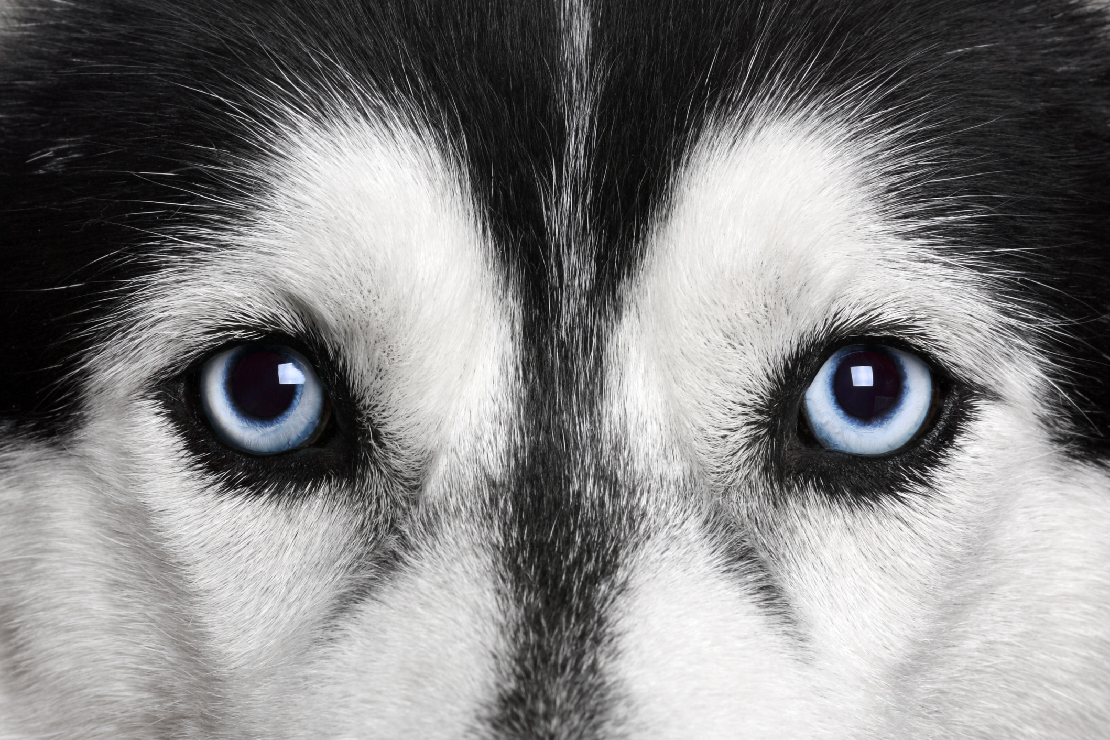
Notes:
Dogs can see better than us when it’s getting dark – their low-light vision is much better than a humans. They find it easier to recognise something if it’s moving rather than still. They can perceive direction, speed and may even be able to recognize an animal or human by their pattern of movement.
Dogs aren’t colour blind, as many people think they are, but they can only see in shades of blue and yellow.

Slide 9
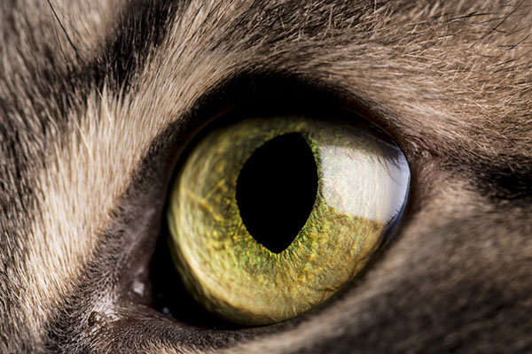
Cats can see better than humans in the dark.
Their field of vision is wider than ours – they see the bigger picture.
They can see some colours such as red, blue, yellow and green.
They have a third eyelid!
They don’t need to blink.
Sight
Notes:
Cats, like dogs, have a reflective layer behind their retina, meaning they can see in the dark better than humans.
Cats have a visual field of 200 degrees – as opposed to 180 degrees in humans.
They can see some colours and can tell the difference between red, blue, yellow and green lights.
Cats have a third eyelid which closes from the side of their eye. You might see this if your cat is feeling ill or tired.
Cats don’t need to blink, unlike humans. This plays an advantage when hunting. They might squint their eyes as a sign of affection though.

Slide 10
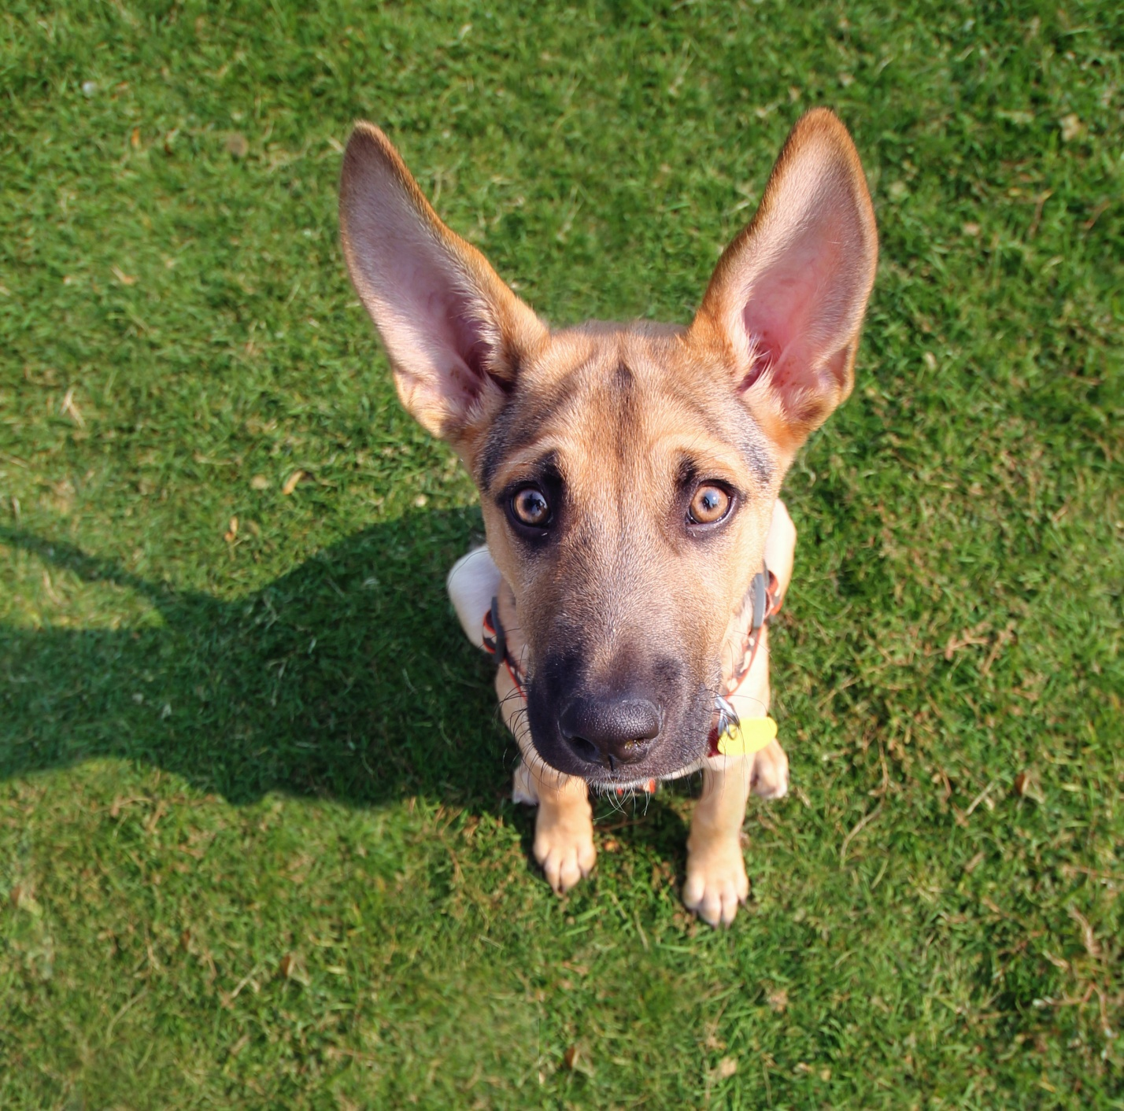
Hearing
Notes:
Dogs can hear sounds from 4 times further away than people. Have you ever noticed how your dog pricks up it’s ears a long time before you hear anything if someone comes to the door? They can also hear higher pitched sounds that we can’t hear. Dogs often bark at things like vacuum cleaners because they hear a very loud, annoying pitch coming from the motor that we can’t hear. So there’s no need to shout at your dog, they can hear you really well, even if you whisper.
Dogs have a lot of muscles in their ears, meaning they can move them around – you may see a dog swivel it’s ears towards a sound. We have fewer muscles in our ears and can hardly move them at all. Check with the class if anyone is able to move their ears.
Aren’t dogs amazing?!

Slide 11
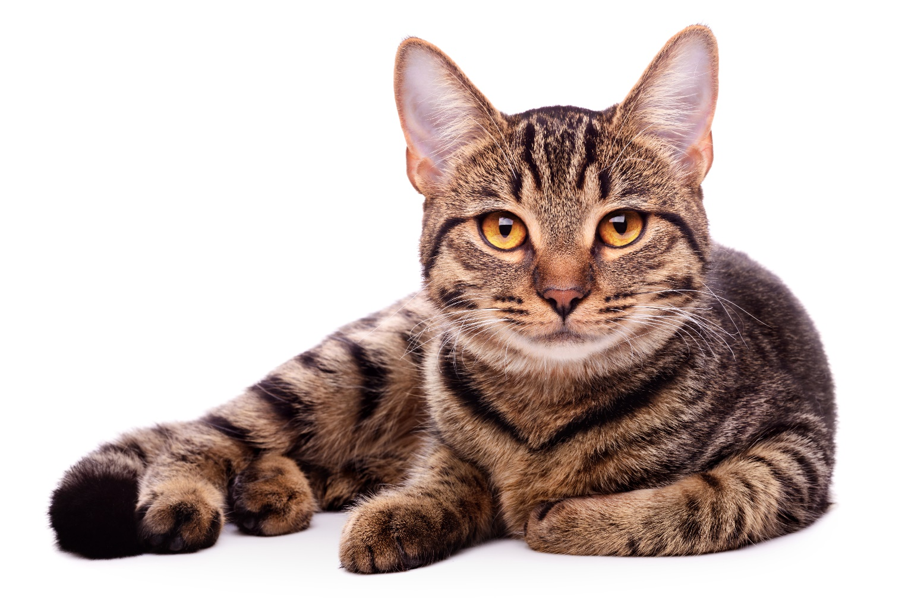
Cats and humans have similar hearing when it comes to low-pitched sounds.
Cats can hear high pitched sounds that humans, and even dogs, cannot hear.
Their ears can turn on their own to face where the sound is coming from.
Hearing
Notes:
Cats and humans have a similar hearing range on the low end of the scale but cats can hear much higher pitched sounds than humans. They can even hear higher sounds than dogs. When listening for something, a cat's ears will swivel in that direction; a cat's ear flaps can independently (one at a time) point backwards as well as forwards and sideways to locate where the sound is coming from.

Slide 12
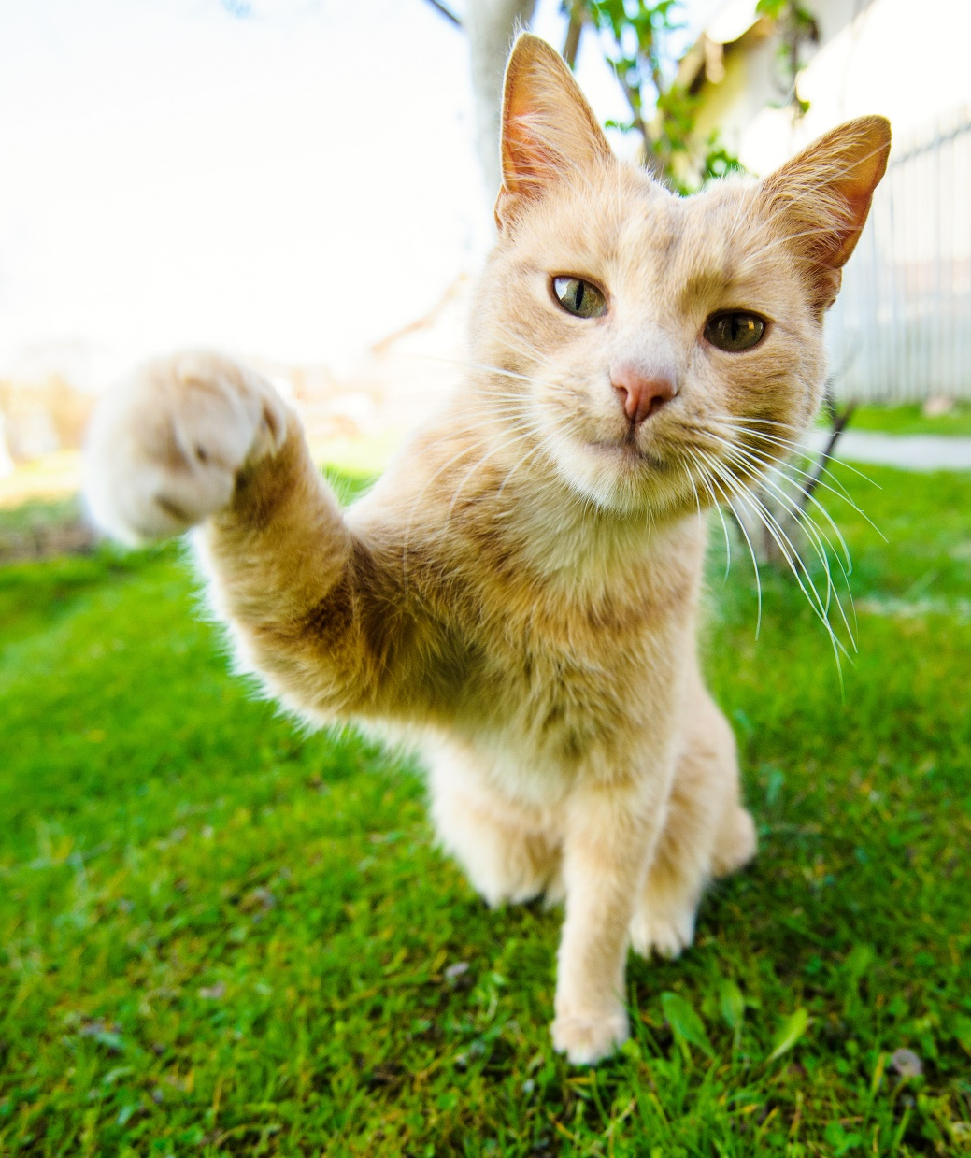
Cats use their whiskers to touch.
They have whiskers on their upper lip, cheeks, over their eyes, under their chin and on the back of their legs.
Whiskers provide the cat with information about their surroundings.
Touch
Notes:
Cats have around 24 moveable whiskers in four sets (on each upper lip on either side of their nose). There are also a few on each cheek, over their eyes, under their chins and on the back of their legs.
Whiskers give a cat detailed information about nearby air movements and any objects they come into contact with. This means they can avoid obstacles without needing to see them.

Slide 13
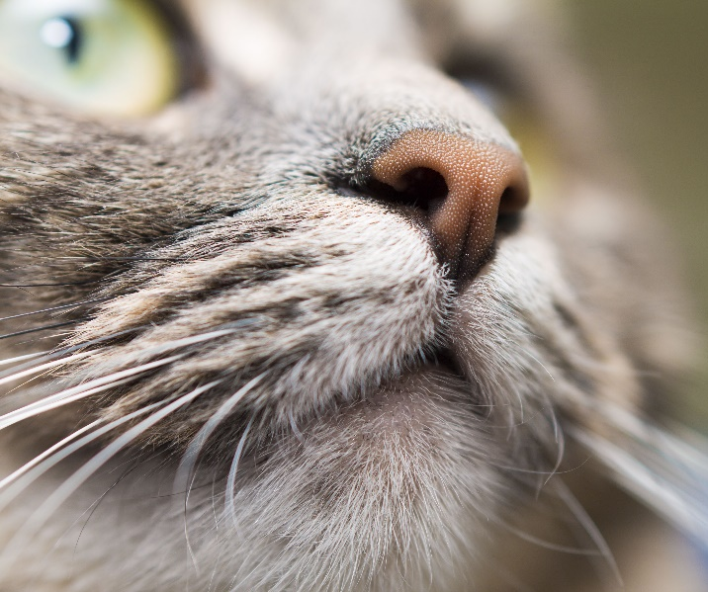
Cats are carnivores and are driven to consume meat.
They don’t need to eat sugar or carbohydrate so they lack a sweet taste receptor.
Cats are able to detect fat.
They like their food temperature to replicate that of their prey.
Taste
Notes:
Cats are obligate carnivores and driven to consume meat. They do not need to eat sugar or carbohydrates (that turn to sugar), thus there is no reason for them to have a taste for it . . . or a sweet tooth, if you will. Essentially, the taste receptors that react to meat and the fats contained therein, are what drive a cat’s appetite.
Many people say they have cats that are attracted to candy, ice cream, pudding, etc. They are sure their cat loves sweets, but it is probably the fat content of the food that they are drawn to. Cats are easily able to detect fat.
The bitter and sour taste sensors are important in that they warn a cat of harmful and/or poisonous foods or objects.
Food temperature is also important to a cat, with preferences usually toward warmer food, approximately 100 degrees Fahrenheit, which simulates the temperature of freshly killed prey. Most cats will reject a cold dish of food just taken from a refrigerator.

Slide 14
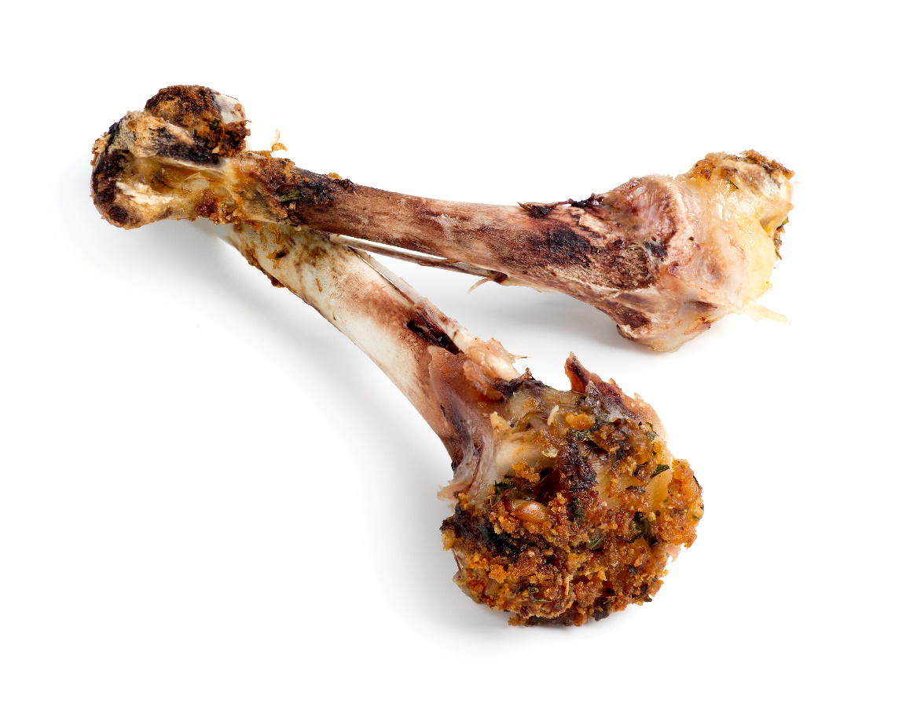
Bones are dead…
…but they were once part of a living person or animal

Slide 15
Trees are living things

Slide 16
Dry leaves on the ground are dead…
…but they were once part of a living tree

Slide 17
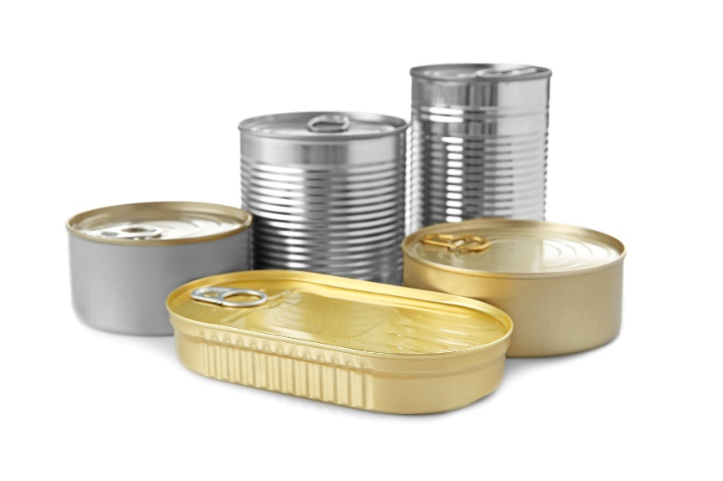
metal,
plastic
stone
Anything or
has never been alive.

Slide 18
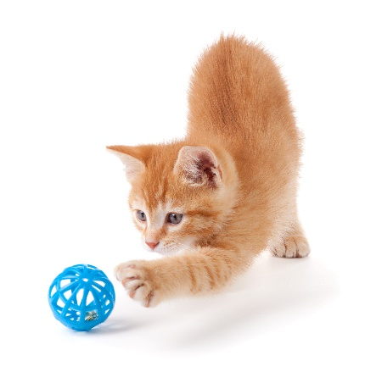
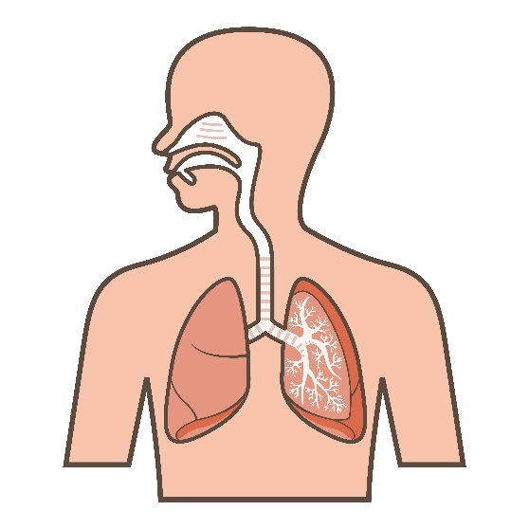
Living test
Can it move?
Can it grow?
Can it breathe?
Does it react?

Slide 19
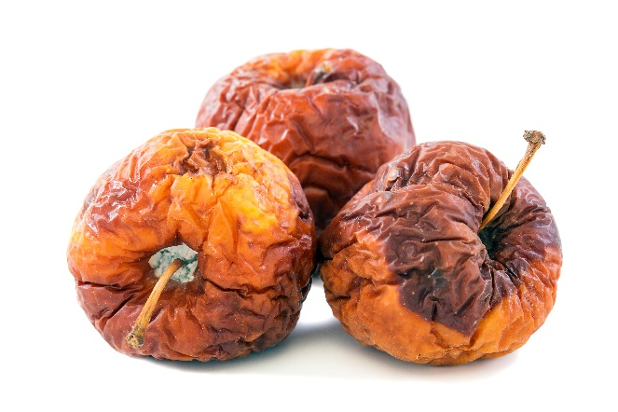
Non-living test
Does someone/something have to make it?
Does someone/something have to move it?
Was it once living, but not anymore?

Slide 20
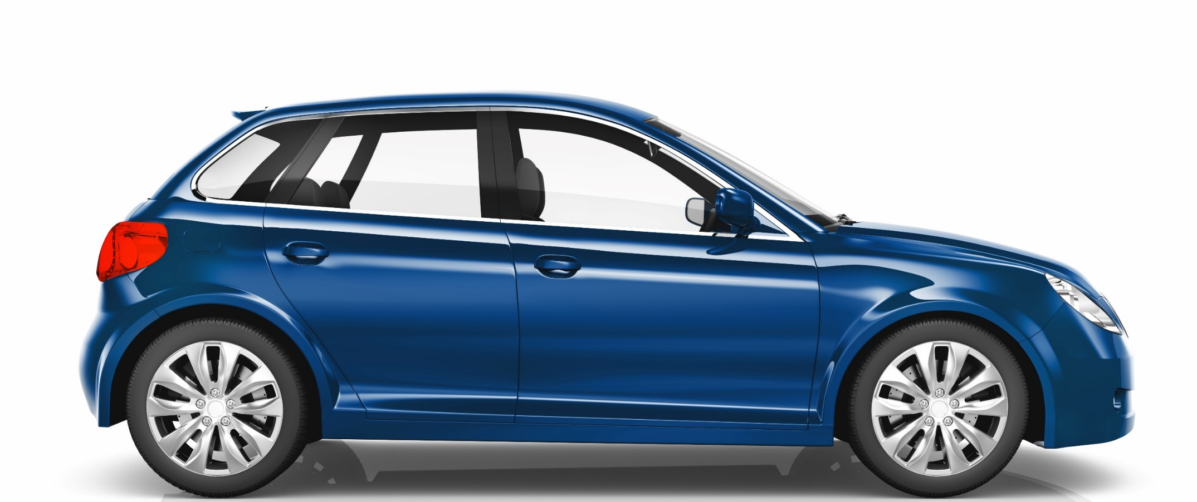
Dead or alive?

Slide 21
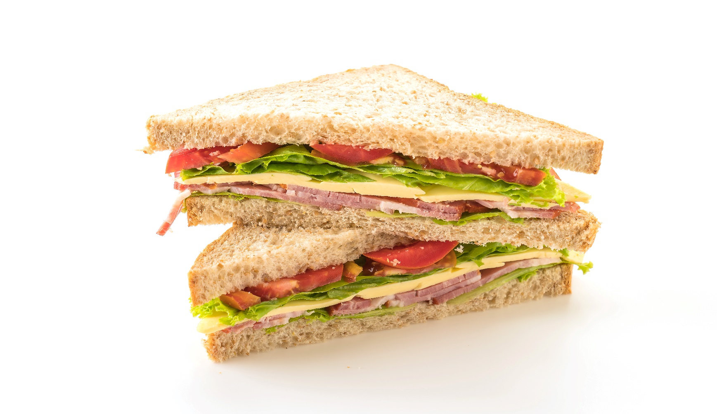
Dead or alive?

Slide 22
Dead or alive?

Slide 23
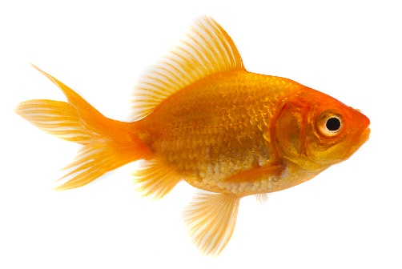
Dead or alive?

Slide 24
Activity
Create a list of objects you find around your school or classroom.
Split your page into three columns: Dead, Alive and Dead but used to be alive.
Move the objects from your list into the correct column.
Dead but used to be alive
Dead
Alive
E.g:
Ruler
Me!
Pencil

Slide 25
Extension
Why not draw your table as a venn diagram?
Alive
Dead
Ruler
Me!
Pencil
Dead but used to be alive

Slide 26
Thanks!

