Slide 1
Get
PetWise
with
PDSA

Slide 2
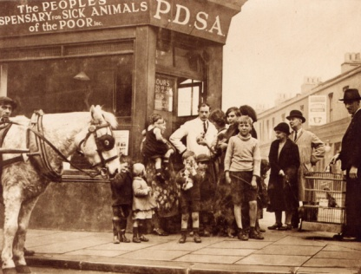
The UK’s leading vet charity
PDSA provide free and low cost care to the sick and injured pets of people in need
Our charity is over 100 years old and we’ve been treating sick and injured pets since 1917
We have Pet Hospitals all over the UK
It costs more than £1 million every week to do our work
We treat hundreds and thousands of pets every year
Notes:
Share the details on the slide and:
Explain the work that PDSA does
Ask the group where they think the money comes from for PDSA to treat all these sick and injured pets . Get answers from group and then share that it comes from people doing fundraising and donating money
Ask what would happen to all the pets we treat if PDSA weren’t around

Slide 3
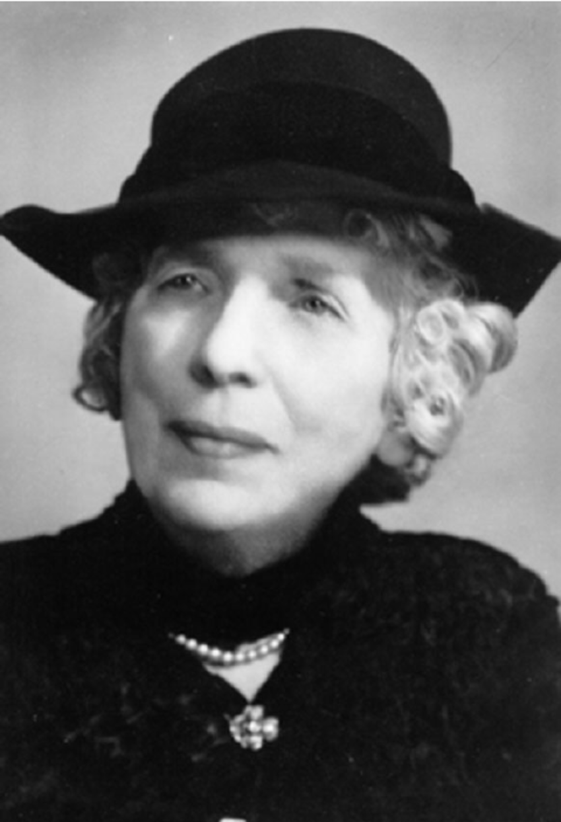
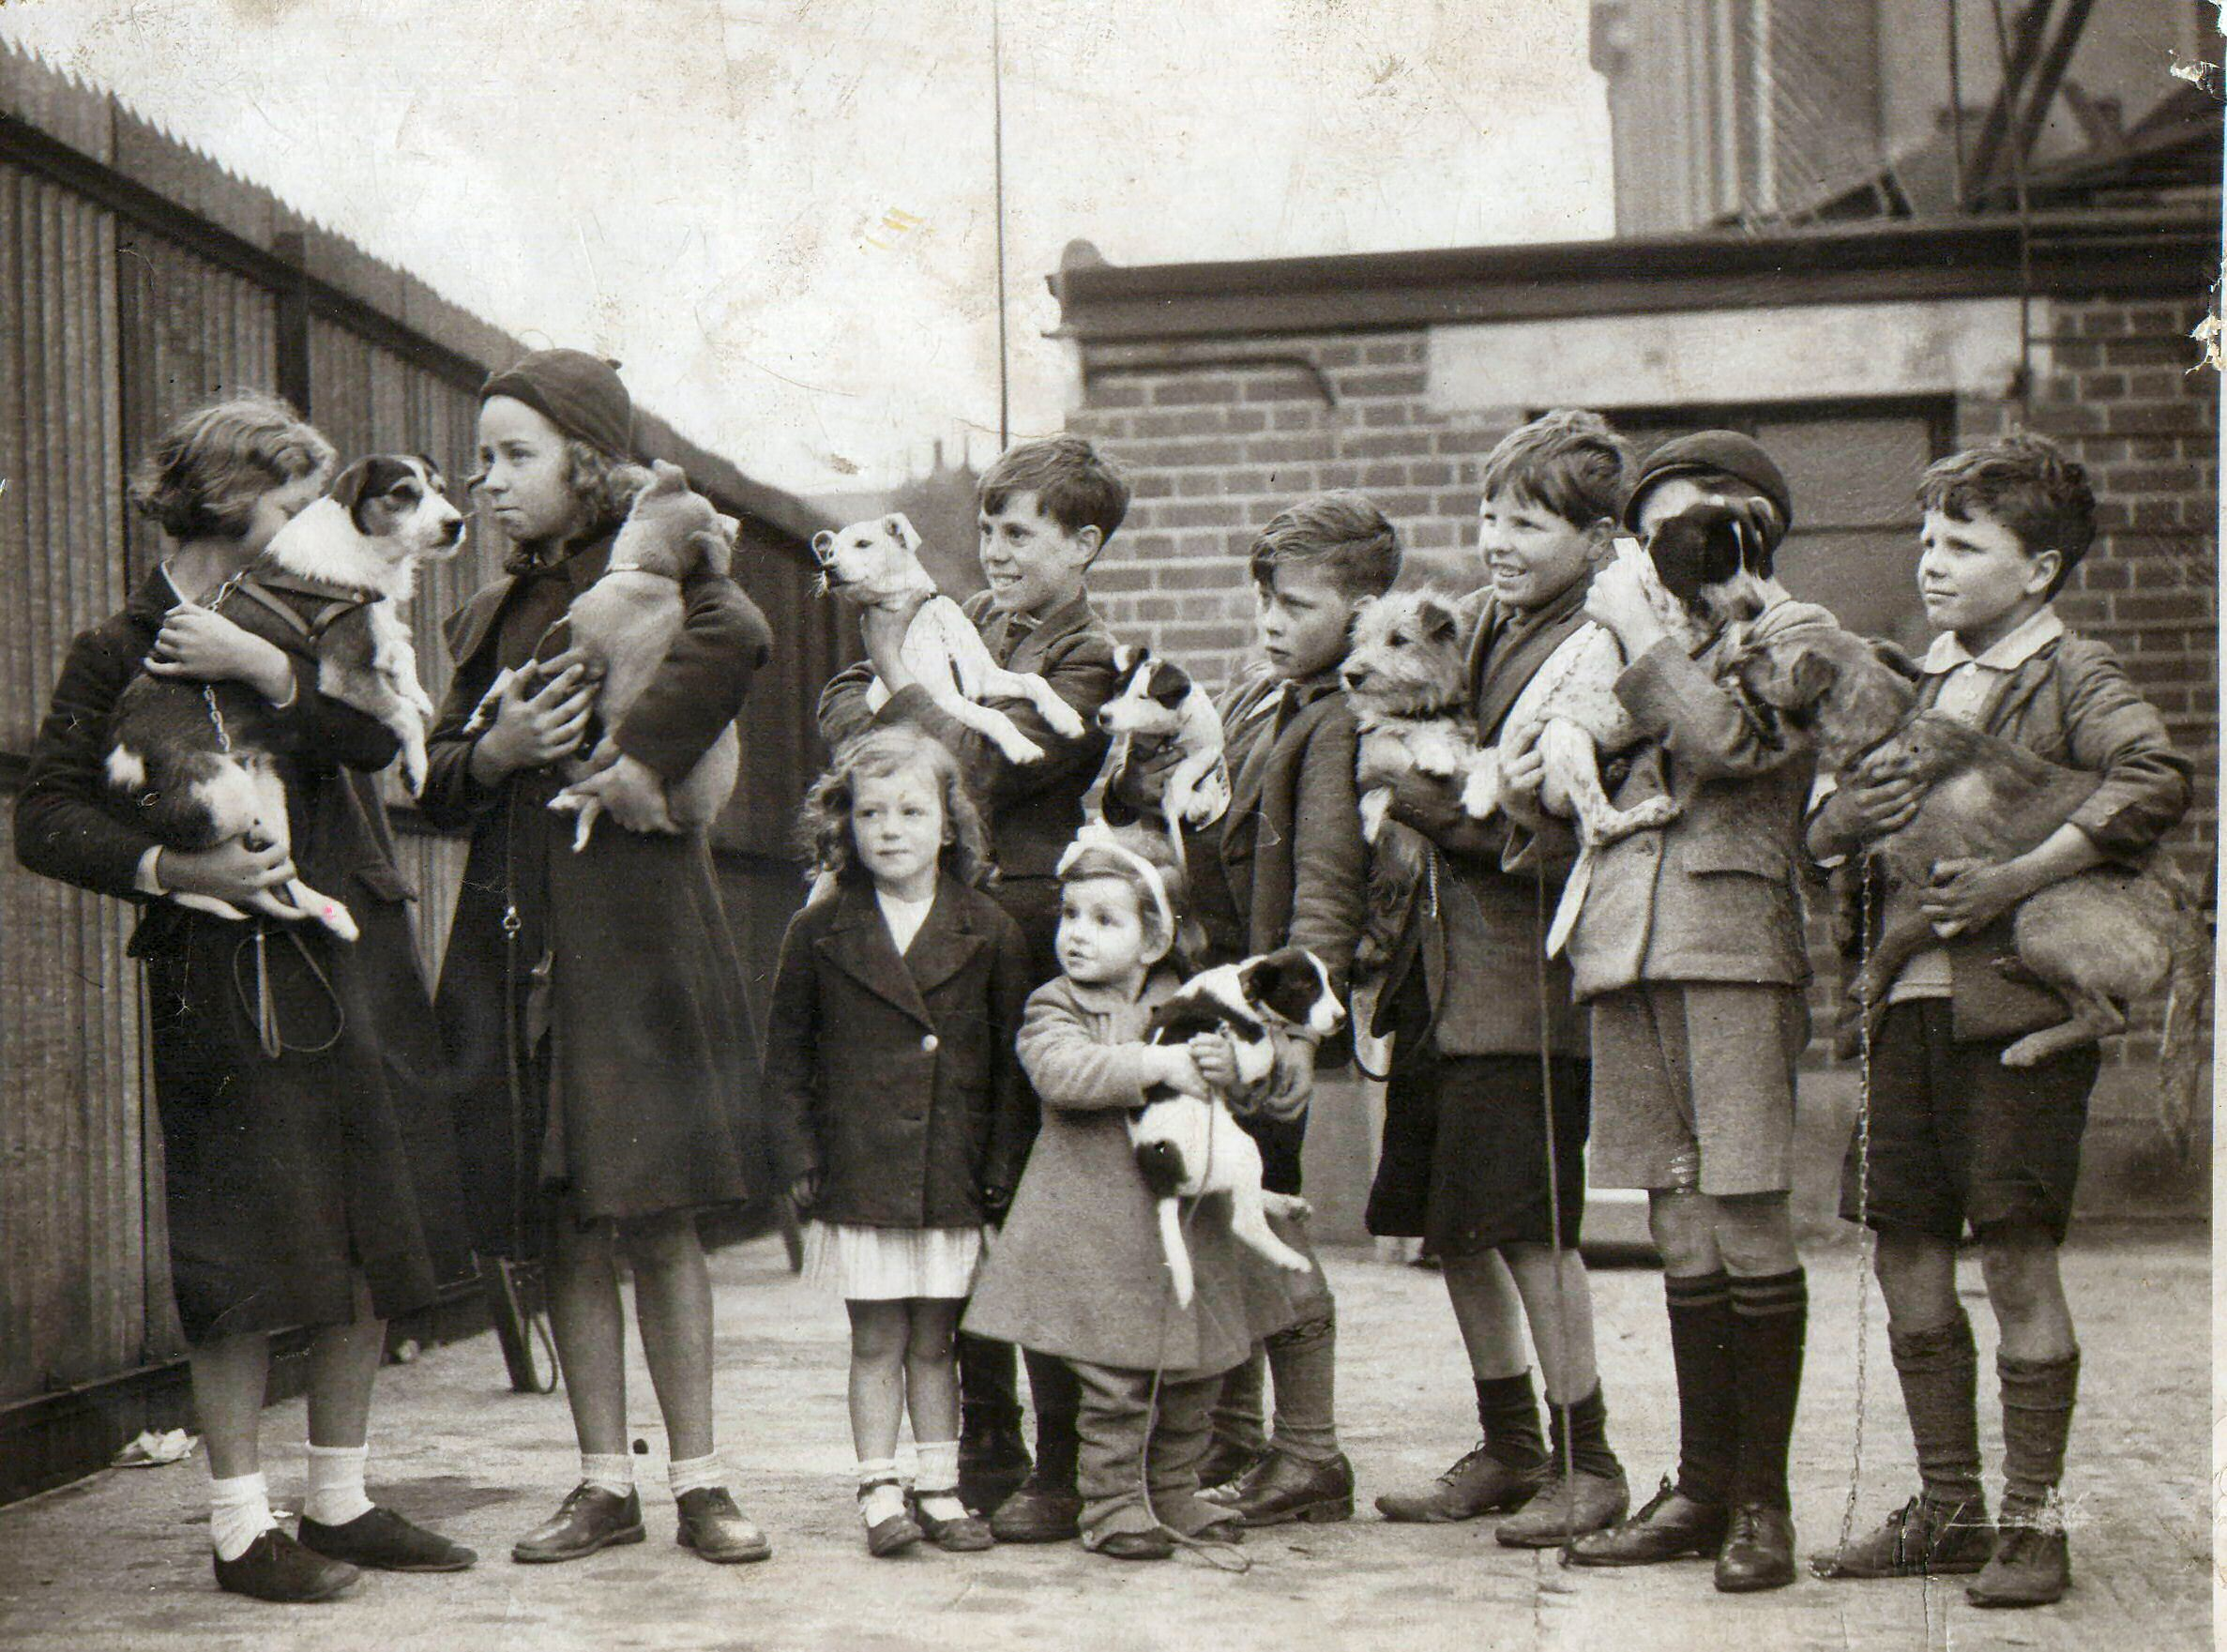
Maria Dickin, Pet Superhero & Founder of PDSA
In 1917, Maria opened the doors to the very first PDSA in a basement in London. People needed their pets just as much as their pets needed them and Maria refused to let them suffer.
She put a sign outside for owners saying:
“Bring your sick animals.
Do not let them suffer. All animals treated.
All treatment free.”

Slide 4
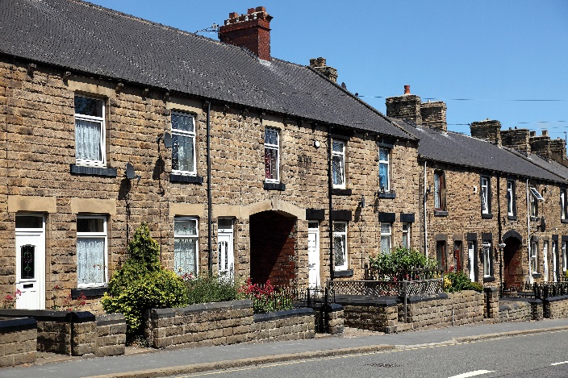
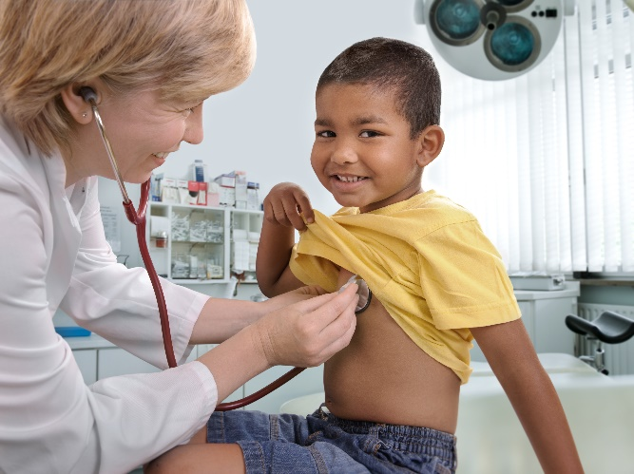
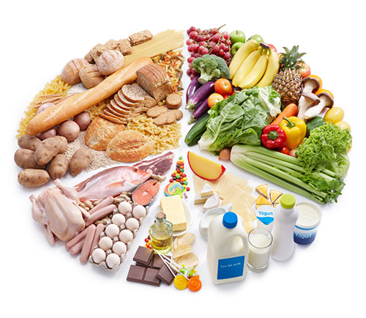
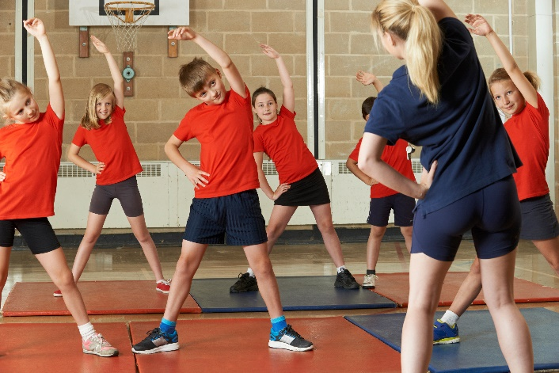
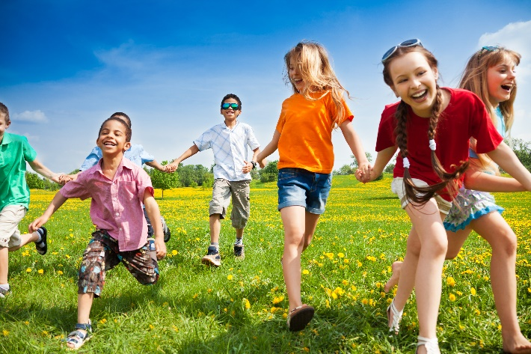
What do you need to be happy and healthy?
A home
Good health
Food
&
water
Exercise & fun
Friends
Notes:
This slide sets up for the welfare needs – encourage the children to think about what they need to stay happy and healthy.
If they get stuck for answers show each picture individually and see if they can come up with the answers.
When you get to the health slide, talk about the things they do to keep themselves healthy: Brush their teeth, bathe, wash and brush their hair, trim their nails, have vaccinations etc. Also talk about where they go when they’re poorly – compare vets with doctors.

Slide 5
All pets need…
The Five Welfare Needs
A home
Exercise & Fun
Health
Food & water
Friends
Notes:
Explain that pets are just like us and need a variety of things to keep them happy and healthy even though they are very different from us and from each other (different species)
For instance; you wouldn’t keep a dog in a rabbit hutch or a cat in a fish tank!
Environment – Pets need a clean, safe environment with enough space
Diet – Pets need the right kind of food in the right amount and 24 hour access to fresh clean water
Behaviour – Pets need to be able to express their normal behaviour; they need to exercise, to play and do specific things, depending on what species they are.
Health – Pets need to be kept in good health. This means taking them to the vet when they’re ill, but also making sure we keep them healthy.
Companionship – Pets need the company of people and sometimes other animals, depending on the species.
Responsibility: Ask children to tell you who is responsible for keeping pets happy and healthy. Stress to the children that if they have a pet, that it’s their responsibility to make sure that all these welfare needs are met. Tell them that people who don’t provide these needs are now breaking the law.

Slide 6
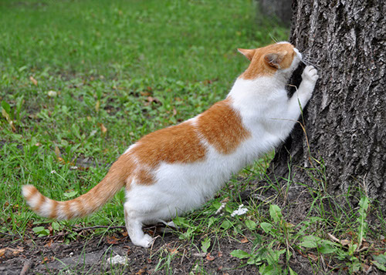
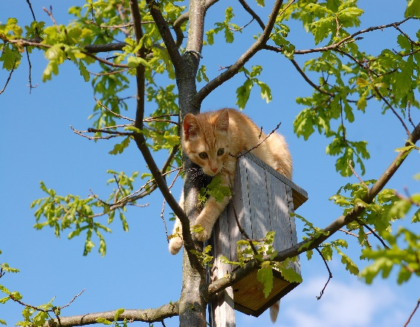
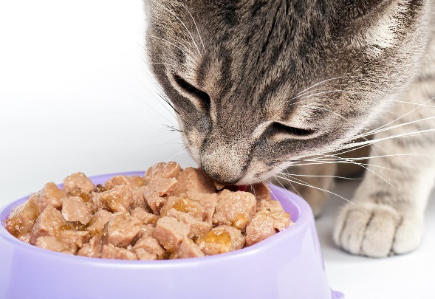
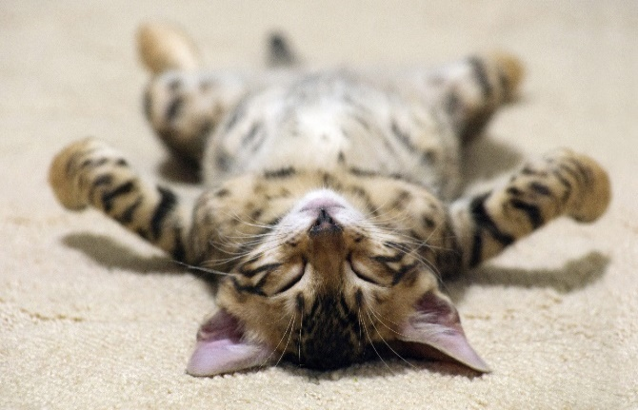
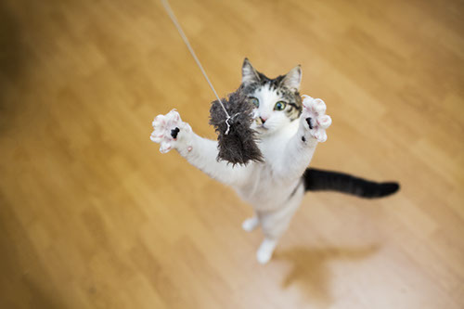
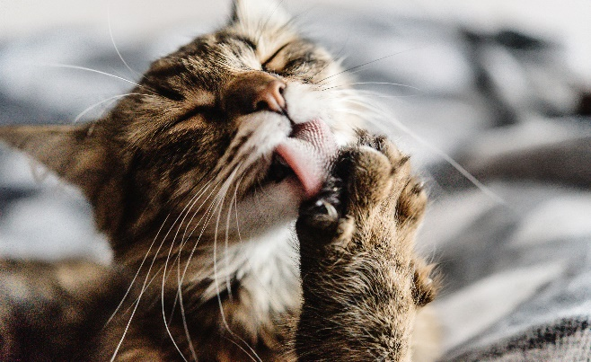
Cats – What do they do?
Scratch/Scent Mark
Climb/Hide
Eat/Drink
Sleep
Hunt/Play
Groom
Notes:
So let’s start with cats – you can see from the headings that cats naturally do lots of different things.
Explain each picture
Scent mark/scratch – Cats leave their individual scent behind from the pads of their feet and their faces, to let other cats know that this is their territory – cats naturally like to live alone, although some will put up with other cats if they have enough space around them or if they’ve grown up together. Explain that cats rub their faces on furniture and on people to leave their scent – explain that by rubbing their faces on you, they’re telling other cats that you belong to them!
Climb/Hide – cats are great at climbing. They’re very agile creatures with great balancing skills. Explain that cats climb so they can stay safe and see what’s going on from above and that if they’re scared they’ll hide.
Eat/Drink – All living things need water to survive and must have fresh water at all times. Explain that cats often prefer to drink from running water or from pools. This means they prefer to drink from wide and flat bowls or fountains. Explain that cats have to eat meat to survive and can’t be vegetarian. Also explain that some cats still have wild behaviour and hunt. Explain that this is natural behaviour for a cat.
Sleep – Explain that cats sleep a lot – for almost two thirds of their lives! They can spend up to 16 hours every day asleep. In the mammal world, only sloths and bats sleep for longer than cats. Cats actually do have ‘catnaps’ and sleep for short periods of time very frequently. They tend to be awake early morning and when it’s going dark – the best time for hunting.
Hunt/Play – Cats like to hunt and play at hunting. They’ll try to stay hidden for as long as possible and sneak up on their prey or their toys – they’ll move very slowly so that they won’t be seen and when they get close enough they’ll sprint as fast as they can to catch their prey.
Groom– Cats love to be clean and spend a lot of time grooming themselves – their tongues have lots of hairs on them that act like little combs. Ask if anyone has been licked by a cat and talk about how their tongues are rough like sandpaper.
Ask if they’d like to see some cats in action and introduce the video.
The next slide shows a video of some cats showing some cat behaviours

Slide 7
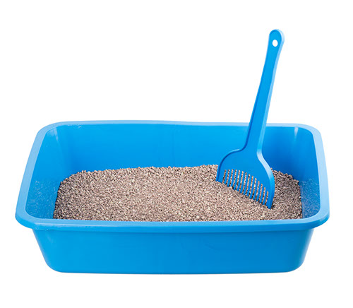
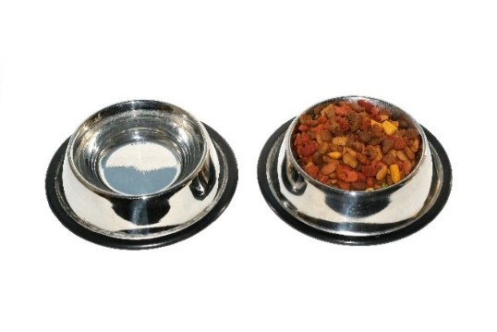
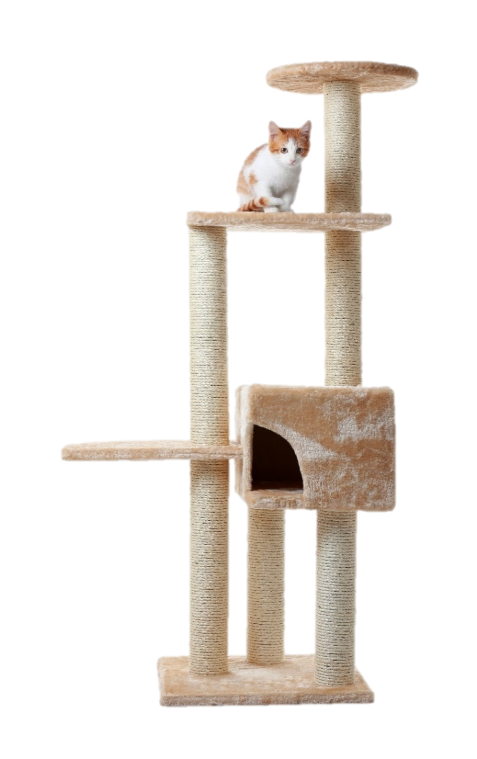
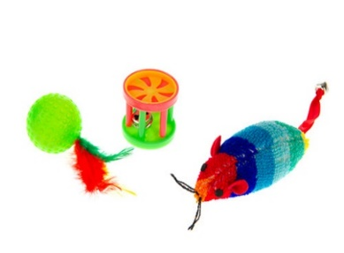
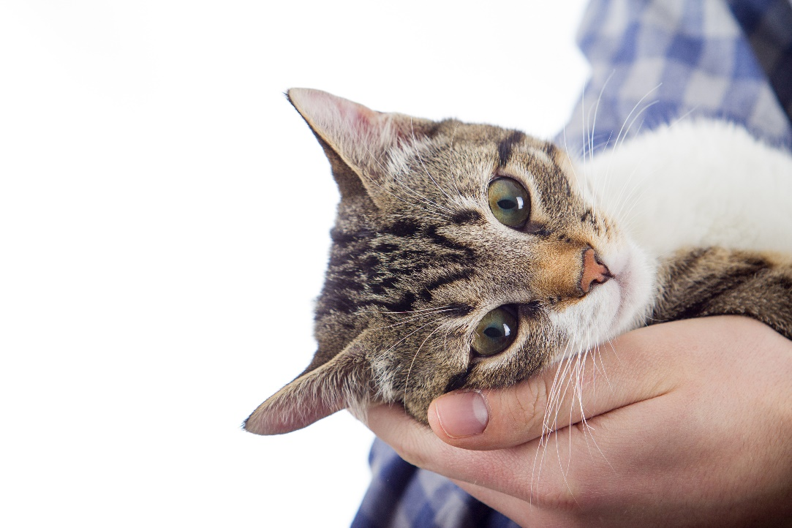
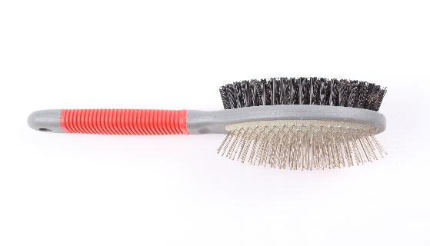
What do cats need?
Cats …
Notes:
Ask children if they can guess what things they’d need to provide a cat with to keep it happy.
Show each picture and ask group to discuss why they need it:
Scratch post – display natural scratching/scent marking/climbing behaviours – up high away from dangers
Water fountain for fresh water or wide brimmed bowl – away from food and litter tray
Food – complete balanced diet, either wet/dry or both.
Litter tray – at least one per cat in household in different areas of house and away from food and water bowls.
Toys – practice stalking/hunting behaviours
Companionship – people rather than lots of cats
Discuss the dangers of feeding cats milk

Slide 8
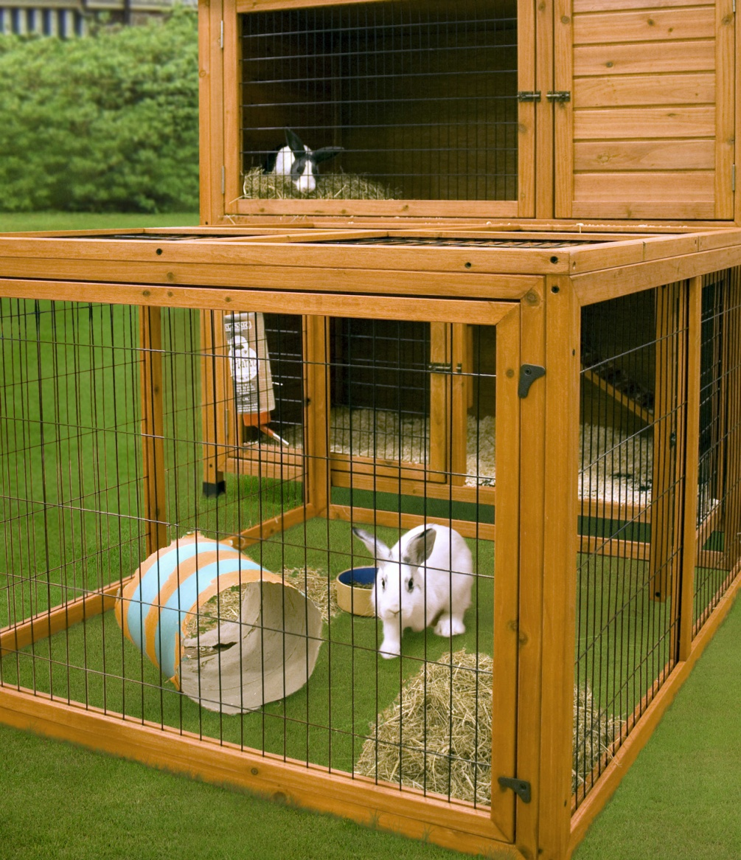
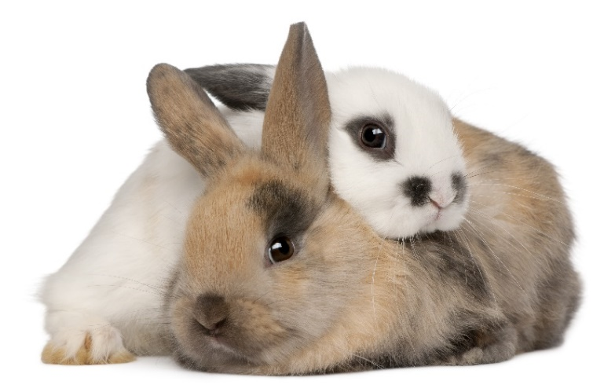
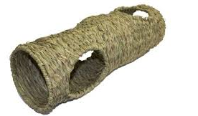
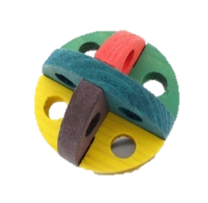
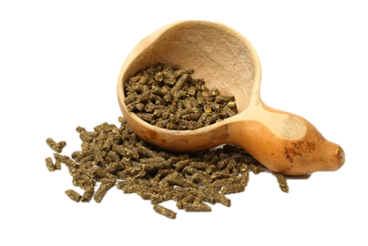
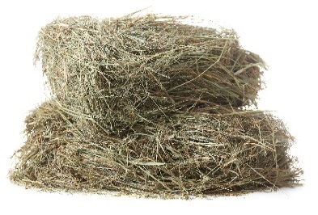
Rabbits
What do rabbits need?
Notes:
Ask the group what they think pet rabbits need?
Big hutch with plenty of room to run around – reflect on the video at just how much space a rabbit needs – a hutch alone is not enough – they are not ‘easy’ pets to care for as people think. You could get one of them to do 3 big hops and stand as tall as possible to show how much space they need.
Food – pellets are better than muesli as they contain all nutrients, lots of hay & grass, small amount of greens, & unlimited water.
Hay – explain importance of right amount of hay in their diet for their tummies and their teeth.
Toys to play with and tunnel etc. to run through and hide in.
Friends – rabbits hate being alone – remember how they live in the wild – in groups – they look out for each other – a lone bunny will be a very worried and lonely bunny!
Discuss carrots and how calorific they are for rabbits

Slide 9
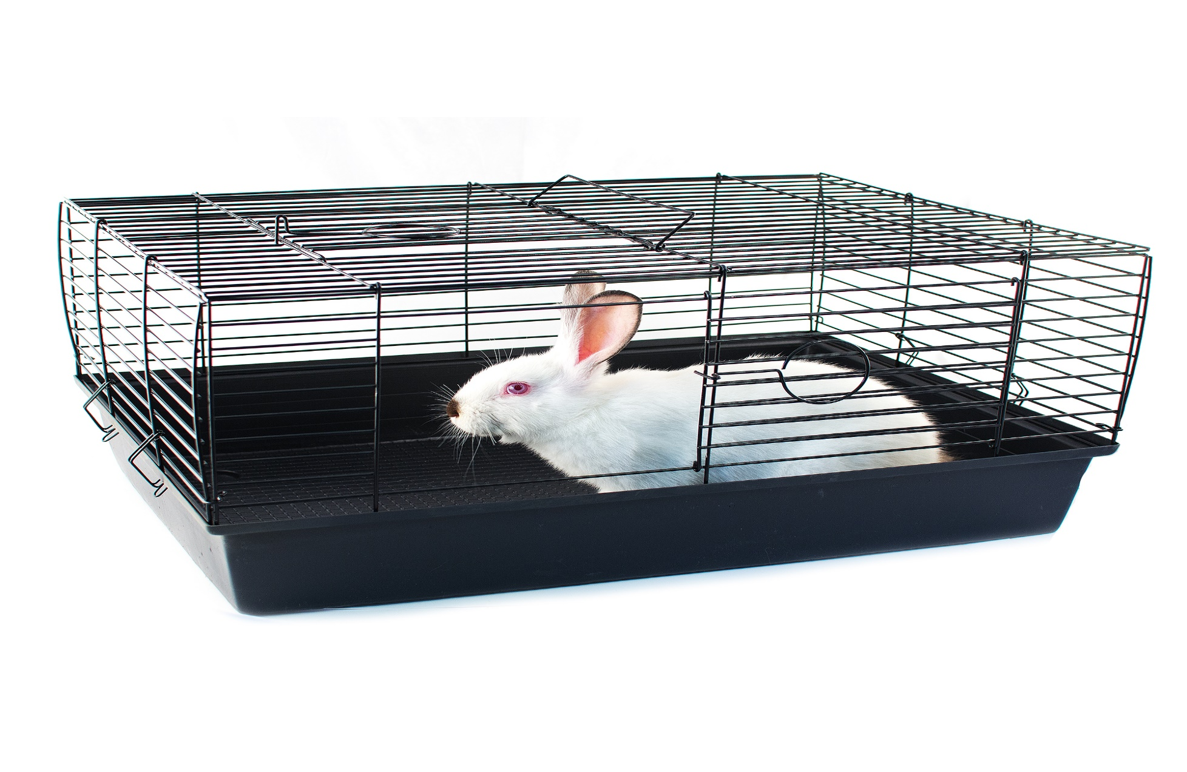
What is wrong with this picture?
Does this rabbit have everything he needs?
Notes:
Ask:
Based on what we’ve just learnt about rabbits, what is this rabbit missing in terms
of his five welfare needs being met?

Slide 10
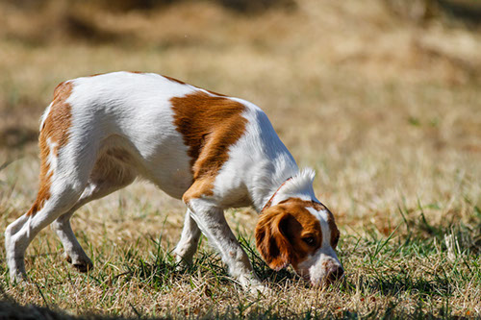
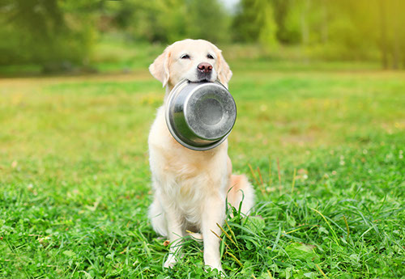
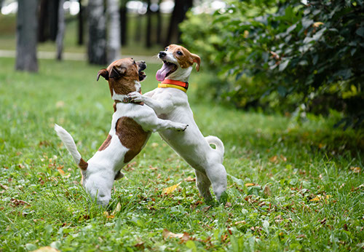
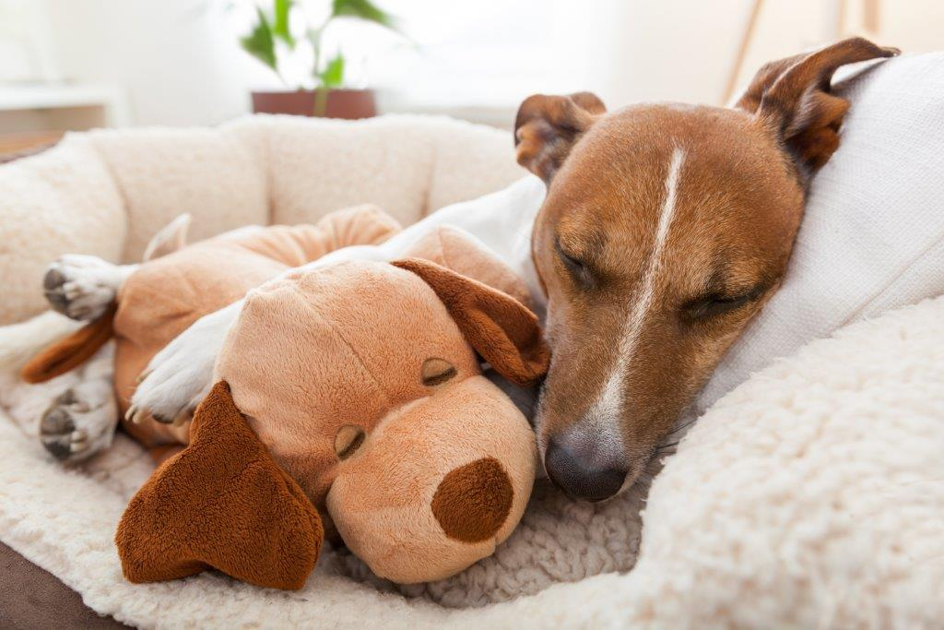
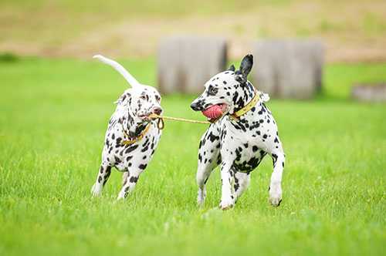
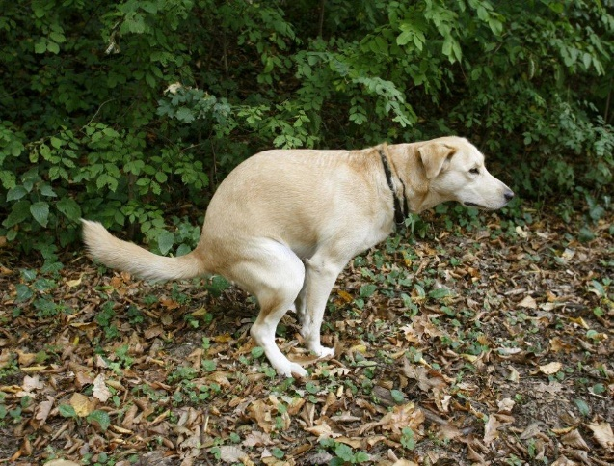
Dogs – What do they do?
Sniff/Smell
Eat/Drink
Exercise/Socialise
Sleep
Hunt/Play
Toilet
Notes:
Sniffing/smelling –Explain that dogs use their great sense of smell to sniff people, other dogs and the environment. Explain that some dogs use their great sense of smell to help people, by sniffing out drugs, weapons, people buried by earthquakes etc. Tell them amazing facts of dogs sniffing out cancer and being able to tell a person’s mood by how they smell.
Eat/Drink – Explain that dogs are omnivores. Check if anyone knows what this means. Confirm that omnivores can survive on eating either meat or plant material (or a mixture of both) We provide them with their food which must be a complete balanced diet that gives them everything they need – not our food! Explain that some human foods can be dangerous to dogs. Explain that they need unlimited fresh water.
Exercise/Socialise - Explain that dogs are very social and don’t like to be left alone. People have developed such a strong bond with dogs that we’ve replaced their ‘wolf pack’ – which is why we should make sure that our dogs are only left alone for up to four hours at a time. Wolves will exercise naturally by hunting and covering large distances. Our pet dogs need lots of exercise too – at least two walks a day, with time off the lead to run.
Sleep – Explain that it’s important to make sure that dogs have their own bed and that they’re not approached when they’re on it – give explanation and safety advice.
Hunt/Play – Explain that play is a huge part of a dog’s life. Dogs love to play but it’s no fun playing on their own, so make sure your dog gets plenty of chance to play with other dogs and also has lots of toys that you can help him play with at home. Remember, dogs use their mouths to play – they don’t mean to hurt, but sometimes their teeth can hurt our delicate skin – other dogs with fur coats make a much better play mate. Unlike cats, our domestic dogs don’t hunt but they still have some natural desires – they love to chase and catch with toys – just like in the picture
Toileting/Scent marking Explain that this is something that dogs do. They’ll often seek out spots that another dog, or many dogs, have used to pee on, to make their mark on the world and mask the scent markers left by other dogs. Female dogs in heat will pee at every chance they get, to try to attract a mate. Explain that scent marking and sniffing are like doggy Facebook. Explain the importance of poop scooping from a public health angle.
Here are some dogs doing some great doggy things and a few tricks too

Slide 11
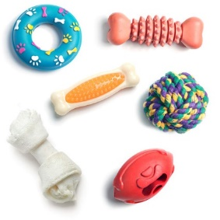
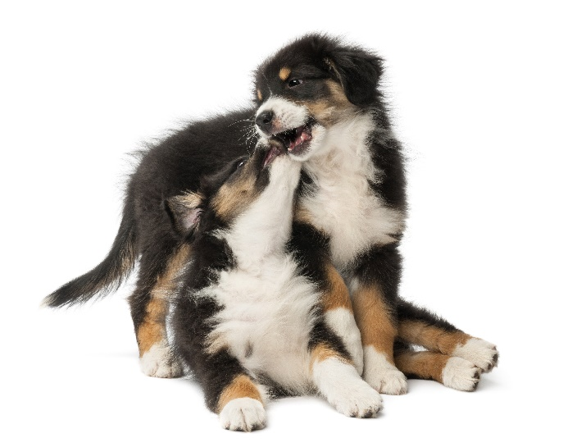
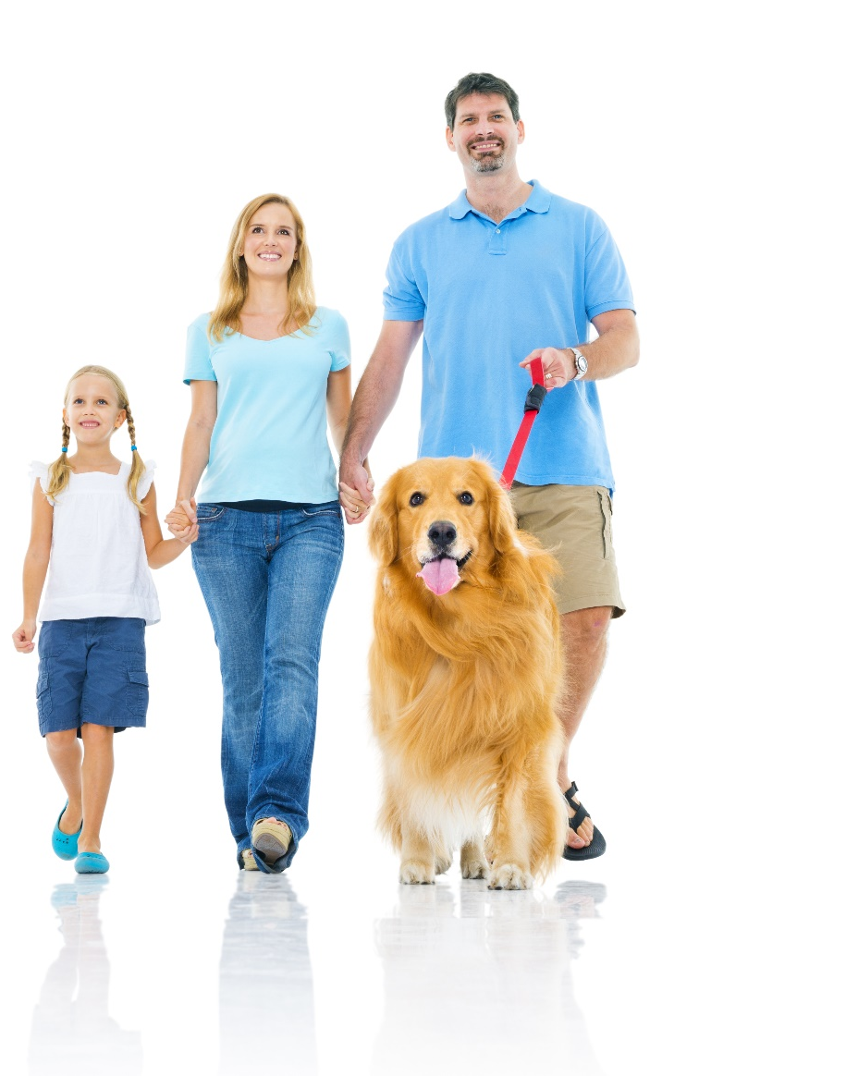
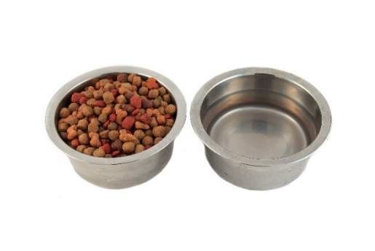
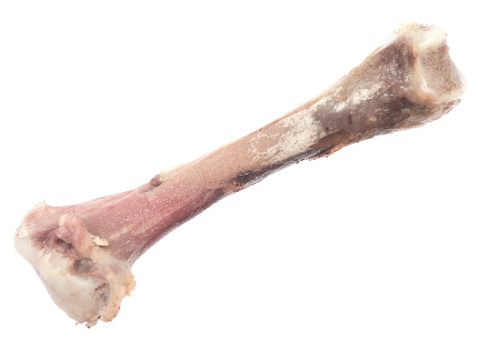
What do dogs need?
Dogs …

Slide 12
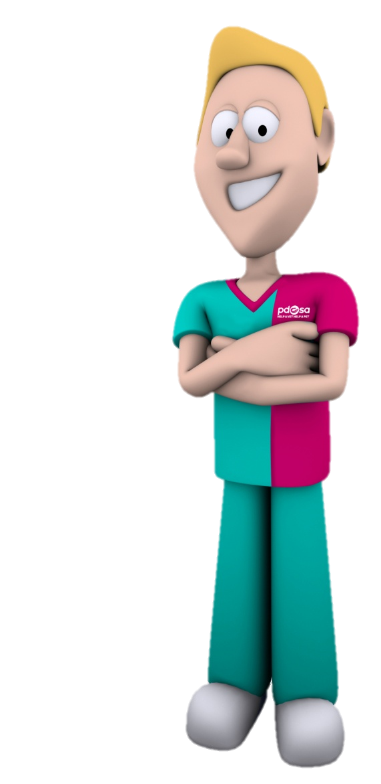
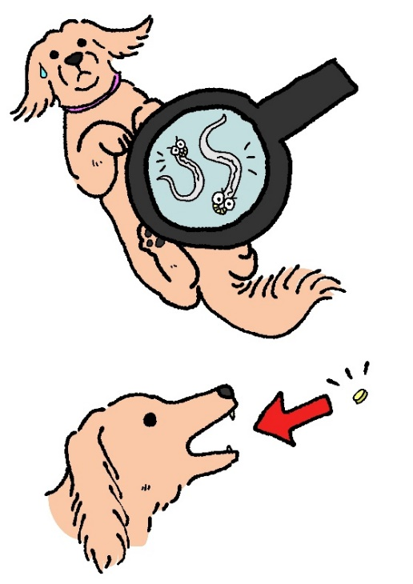
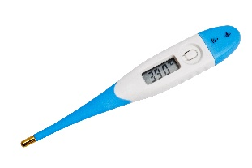
Keeping pets healthy
Notes:
Explain each aspect of preventive healthcare
Vaccinations – explain need to given every year to dogs, cats and rabbits to prevent disease
Scan for chip – explain dog microchip law but also good to have other pets chipped too
Grooming – explain that pets need to be groomed to keep their skin and coat healthy. Explain that it’s also a chance to check all is ok – look for parasites
Parasites – explain internal and external and treatment – Use toy flea and worm.
Neutering – explain the importance of neutering
Ask children if they’d like to meet one of the pets we’ve helped to get better at PDSA.

Slide 13
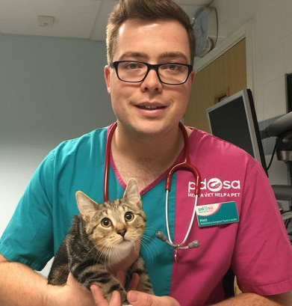
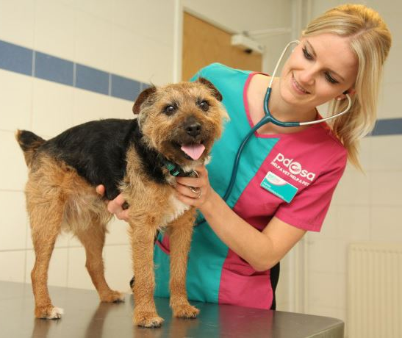
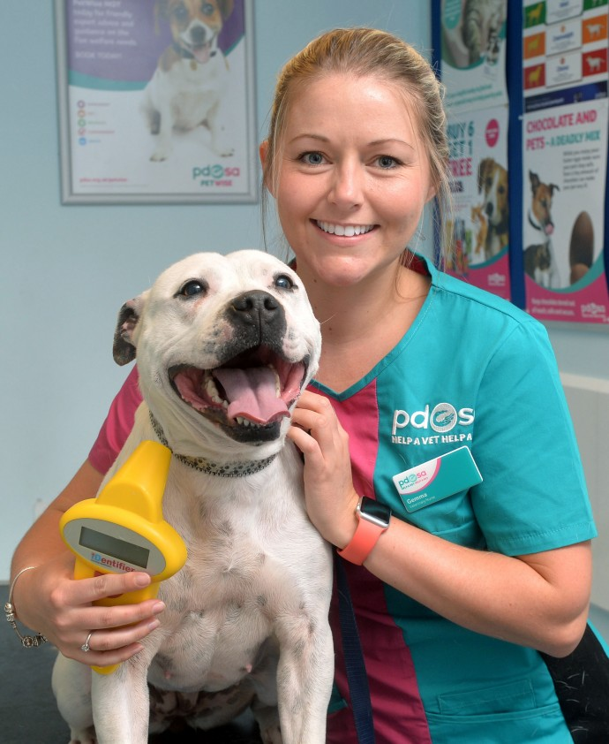
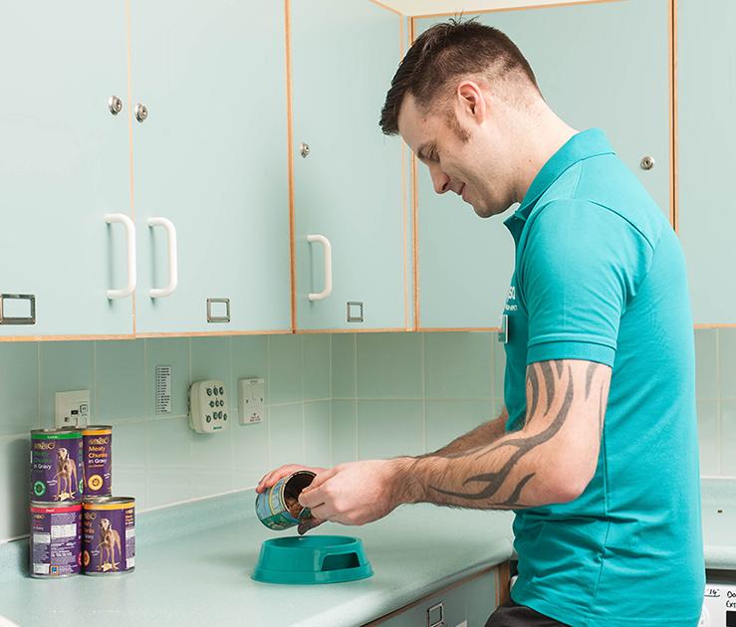
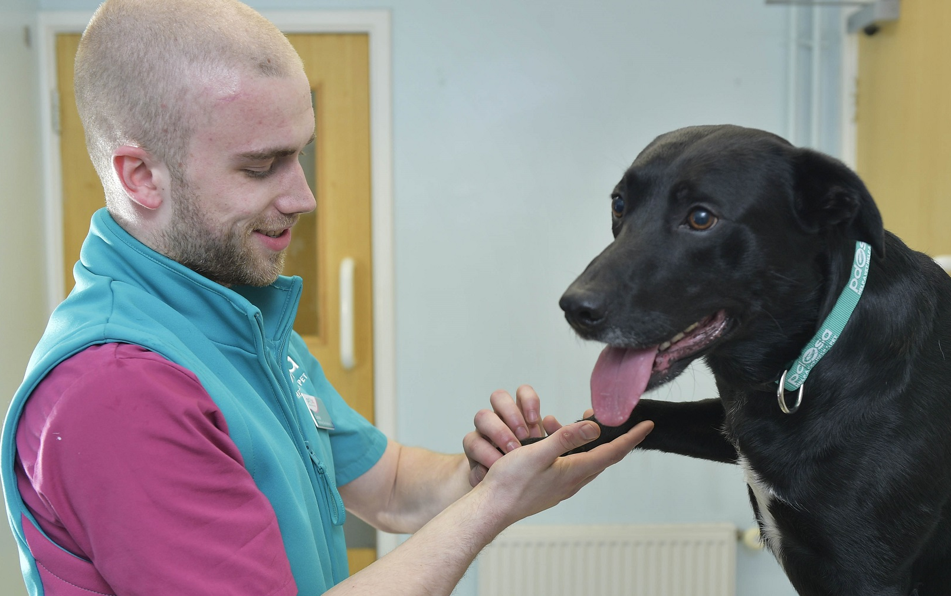
Roles in a PDSA Pet Hospital
Senior Vet Surgeon
Vet Surgeon
Vet Nurse
Head Nurse
Volunteer
Receptionist
Client Services Manager
Veterinary Care Assistant
Notes:
As you can see here there are many different jobs that work with animals in a PDSA Pet Hospital.

Slide 14
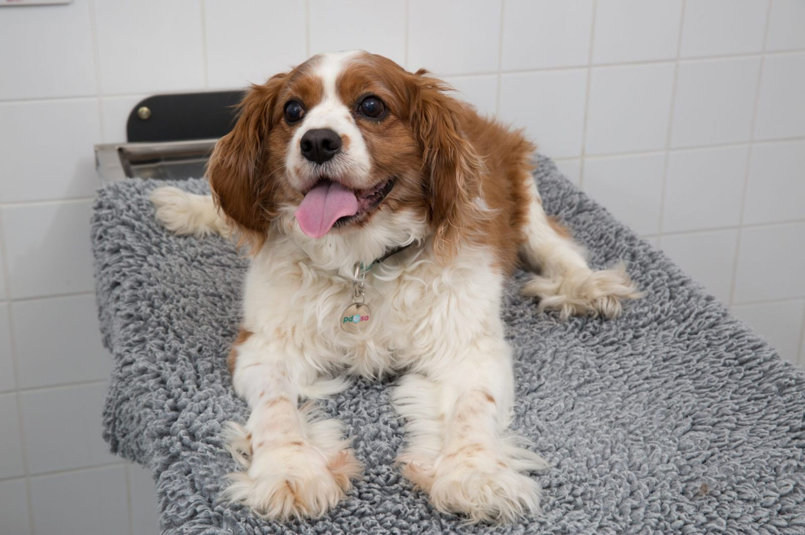
Cyril’s Story
Notes:
One day, Cyril was feeling unwell – he had a sore tummy and he was being sick. He didn’t want to eat or drink.
His owner was so worried about Cyril that she took him to her local PDSA Pet Hospital to see a vet.
The vets and nurses couldn’t tell what was making Cyril feel unwell just by checking him over and feeling his tummy, so they had to do an x-ray. The x-ray machine took a picture of inside of Cyril’s tummy – do you want to see what they found?

Slide 15
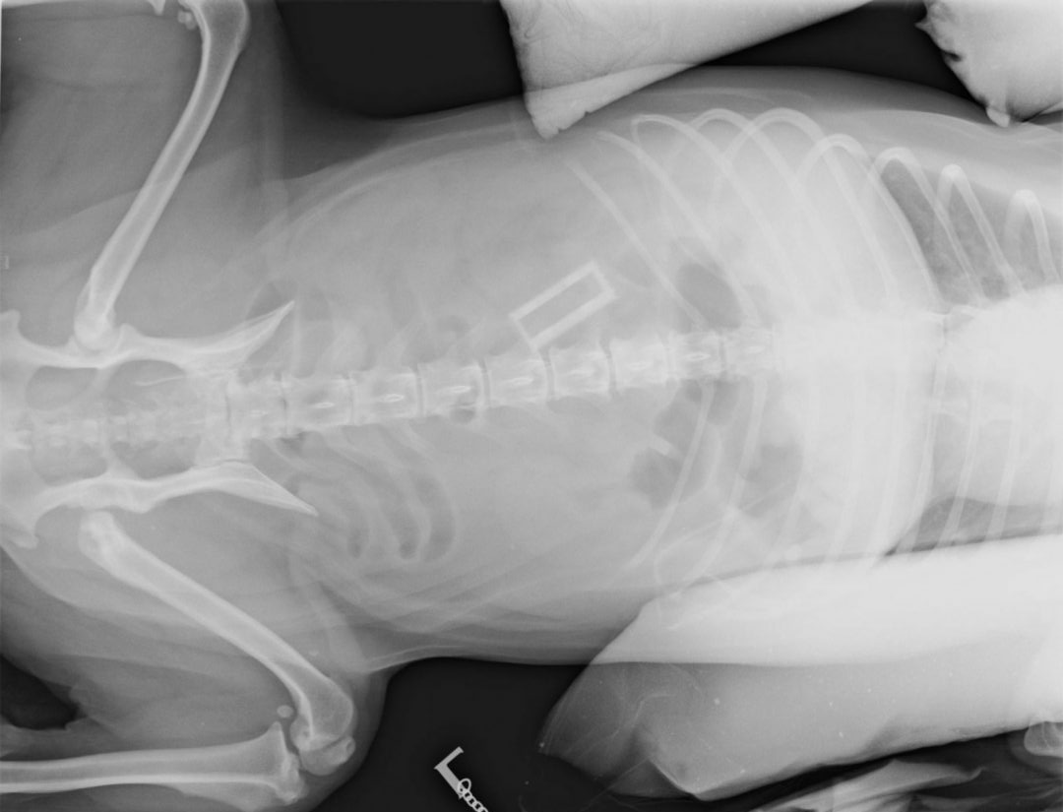
Notes:
The object in the red circle shouldn’t be there….can you guess what it is?
We’ll see the answer on the next slide…
Cyril needed surgery to remove the mystery object.

Slide 16
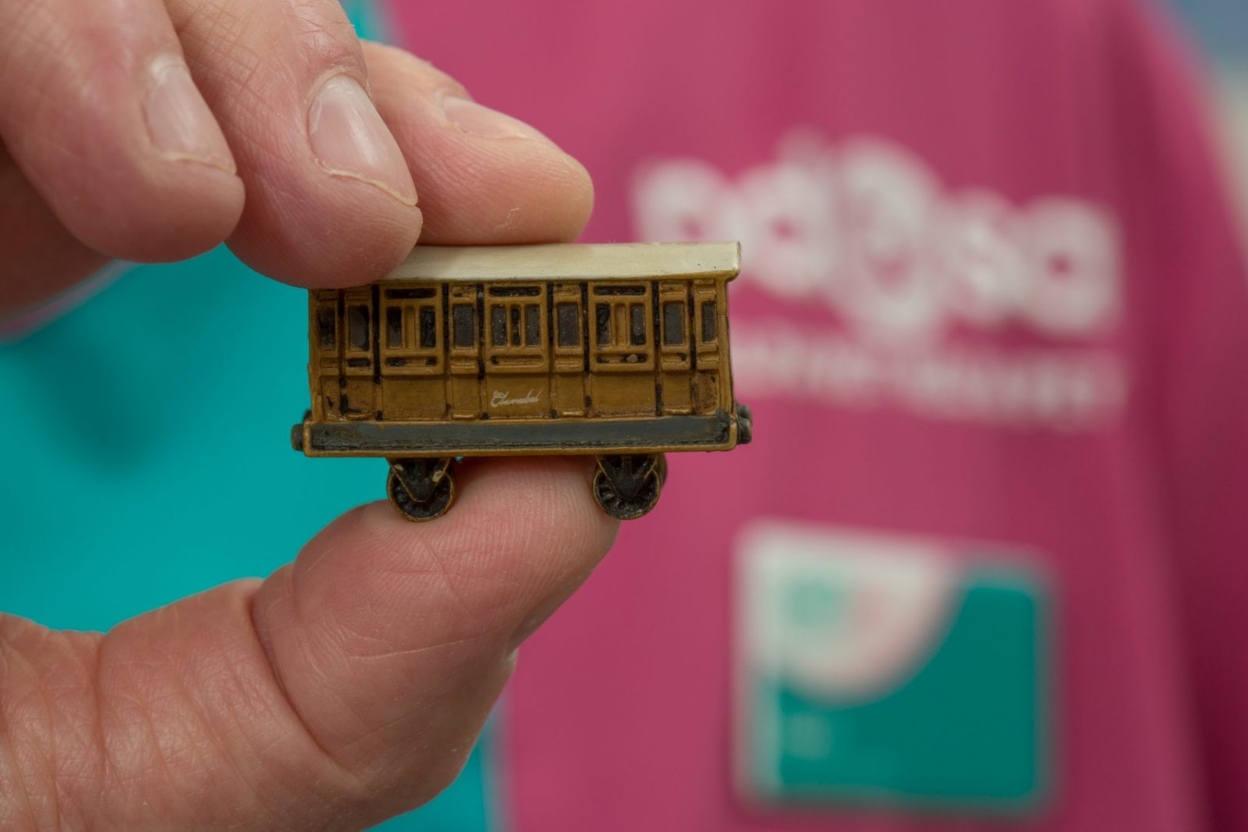
Notes:
Did you guess right? It was a Clarabelle train carriage from a Thomas the Tank Engine toy set. How could Cyril have eaten that?

Slide 17
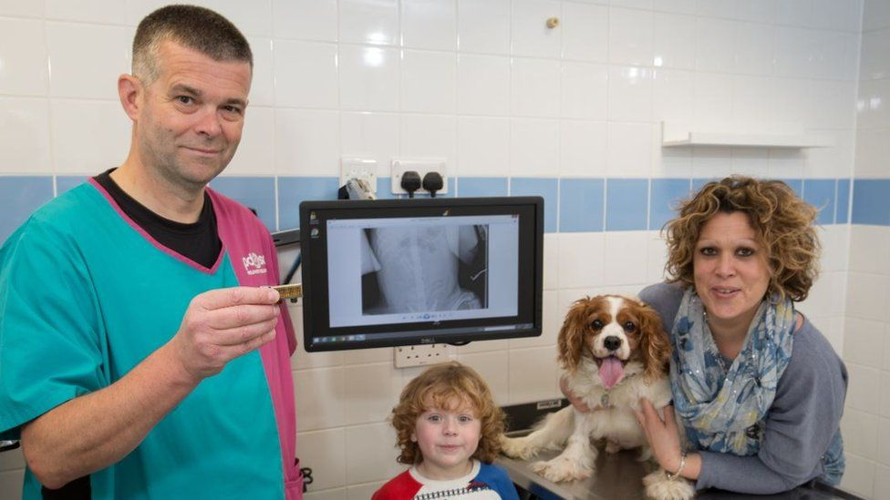
Notes:
The little boy who lives with Cyril had left his toys out and Cyril must have eaten the toy. Dogs like to explore the world with their noses and sometimes they can accidentally eat things they shouldn’t. Thankfully, Cyril is feeling much better now and he’s back at home living his best life. Do you think the little boy will leave his toys out again?
Would you leave your toys on the floor if you have a pet at home?

Slide 18
You’re the Reason
https://youtu.be/pROHRrZGaw8
Notes:
Video

Slide 19
Do you want to help PDSA save pets like Cyril?
Sign up to
Hold your own
PetWise School Award
Non-uniform day
pdsa.org.uk/petwise-award
Notes:
Explain that these are just some of the ways they can help raise money for PDSA.
You can find our fundraising resources on pdsa.org.uk/PetWise

