Slide 1
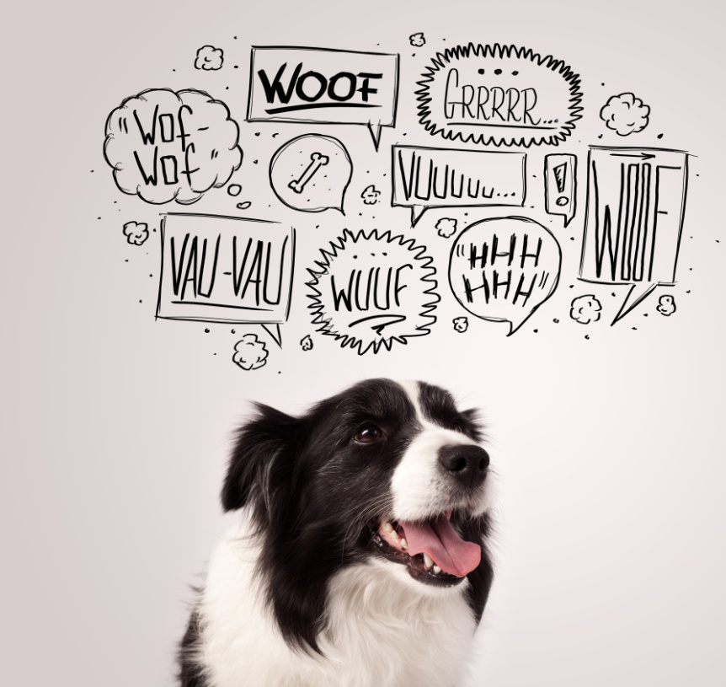
Canine Communication
Notes:
Introduce yourself and your role/job
Ask questions: who has a dog, who’s nervous of dogs?
Explain that today you’re going to share with them your knowledge and skills about how to speak dog.
Give overview of session – explain that at the end of the session, they’ll
Understand how dogs are feeling and how they ‘talk’ to you through their body language
Be able to keep themselves and dogs safe

Slide 2
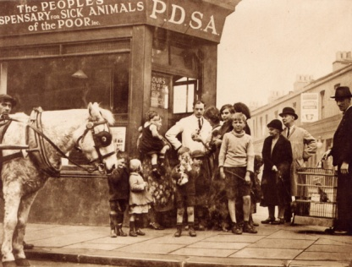
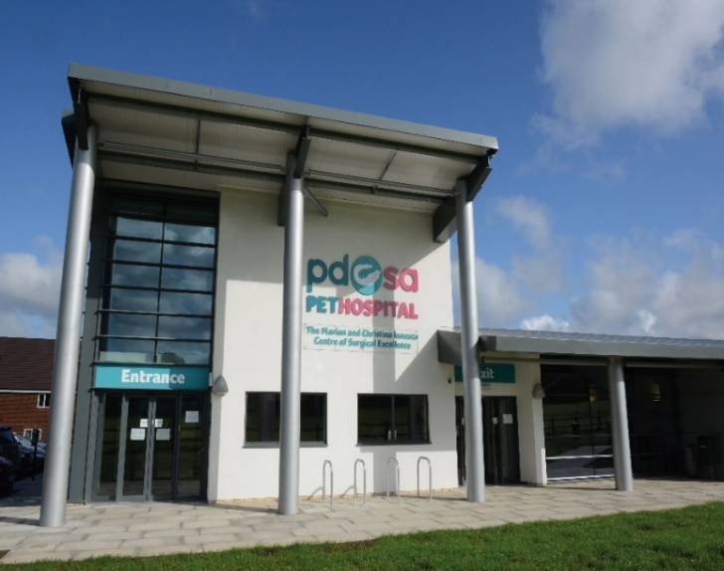
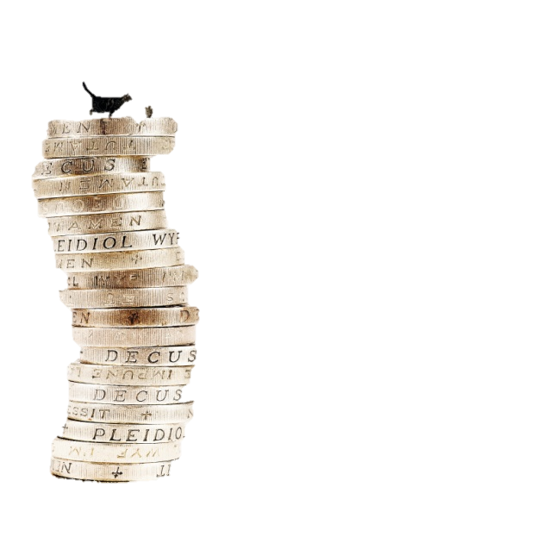
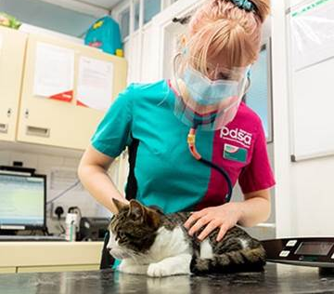
The UK’s leading vet charity
Our charity is over 100 years old and we’ve been treating sick and injured pets since 1917
We have Pet Hospitals all over the UK
We treat hundreds and thousands of pets every year
It costs more than £1 million every week to do our work
Notes:
Share the details on the slide and:
Explain the work that PDSA does
Ask the group where they think the money comes from for PDSA to treat all these sick and injured pets . Get answers from group and then share that it comes from people doing fundraising and donating money
Ask what would happen to all the pets we treat if PDSA weren’t around

Slide 3
https://youtu.be/cUY4_nVpdj4
Over 100 Years of PDSA
Notes:
100 years of PDSA Video

Slide 4
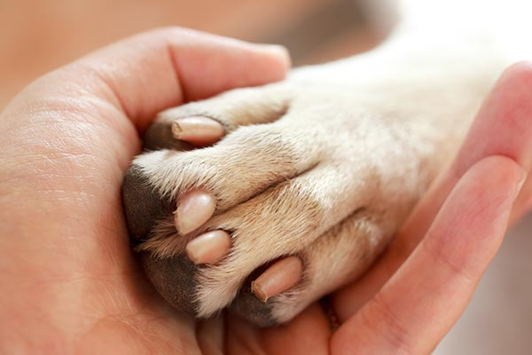
Man’s Best Friend
Notes:
Man’s (and woman’s!) best friend
It’s thought that dogs were first tamed by hunter-gatherers as long as 30,000 years ago to help with hunting and also to protect their human friends from danger. Having dogs around who would bark and alert them to people or other animals approaching, meant they could stay safe. In return, dogs would be given warmth, food and company.
This is where the phrase ‘man’s best friend’ comes from.
Explain that over the years we’ve interfered quite a lot in the breeding of dogs, which has lead to the huge range of shapes, sizes and coat types that we see today.

Slide 5
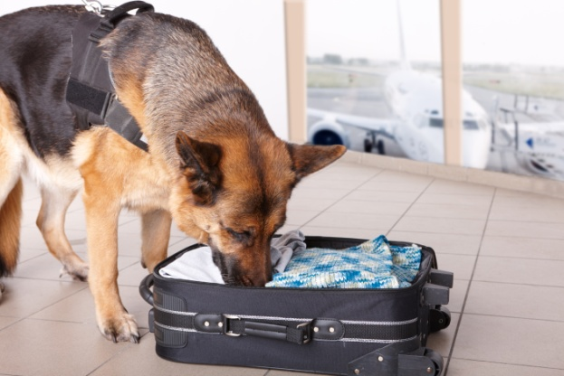
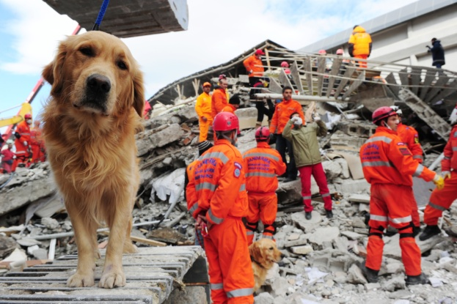
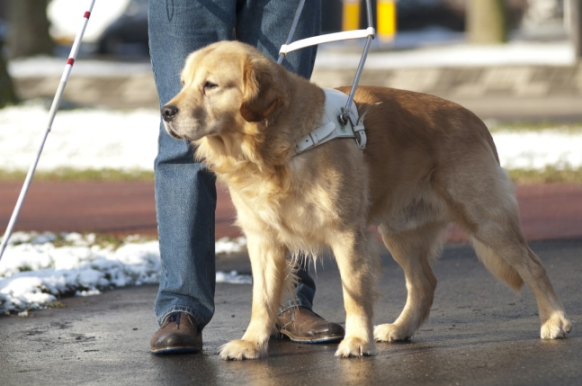
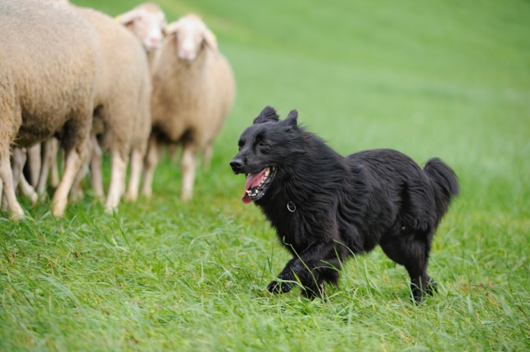
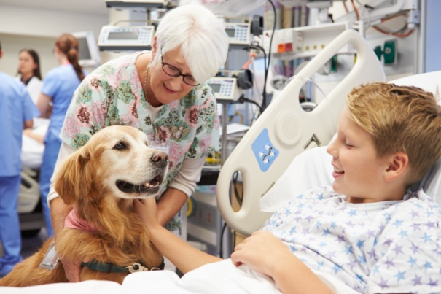
How do dogs help us?
Notes:
Dogs do so much to help us. Did you know that many dogs have jobs, just like we do? Can you guess what jobs these dogs might do?
Dogs can do lots of things that we can’t – like get into small places when searching for missing people and use their amazing sense of smell to sniff out things we can’t.
Search and rescue dogs – detect human scent and find missing people
Pets as Therapy dogs (PAT dogs) – a therapy dog is trained to give affection and comfort to people in hospitals, retirement homes, nursing homes and to people with learning difficulties
Guide dogs – are assistance dogs trained to lead blind and visually impaired people
Sniffer dogs – are trained to use their senses (almost always their sense of smell) to find things such as explosives, drugs or bodies.
Herding dogs – are trained to herd other animals, such as sheep or cattle. They work from whistles or simple commands and can make a farmer’s life much easier!

Slide 6
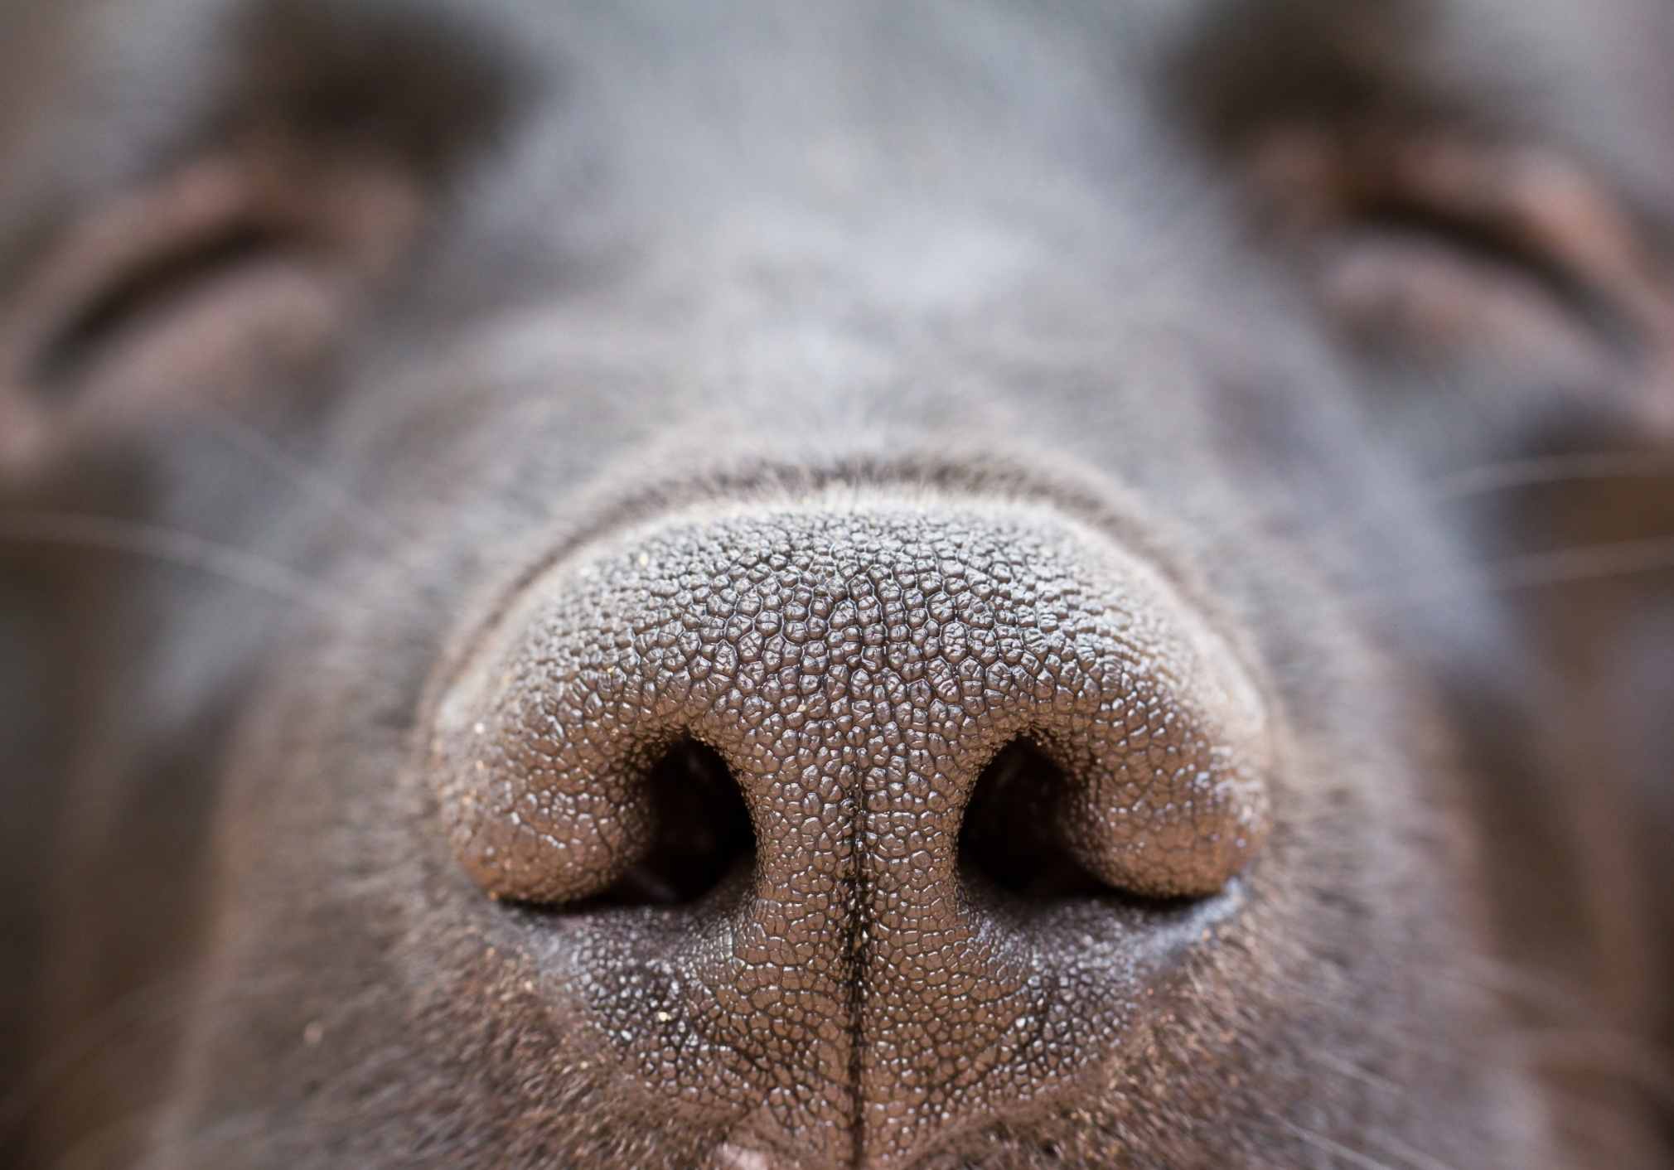
Notes:
Ask children to sniff the person next to them and tell you:
What they had for breakfast
What mood they’re in
Where they’ve been today
Explain that dogs can tell all these things about you just by smelling – they can even tell if we’re poorly!
Explain that dogs have senses that are very different to ours. People and dogs have the same three senses – sight, hearing and smelling. People normally communicate by hearing, seeing, then smelling. How do you think dogs communicate? They normally communicate through smelling, seeing and lastly hearing. Let’s take a look at their senses and show just how special dogs really are...
Dogs use their nose and their sense of smell to work out what’s going on in the world – and it really is amazing! Did you know that the part of the brain that controls smell is 40 times larger in dogs than in humans! A dog’s sense of smell is up to 10 million times more sensitive than a human’s. Ever wondered why your dog’s nose is wet? The mucus on a dog’s nose actually helps it’s sense of smell by capturing scent particles!
Did you know - dogs can smell week-old human fingerprints and detect scents up to 40 feet underground, just two examples of their incredible smelling abilities.
When a dog smells something they don’t just get a smell, they get a story. They can even smell pheromones – something people can’t smell – and from pheromones they can tell lots about another dog or a person, like if they’re male or female, what they ate, where they’ve been, what they’ve touched and what kind of mood they’re in! Dogs have even been know to smell cancer on people, alerting them and saving their lives. So if you see a dog sniffing a person, or a tree in the park, they’re not just sniffing something really interesting – they’re reading a story. Dogs can even move their nostrils one at a time – can you do this? This means that they can tell which direction a smell is coming from!

Slide 7
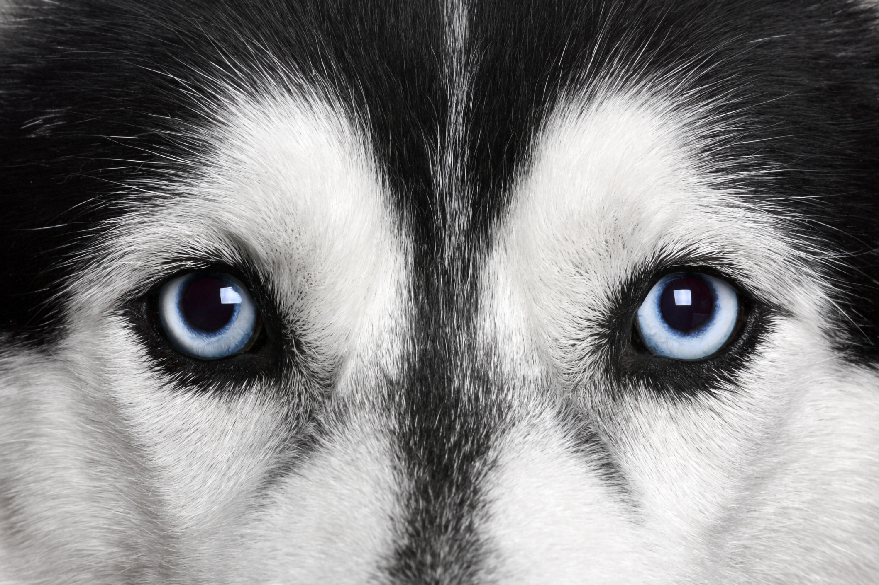
Notes:
Dogs can see better than us when it’s getting dark – their low-light vision is much better than a humans. They find it easier to recognise something if it’s moving rather than still. They can perceive direction, speed and may even be able to recognize an animal or human by their pattern of movement.
Dogs aren’t colour blind, as many people think they are, but they can only see in shades of blue and yellow.

Slide 8
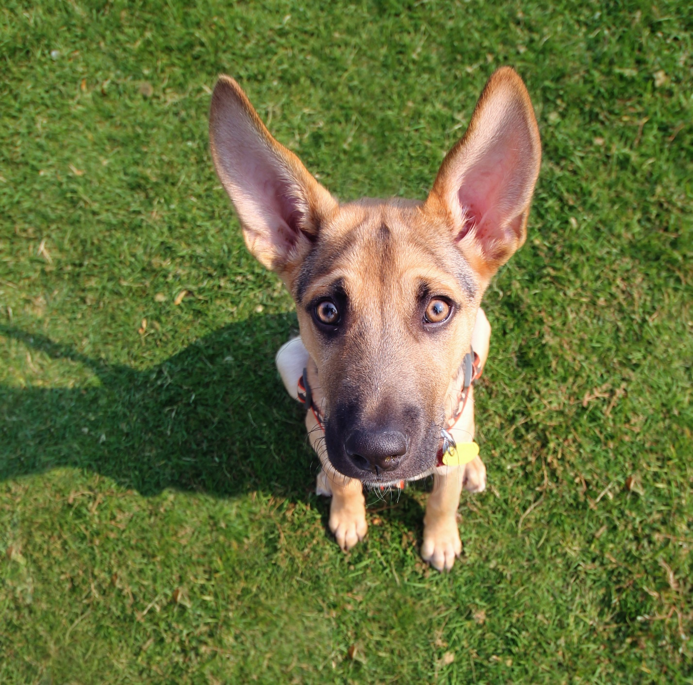
Notes:
Dogs can hear sounds from 4 times further away than people. Have you ever noticed how your dog pricks up it’s ears a long time before you hear anything if someone comes to the door? They can also hear higher pitched sounds that we can’t hear. Dogs often bark at things like vacuum cleaners because they hear a very loud, annoying pitch coming from the motor that we can’t hear. So there’s no need to shout at your dog, they can hear you really well, even if you whisper.
Dogs have a lot of muscles in their ears, meaning they can move them around – you may see a dog swivel it’s ears towards a sound. We have fewer muscles in our ears and can hardly move them at all. Check with the class if anyone is able to move their ears.
Aren’t dogs amazing?!

Slide 9
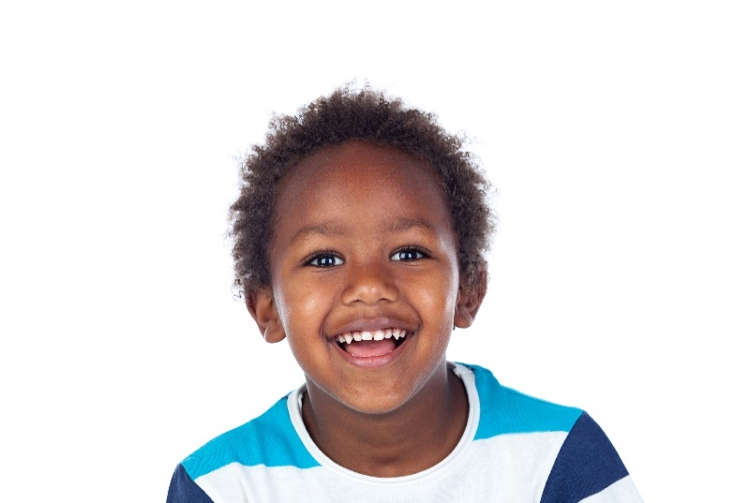
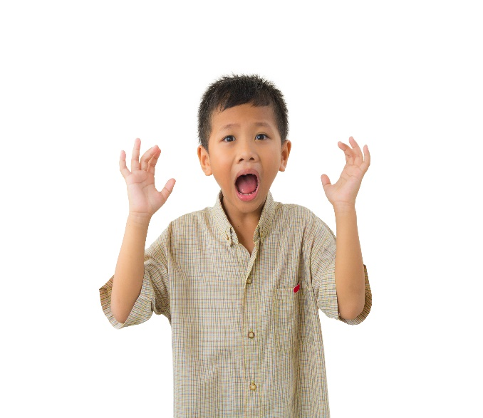
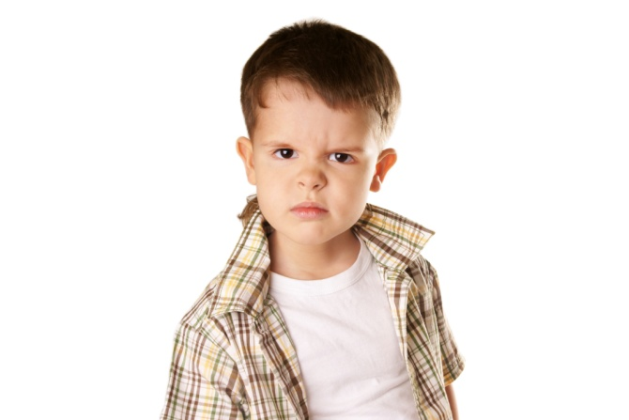
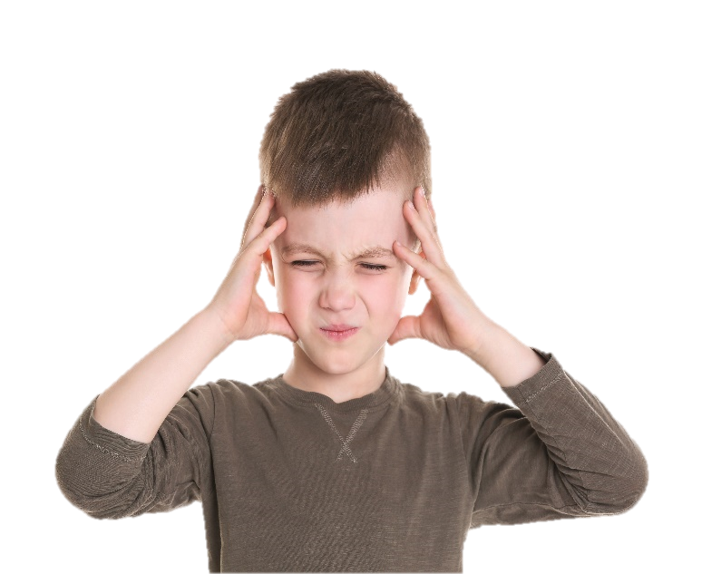
How do these children feel?
Notes:
What do you think these people are feeling? (go through each image and use questioning to discuss with group)
Without talking to each other, how can people understand what someone is trying to say? We normally do it through body language – this means you can tell what a person is feeling or trying to tell you just by looking at them.

Slide 10
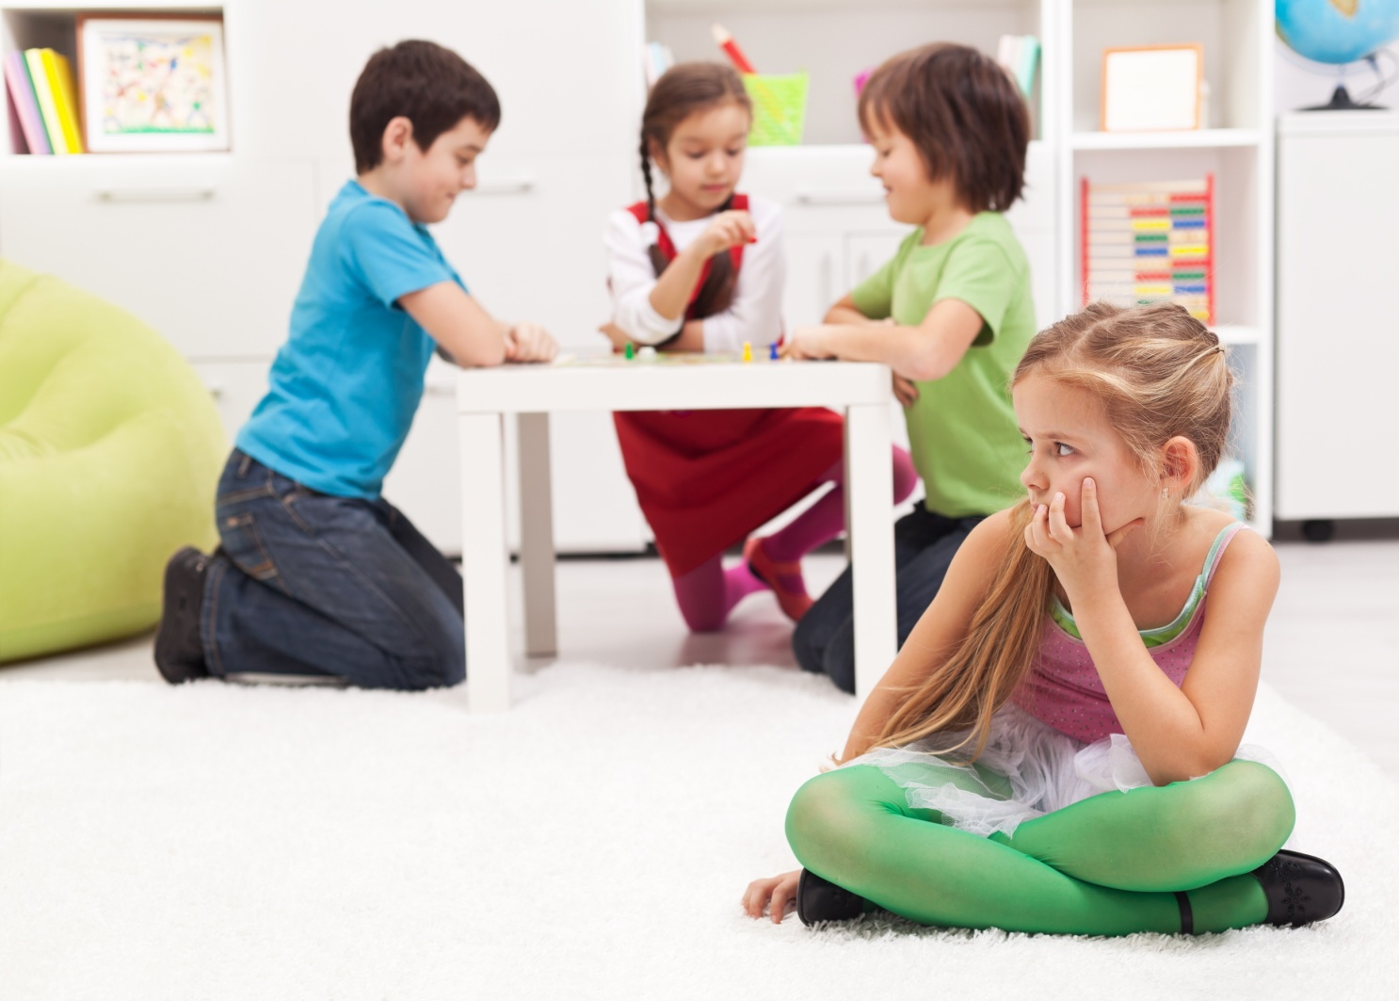
How would you feel if people didn’t listen to you?
Notes:
Now think about how you would feel if you were trying to tell someone something and they weren’t listening. Can anyone tell me how they’d feel? (Angry, frustrated etc.)
If you were shouting and shouting and shouting – and people weren’t listening, how would you feel?
IT’S THE SAME FOR DOGS

Slide 11
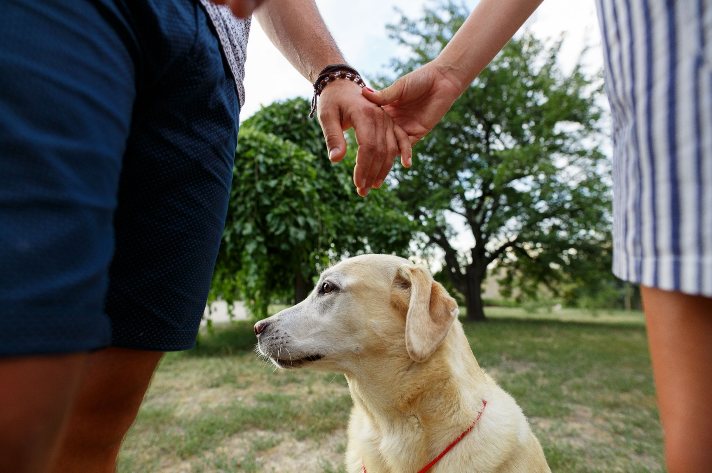
It’s the same for dogs…

Slide 12
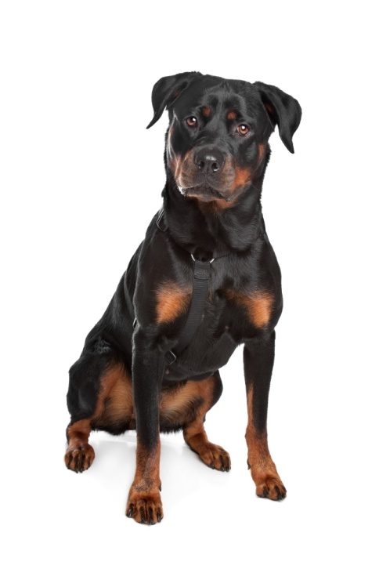
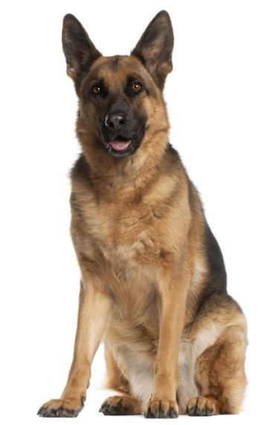
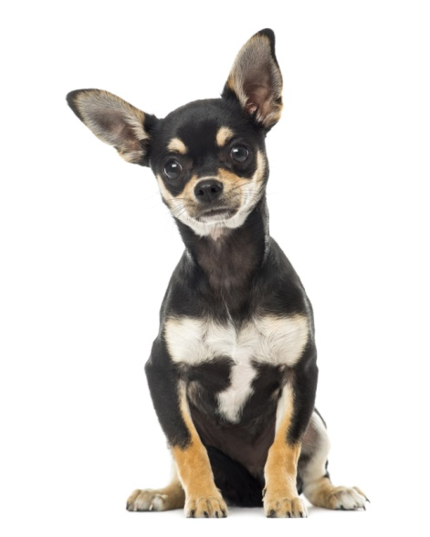
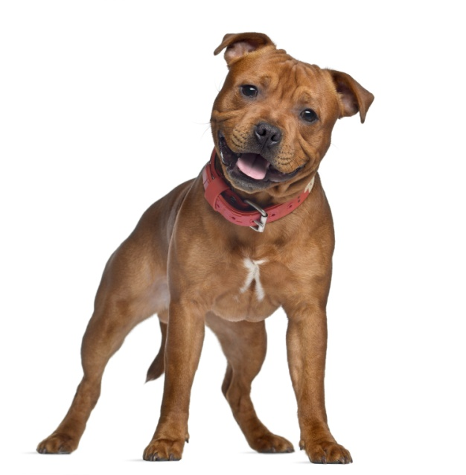
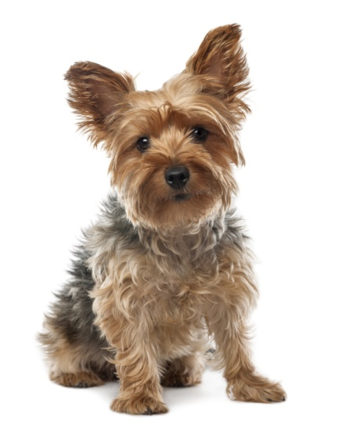
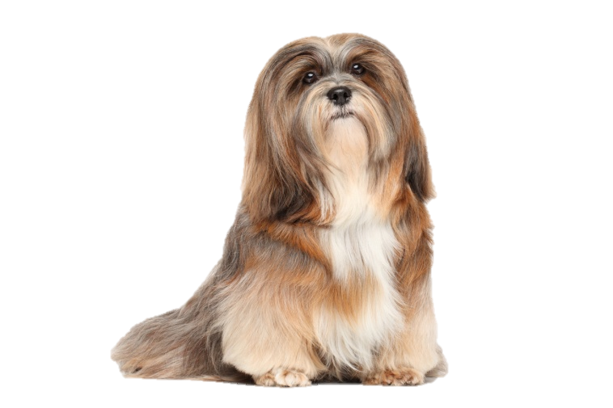
Notes:
Which breeds are most dangerous?
Answer: Any breeds can be dangerous - but all will give warning signs before biting
Breed pictures
Top l-r: German shepherd, Chihuahua, Rottweiler
Bottom l-r: Yorkshire terrier, Staffordshire bull terrier, Lhaso Apso
Also discuss how, because of breeding, it’s sometimes difficult for dogs to show us how they’re feeling – use examples of dogs with docked tails and squashed faces.

Slide 13
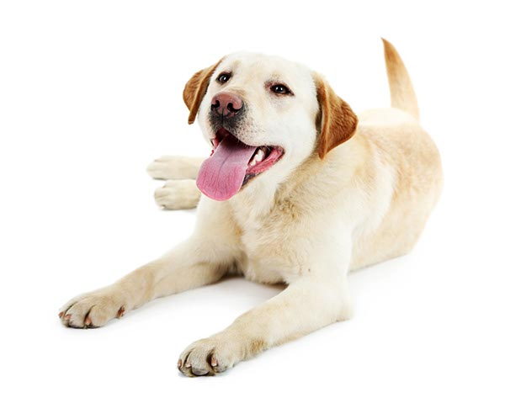
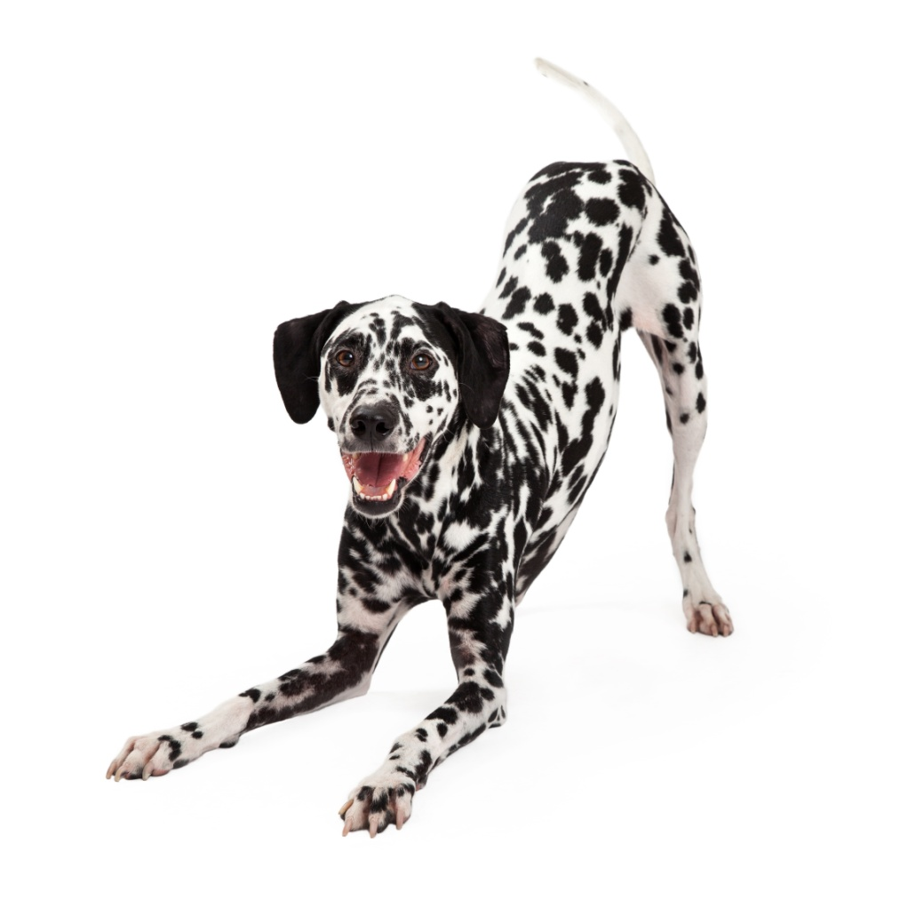
‘I’m happy and relaxed’
Notes:
Ask the group to show how they look when they’re happy. You could ask them to show you.
What do you think these dogs are trying to tell us?
(Invite pupils to put their hands up and answer. Ask them why they think these things)
These dogs are trying to tell us that they’re happy and relaxed. How do we know this? They’re showing us some very simple signs:
The whole body looks relaxed and when they move it’s very free and wiggly – remember – a wiggly dog is a happy dog!
Their mouth is open and relaxed
Their tail is held at a normal level – not too high or tucked between their legs (but remember that some dog breeds always hold their tail in a certain way – Husky’s hold theirs high, greyhounds and whippets often hold theirs tucked low)
Sometimes they might play bow – that really means they’re happy and they’re inviting you to play with them
Rolling on their back and exposing their tummy is often a sign that a dog’s happy and relaxed – and feels safe with you

Slide 14
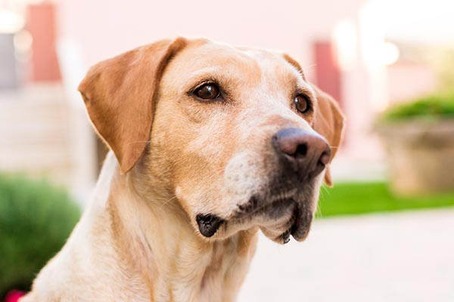
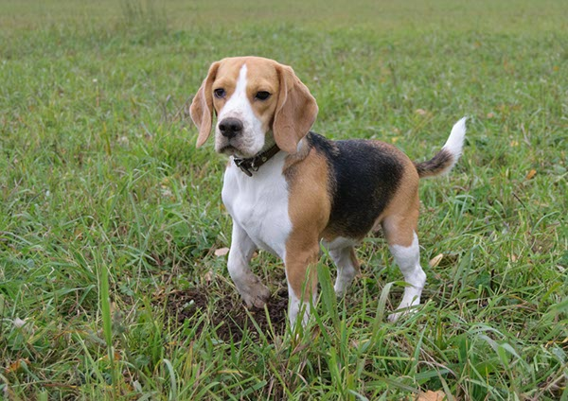
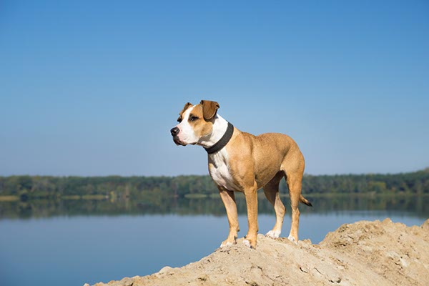
‘I’m alert and interested’
Notes:
Ask the group to tell you how they look when they’re concentrating. Ask them to show you.
What do you think these dogs are trying to tell us?
(Invite pupils to put their hands up and answer. Ask them why they think these things)
These dogs are trying to tell us that they’re alert and interested. How do we know this? They’re showing us some very simple signs:
They have a very focused stare – but a relaxed face
Their ears are forward
Their mouths could be open or closed

Slide 15
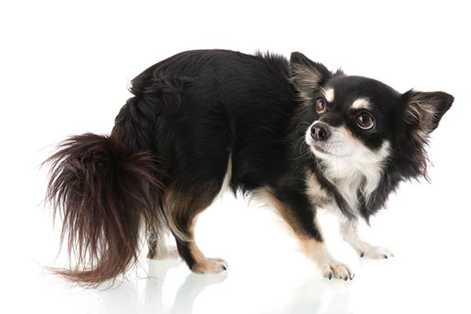
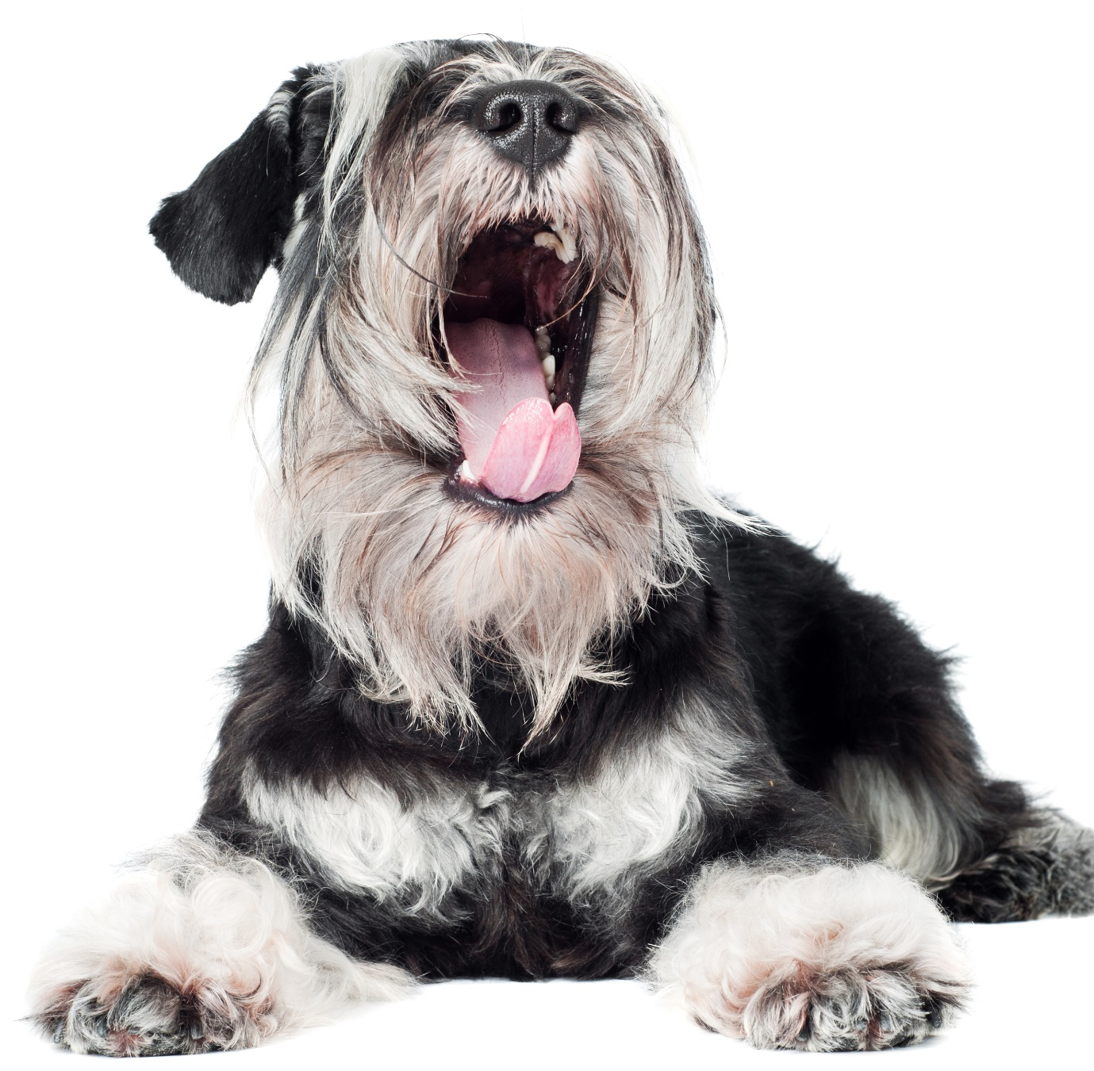
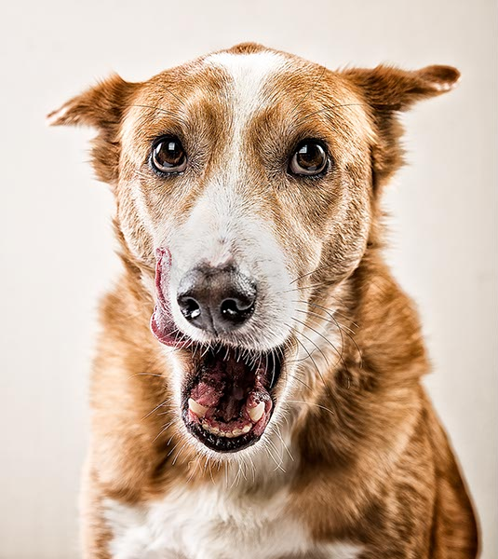
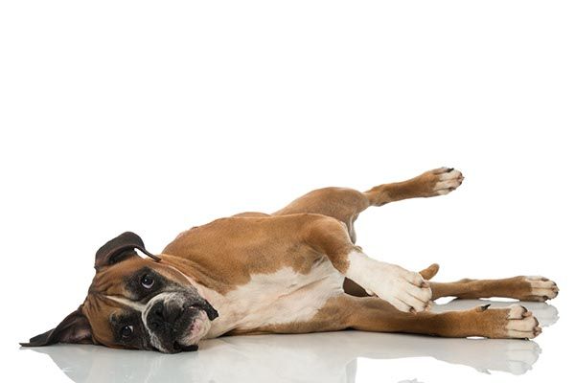
‘I’m stressed and worried’
Notes:
Ask the group to show how they would look when they’re uncomfortable or anxious. Ask them to show you.
What do you think these dogs are trying to tell us?
(Invite pupils to put their hands up and answer. Ask them why they think these things)
These dogs are trying to tell us that they’re uncomfortable and anxious. How do we know this? They’re showing us some very simple signs:
Stiff body – remember – stiff dogs are worried or anxious, wiggly dogs are happy!
Ears back or flat against head
Sideways rolling of their eyes so that you can see the whites (“whale eyes” or “half moon eyes”)
Yawning when they’re not tired
Licking their lips when they’re not hungry

Slide 16
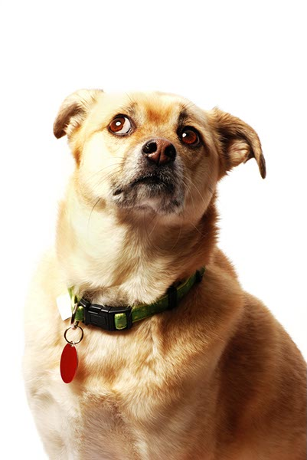
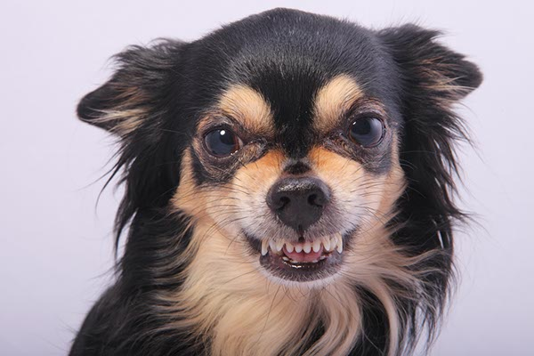
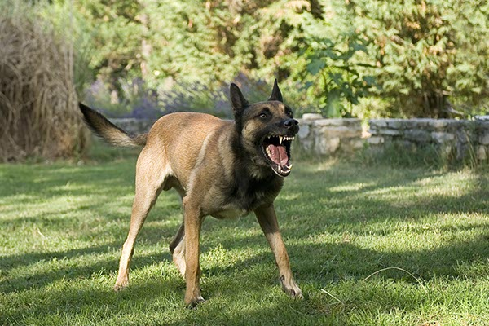
‘I’m about to react and possibly bite’
Notes:
Ask the group to show you how they would look if they were really angry.
What do you think these dogs are trying to tell us?
(Invite pupils to put their hands up and answer. Ask them why they think these things)
These dogs are trying to tell us that they’re about to react and possibly bite. This is a last resort for a dog, when no one listens to what they’re trying to say. How do I know this? They’re showing us some very simple signs:
They are very stiff and still
Their mouths can be tightly closed and they have a very hard, focused stare
They may show their teeth
They may growl or air bite as a final warning

Slide 17
Keeping Safe
Notes:
Talk through each scenario and the right and wrong ways to interact with dogs
Credit: Dr Sophia Yin, DVM, MS

Slide 18
Keeping Safe
Notes:
Talk through each scenario and the right and wrong
Credit: Dr Sophia Yin, DVM, MS
ways to interact with dogs

Slide 19
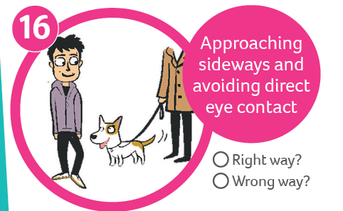
Keeping Safe
Notes:
Talk through each scenario and the right and wrong ways to interact with dogs
Credit: Dr Sophia Yin, DVM, MS

Slide 20
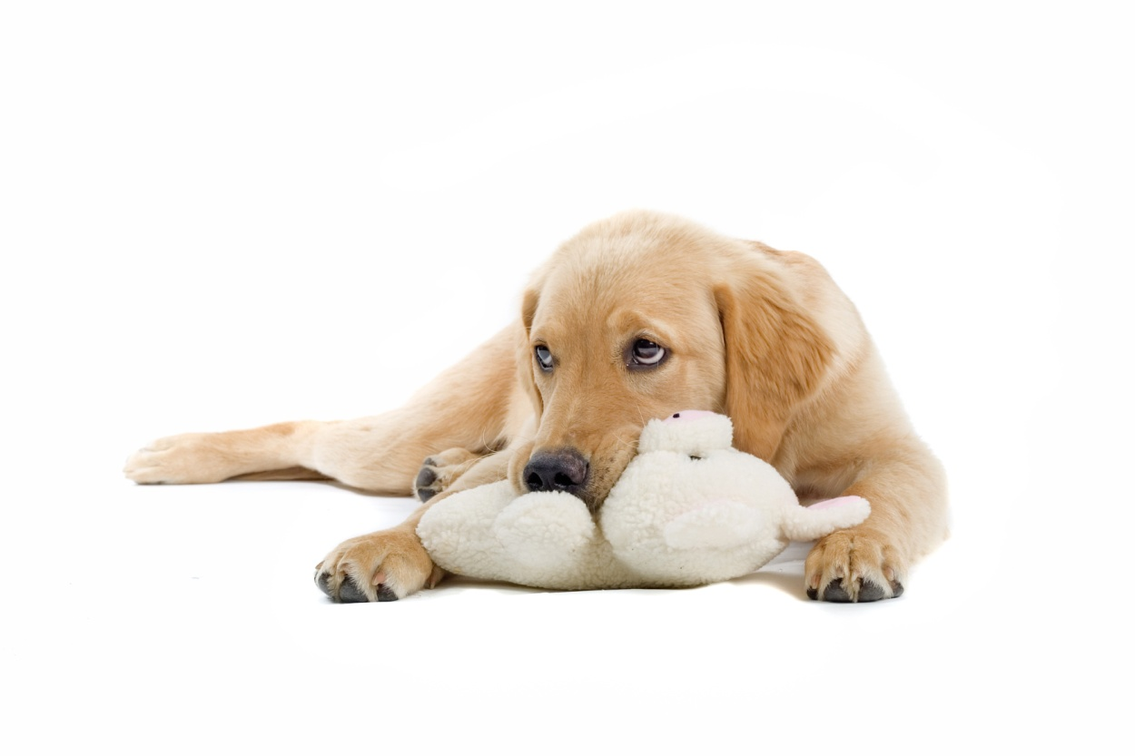
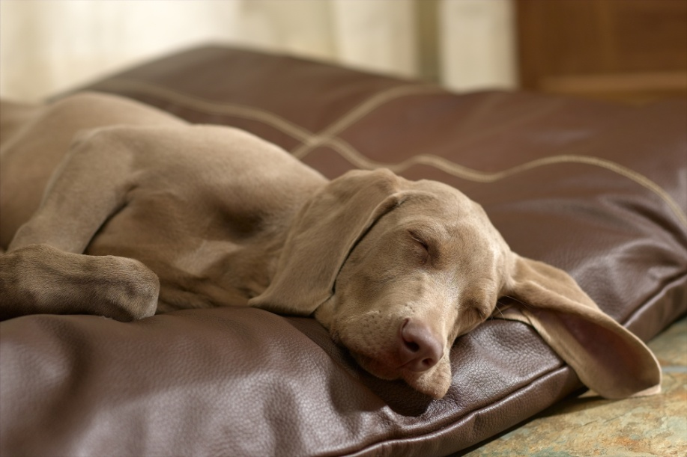
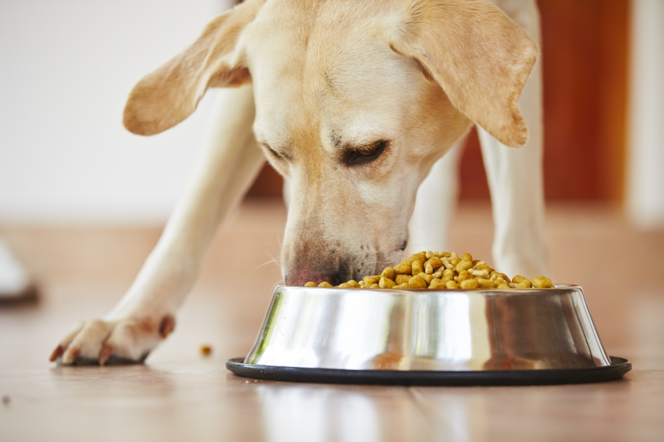
Notes:
Ask the group to tell you how they would feel if you:
Woke them up while they were sleeping
Took their food away from them
Took away their favourite toy
Made them jump or frightened them
Remember it’s the same for dogs, so don’t approach them if:
They’re on their bed – both asleep and not asleep
They’re eating food – dinner and treats
They’re holding toys in their mouth / playing with toys
They’re not well or are injured

Slide 21
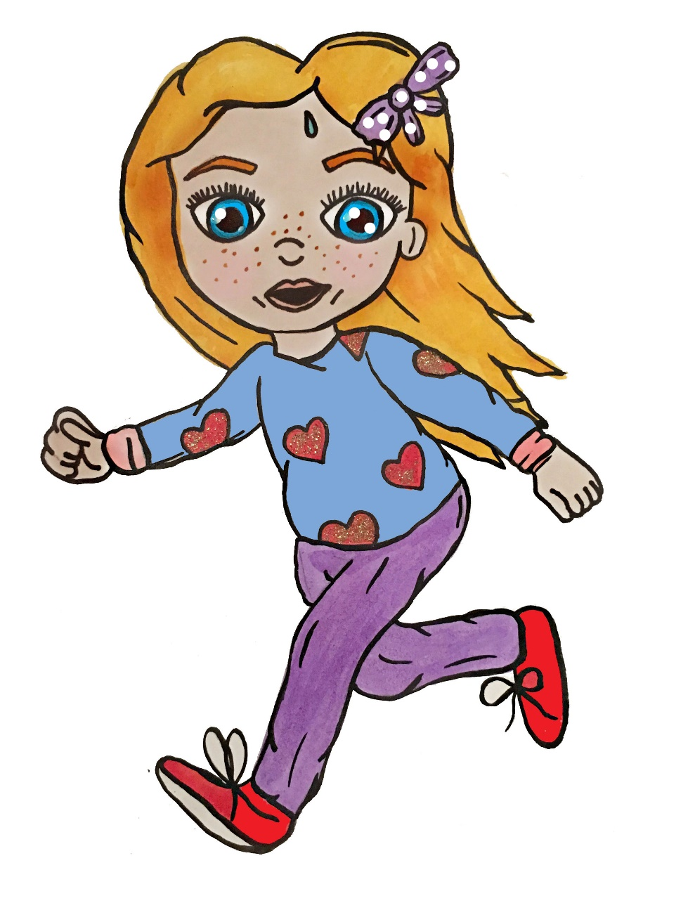
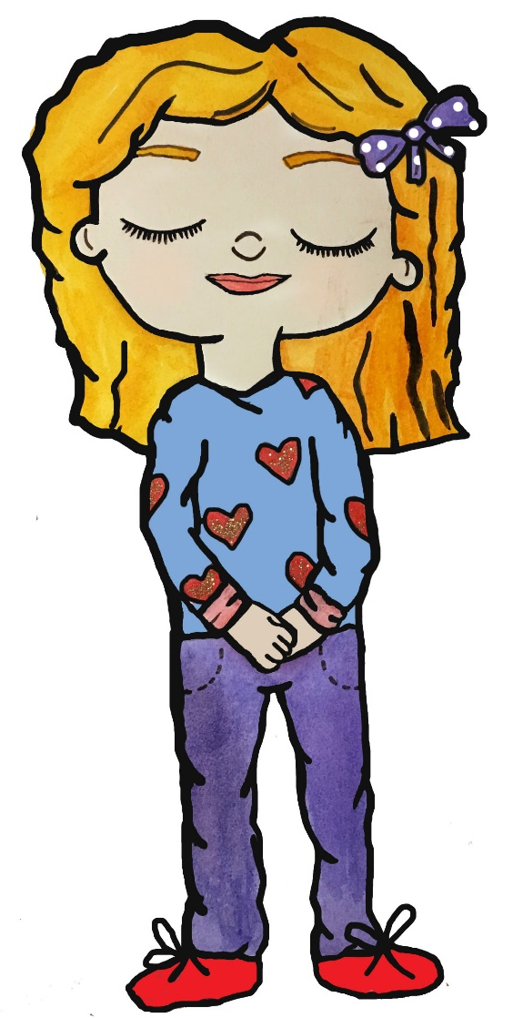
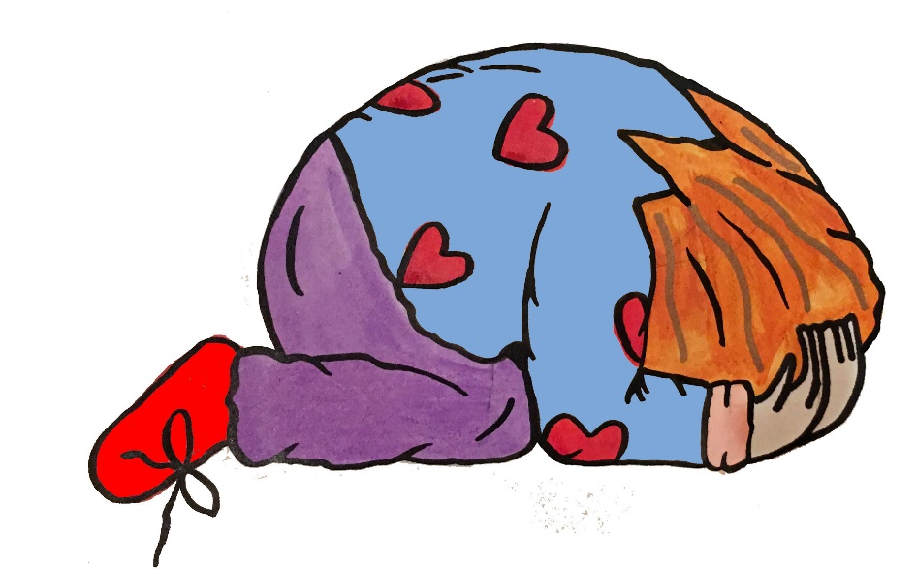
BE A TREE
BE A STONE
DON’T RUN!
Notes:
Ask for a volunteer to help demonstrate the movement – then ask all of the group to have a go (in situ, just create a slight gap when standing up)
Demonstrate how to act around a dog in a park if it comes rushing up to you (be a tree) and if they jump up you (be a stone). Depending on the group, you could get everyone to at least have a go at being a tree.

Slide 22
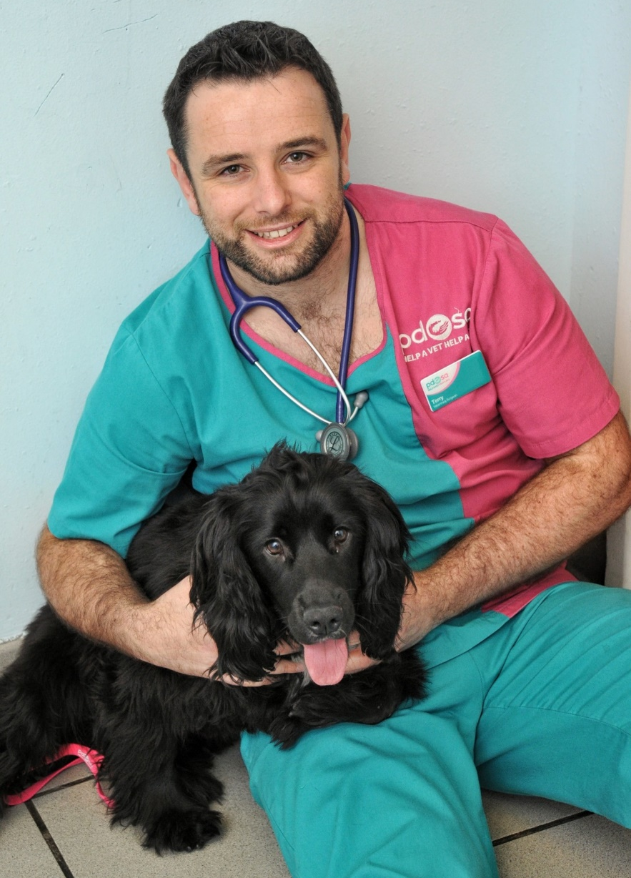
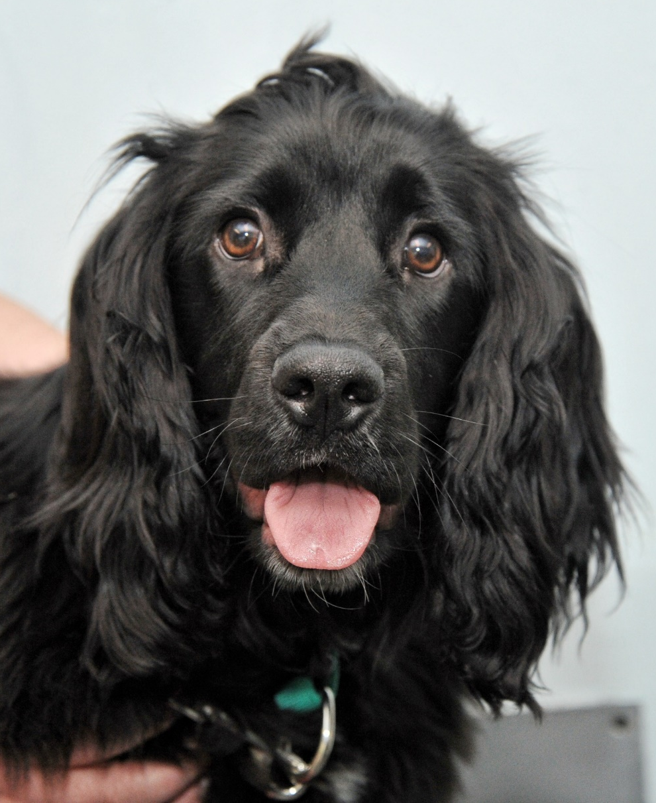
Jake
Notes:
Jake, the Cocker Spaniel puppy, was playing with his favourite soft toy when he ripped it apart and pulled the squeaker out. His owner did her best to get him to drop it but within seconds he’d swallowed it whole!
Action taken:
As soon as he arrived at the Pet Hospital, Jake was given an x-ray, to find out where the squeaker was in his stomach. He was then taken straight to the operating theatre to have surgery to remove it.
Vet’s/nurse’s comment:
‘As he was only a puppy, Jake was more at risk of complications from swallowing the squeaker than a larger dog, which is why we needed to operate on him straight away. If we hadn’t, the squeaker could have passed through into his intestines and may have caused a tear or blockage, which could have been life-threatening
Luckily, we managed to remove the squeaker, before it had time to cause any damage.’
Owner’s comment:
‘I was completely devastated to find out that my bouncy little pup needed life-saving surgery. Jake is so loving and I was beside myself with worry. PDSA have been absolutely brilliant - we were so pleased they were able to help Jake so quickly – it stopped the accident from becoming a serious disaster.”
I want Jake’s story to help raise awareness of the life-saving work PDSA does, saving thousands of sick and injured pets across the UK every day.’

Slide 23
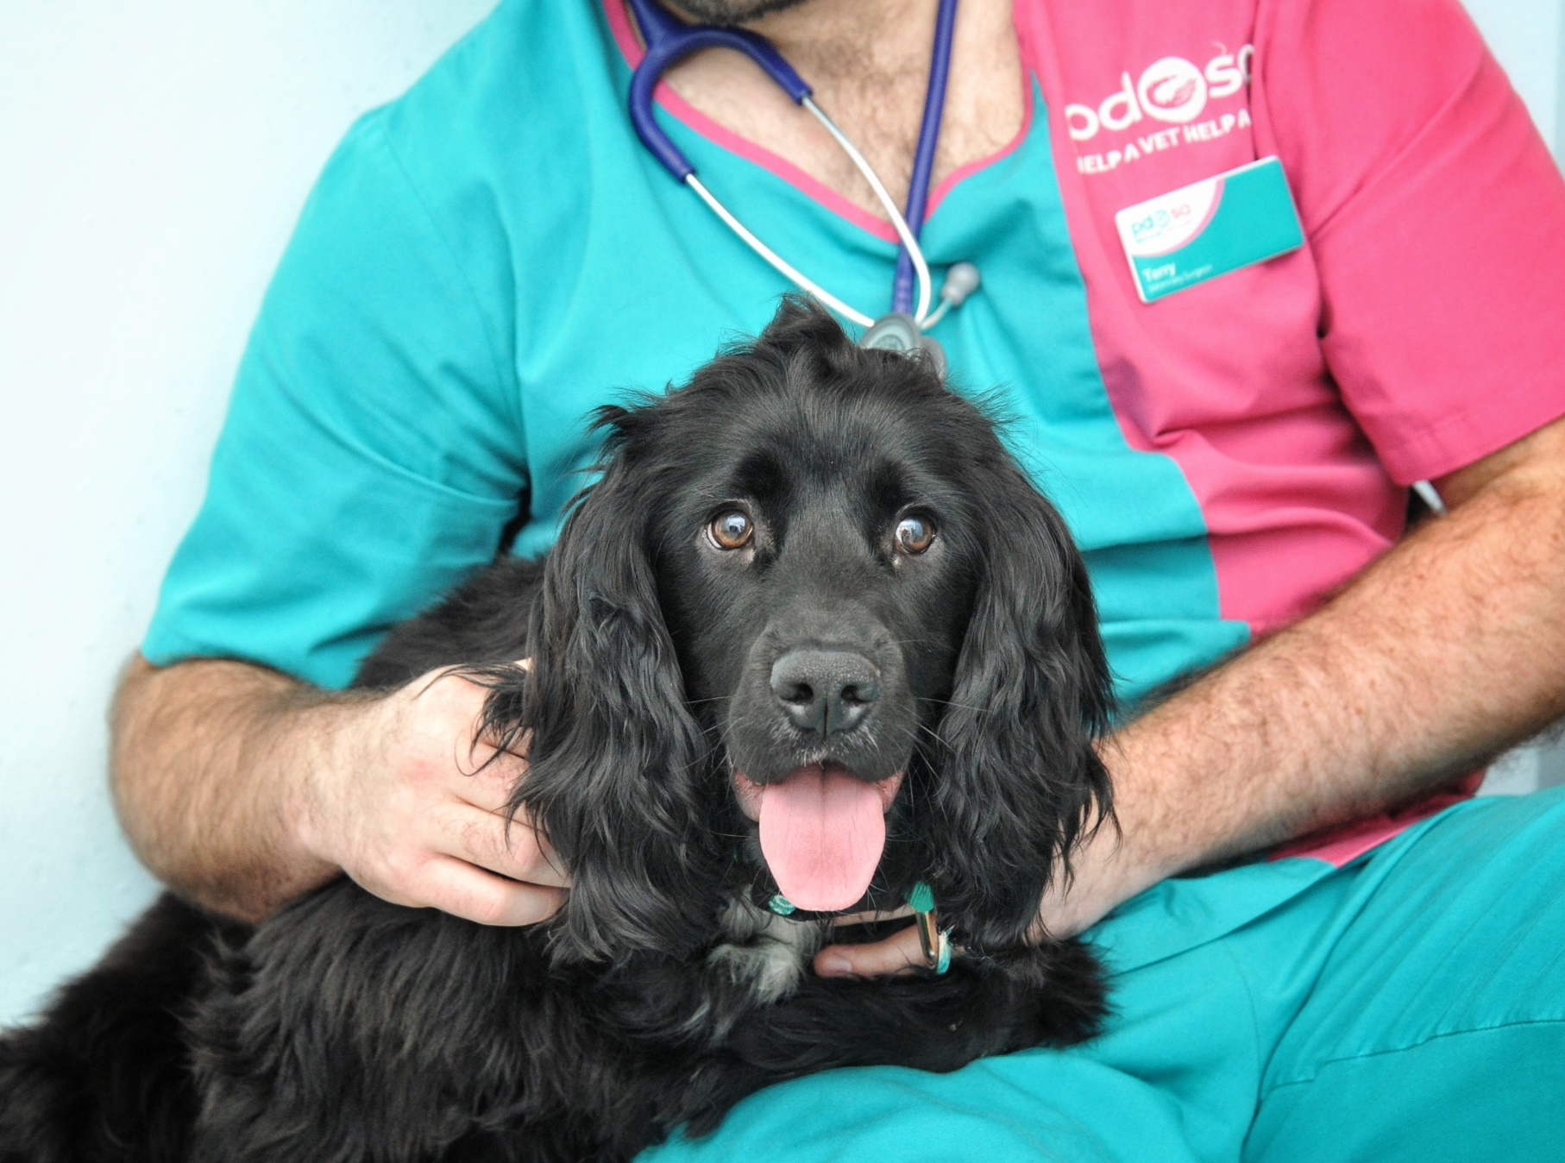
SAVED thanks to PDSA

Slide 24
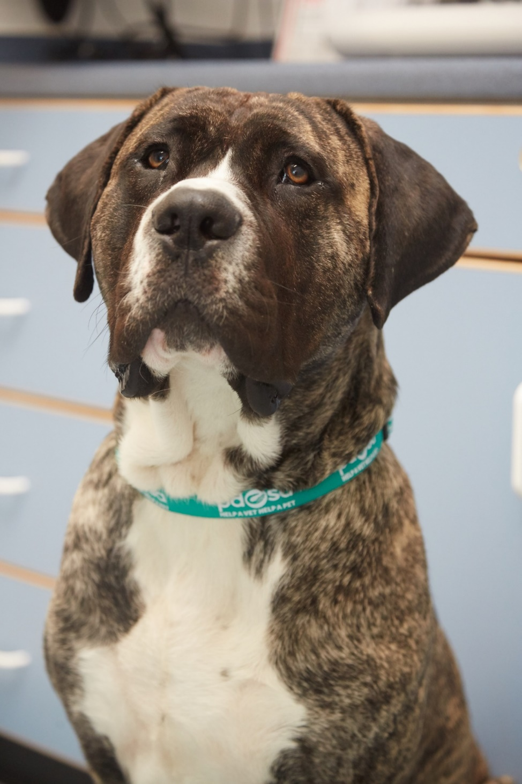
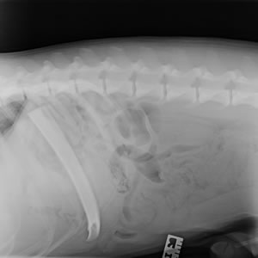
Chico
SAVED thanks to PDSA
Notes:
Not realising how dangerous it can be to give a dog a bone, Chico’s owner, bought him a large rib bone from the butcher as a treat.
His owner thought that if he supervised him, it would be fine, but the Bull Mastiff Cross, managed to swallow the whole rib in one mouthful!
Although, Chico seemed fine, his owner realised that he wouldn’t be able to digest the bone, so took him straight to our Glasgow Pet Hospital.
Action taken:
Chico’s owner gave our vets a clear history of what had happened and what he’d swallowed. Our vets took an x-ray, to find out exactly where the bone was in Chico’s stomach and then moved him to the operating theatre, where he had an anaesthetic and surgery to remove the six-inch rib bone.
Vet’s/nurse’s comment:
‘I was surprised that, although Chico is quite a big dog, he’d managed to swallow a six-inch bone with one gulp. When I looked at his x-ray, I was amazed, as the position of the bone made it look like Chico had an extra rib!’
Owner’s comment:
‘I was so worried while Chico was in the operating theatre and know, from speaking to the vets and nurses, that it’s a miracle the bone didn’t cause him any damage. I’m so grateful to PDSA for the amazing care they gave to Chico, it’s something I’ll never forget.
I don’t give bones to him anymore and by telling Chico’s story, I hope other owners will think twice too about ever giving their dog a bone.’

Slide 25
Do you want to help PDSA save pets like Jake & Chico?
Sign up to
Hold your own
PetWise School Award
Non-uniform day
pdsa.org.uk/petwise-award
Notes:
Explain that these are just some of the ways they can help raise money for PDSA.
You can find our fundraising resources on pdsa.org.uk/PetWise

Slide 26
Thanks!
On behalf of the sick and injured pets at PDSA

